Slide 1
Flaticons by pikepicture
Notes:
Customisation:
Add school name.
Replace picture with school logo.
Talking points:
“Kia ora koutou! (hello everyone)”

Slide 2
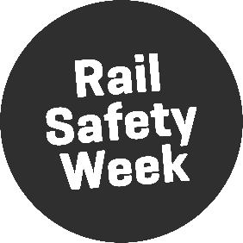
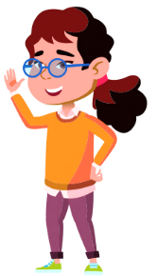
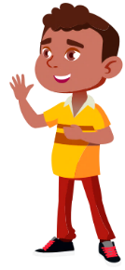
Flaticons by pikepicture
Notes:
Customisation:
Add names of visiting staff.
Talking points:
“Our names are … and we work for KiwiRail.”
“We’re here because it is Rail Safety Week and we want to talk to you about staying safe around trains and train tracks.”

Slide 3
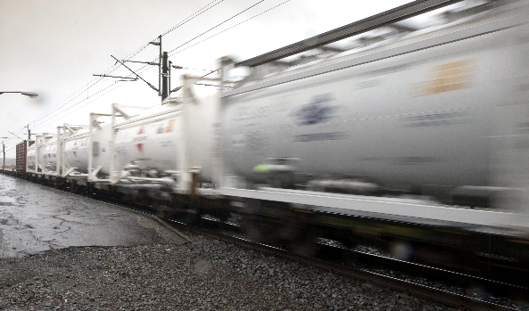
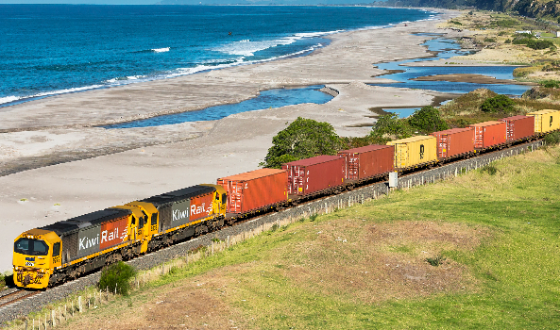
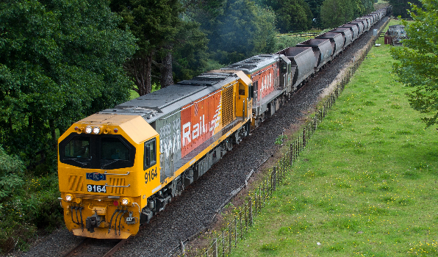
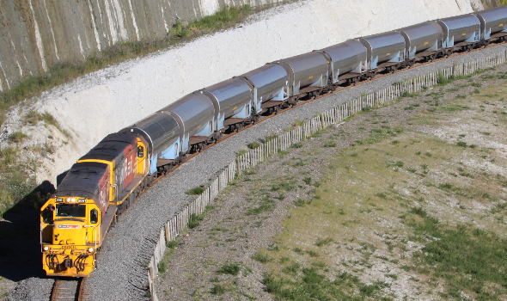
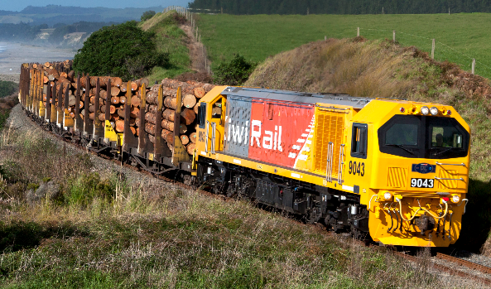
GAS
FREIGHT
COAL
MILK
LOGS
Notes:
Customisation:
Replace left picture with screenshot of local RLX from google street view.
Replace right picture with image of a train carrying local freight type. (Some photo options are off screen to the bottom of the slide).
Talking points:
“There is a railway line quite close to your school. It transports [freight type] from [location] to [location].” (e.g., It transports coal from the West Coast to Christchurch).”
“Put your hand up if you recognise the crossing on the left. It is a crossing close to your school that pedestrians, cyclists, cars, and trucks use to cross over the railway lines.”

Slide 4
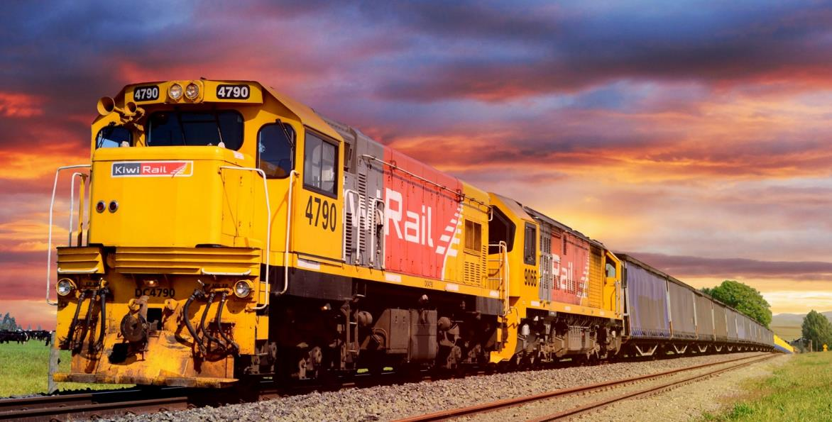
Notes:
Talking points:
“This is one of our locomotive engines. Can anyone tell me what noise they make?”
[Kids make noises]
“Train drivers sound the horn when they are approaching a level crossing. They also flash their headlights.”

Slide 5
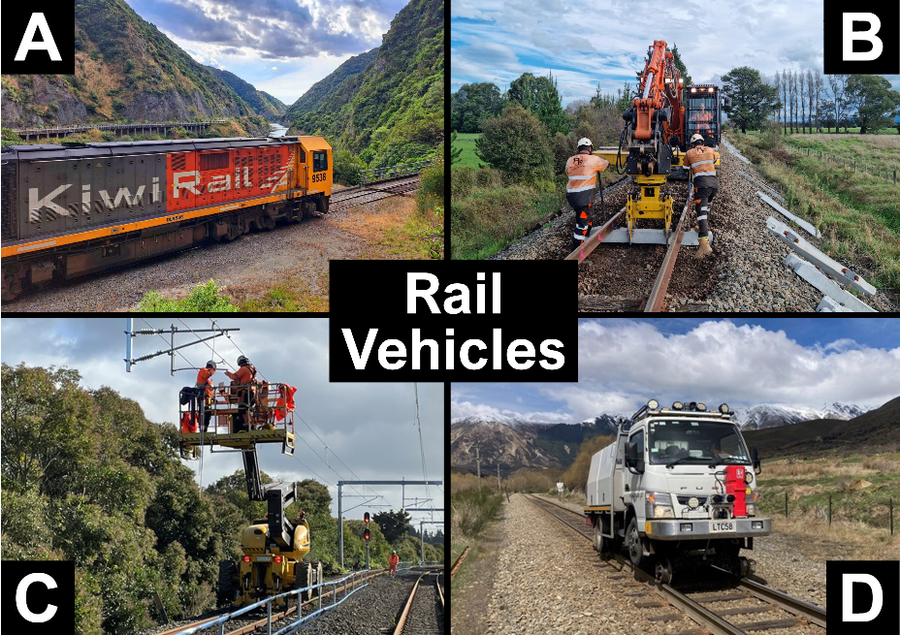
Notes:
Talking points:
“Have you seen any of these vehicles on the train tracks? If you have, put your hand up.”
“Some of you might not know that it is not just trains that run on the tracks. There are also diggers, cherry-pickers, trucks, and lots of other types of vehicles that run on the tracks. You must always give way to all rail vehicles, not just trains. You must be careful around all of these vehicles.”
Note:
Picture A shows a locomotive engine
Picture B shows a Hi-Rail excavator replacing sleepers.
Picture C shows a Hi-Rail cherry-picker working on the overhead wires.
Picture D shows a Hi-Rail truck.

Slide 6
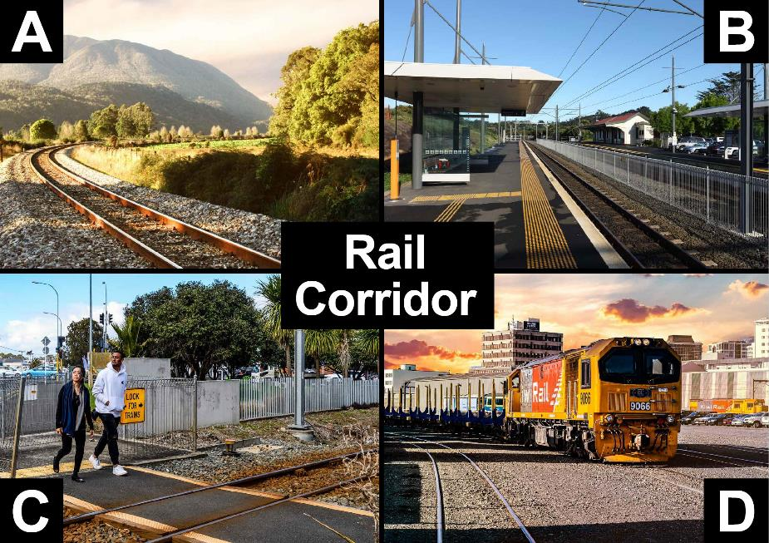
Notes:
Talking points:
“The rail corridor includes the tracks at train stations, level crossings, and our freight yards. You are only allowed to be near the rail corridor if you are at level crossings or at a train station. Anywhere else is out of bounds, it’s against the law to be there.”
Note:
Picture A shows the rail corridor. The corridor includes the area of land at least 5 metres on either side of the middle of the track.
Picture B shows the rail corridor with two sets of tracks separated by a fence.
Picture C shows a level crossing which is also part of the rail corridor. This is a legal place where pedestrians and traffic can cross the rail corridor provided the warning bells, lights and barrier arms are not operating.
Picture D shows a freight yard. The whole freight yard is part of the rail corridor and is out of bounds.

Slide 7
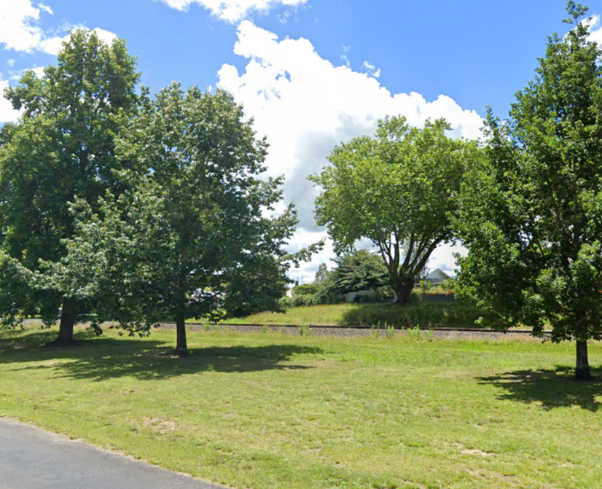
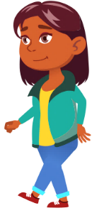
Flaticons by pikepicture
Never walk near the track.
You must be
at least
5 metres
(10 big steps) away from
the track
at all times.
Notes:
Talking points:
“Never walk near the tracks. You must be at least 5 metres, or ten big steps away from the tracks at all times. Who wants to help me show everyone how far away 5 metres is?”
[Choose student. Pace out ten big steps and have the rest of the students count along.]

Slide 8
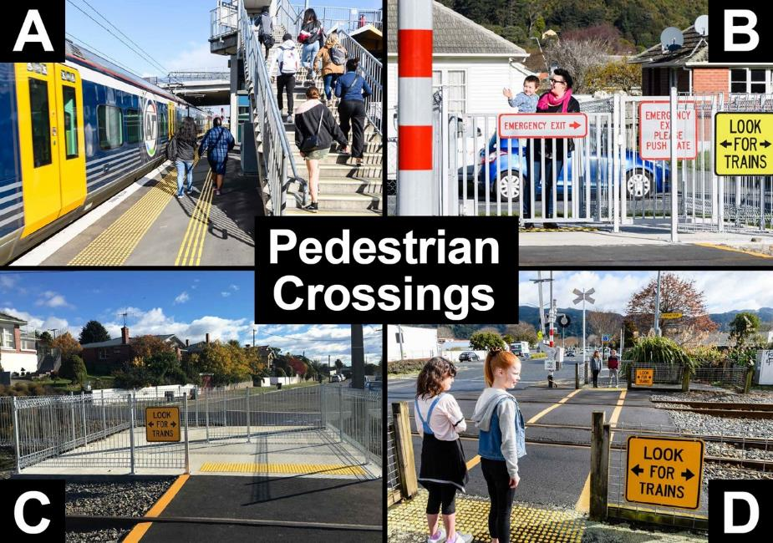
Notes:
Talking points:
“Here are some pedestrian-only level crossings. In picture A you can see a bridge that pedestrians can use to cross on top the tracks. The other pictures show crossings where you walk directly across the tracks. Some of them have automatic gates that shut when a train is coming. Others do not have gates, so you must always check for trains before crossing. It is unsafe and it is against the law to cross anywhere other than a level crossing.”
Note:
Picture A shows a pedestrian bridge. People use these to cross safely above railway tracks.
Picture B shows a pedestrian crossing with automatic gates. Flashing lights and bells activate, and gates close when a train is approaching. An emergency gate can be used if the gates start closing while someone has already started crossing.
Picture C shows a pedestrian crossing with a maze. A zigzag path with railings and warning signs before and after the railway tracks. The zigzag helps a pedestrian to look left and right before crossing.
Picture D shows a pedestrian crossing with flashing lights and bells and barrier arms on the road. The pedestrians wait behind the yellow line. Before crossing they need to wait for the alarms to stop and check that no trains are coming.

Slide 9
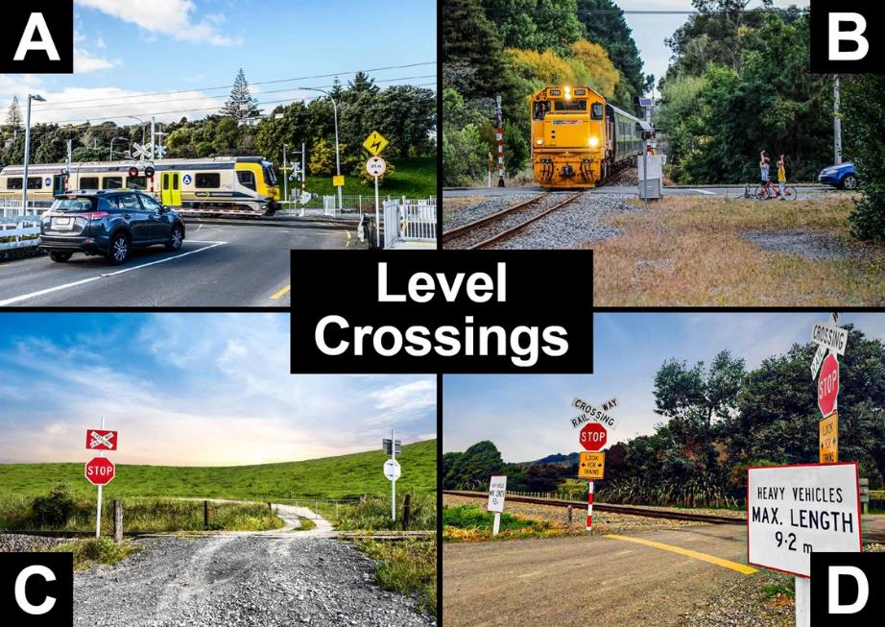
Notes:
Talking points:
“Here you can see different examples of level crossings. These are the only places where you are allowed to cross the train tracks. Some level crossings have lights and bells that tell you when a train is coming. Others do not have lights and bells, they only have STOP or Give Way signs. If you’re driving in the car with your parents/whanau they need to stop and look both ways. They must only drive across when there are no trains in sight.”
Note:
Picture A shows an urban level crossing with barrier arms, lights, and bells.
Picture B shows a rural level crossing with lights and bells only.
Picture C shows a crossing on private land which is required by law to have signage appropriate to the heaviness of the traffic flow.
Picture D shows a level crossing with a crossbuck, a Stop sign, and a ‘Look for trains’ sign. Another sign restricts heavy vehicles over a certain length.

Slide 10


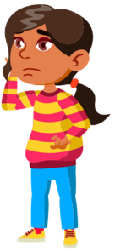
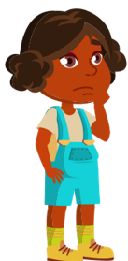
Flaticons by pikepicture
When crossing at a railway level crossing, always…
STOP behind
the line
LOOK
both ways for trains
LISTEN
for trains coming
THINK,
is it safe
to cross?
Notes:
Talking points:
“When crossing the train tracks at a railway level crossing, you must always STOP behind the line, LOOK both ways for trains, LISTEN for trains coming, and THINK, is it safe to cross?”

Slide 11
Flaticons by pikepicture
When crossing at a railway level crossing, always…
STOP behind
the line
LOOK
both ways for trains
LISTEN
for trains coming
THINK,
is it safe
to cross?
Only cross when there are no trains coming!
Notes:
IGNORE OVERLAP – SLIDE HAS ANIMATIONS
Talking points:
“You must only cross when there are no trains in sight!”
“Now we’re going to go over these steps again, for the next few slides I want you to call out what you have to do”

Slide 12
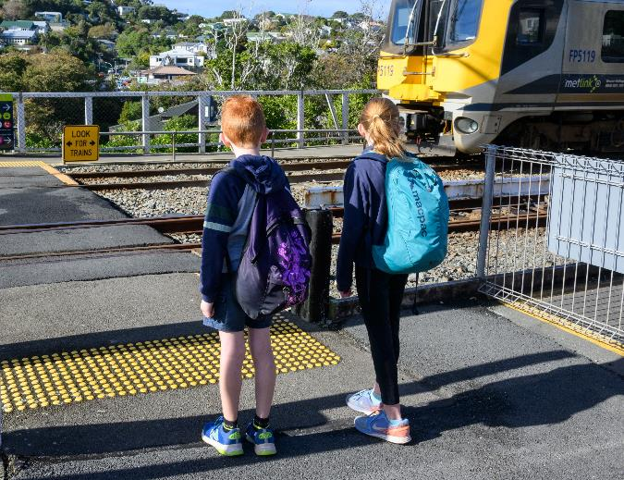

Flaticons by pikepicture
STOP
behind
the line
Notes:
Talking points:
“First, you must…”
[Kids call out “STOP”]
[Click to show text.]
“Stop behind the line.”

Slide 13
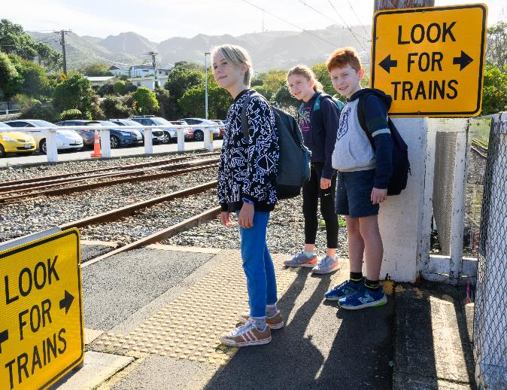

Flaticons by pikepicture
LOOK
both ways
for trains
Notes:
Talking points:
“Then you must…”
[Kids call out “LOOK”]
[Click to show text.]
“Look both ways for trains.”

Slide 14
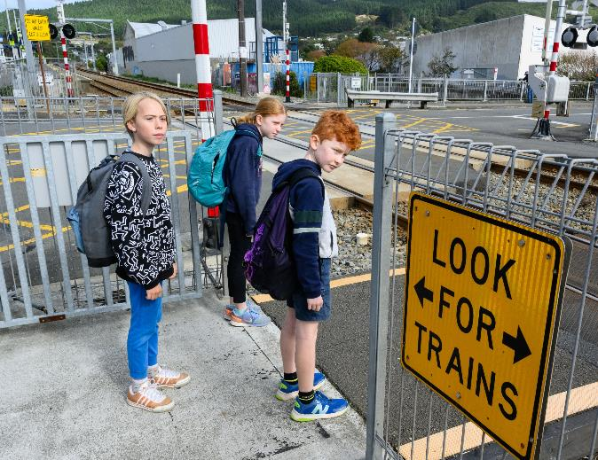

Flaticons by pikepicture
LISTEN
for trains coming
Notes:
Talking points:
“Then you must…”
[Kids call out “LISTEN”]
[Click to show text.]
“Listen for trains coming. Trains can be very quiet and can sneak up on you without you hearing them.”

Slide 15
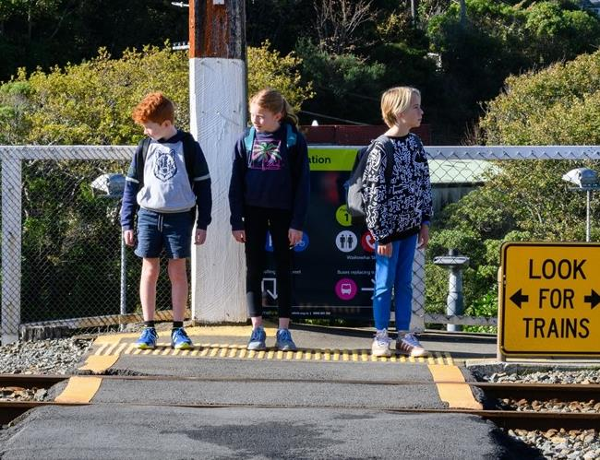
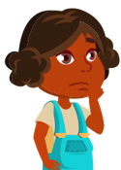
Flaticons by pikepicture
THINK,
is it safe to cross?
Notes:
Talking points:
“Then you must…”
[Kids call out “THINK”]
[Click to show text.]
“Think, is it safe to cross?”

Slide 16
Only cross…
Notes:
Talking points:
“Finally, you must ONLY cross…”

Slide 17
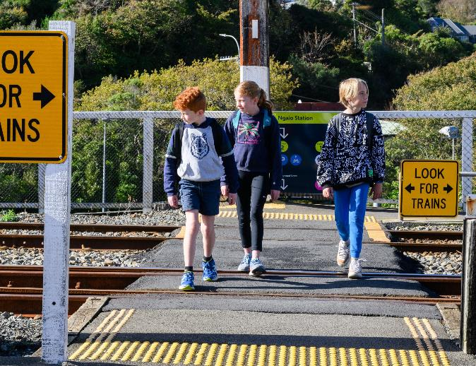
Only cross… when there are no trains coming!
Notes:
Talking points:
“…when there are no trains coming!”

Slide 18
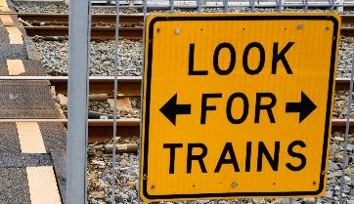
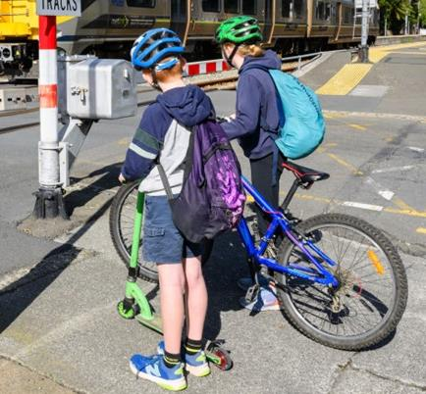
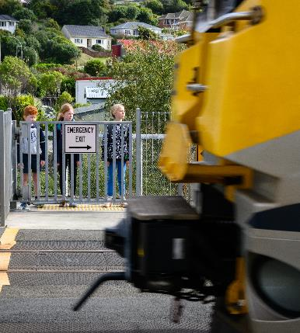
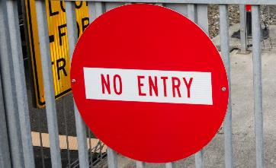
When crossing, you must always…
Obey
the signs
Walk your bicycle/scooter
Expect trains
at any time
Notes:
Talking points:
“When crossing you must always obey the signs, get off and walk with your bicycle or scooter, and expect trains from either direction at any time.”

Slide 19
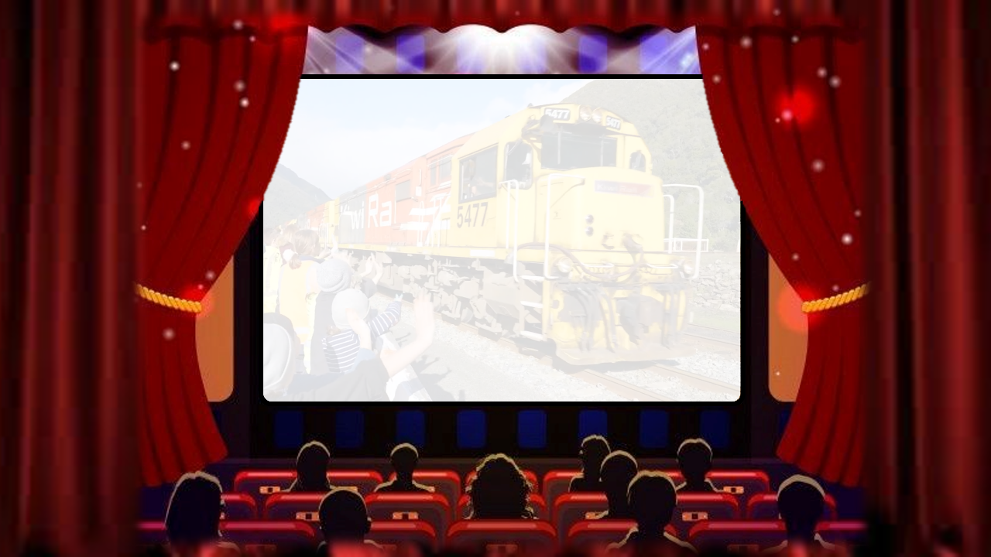



Notes:
Talking points:
“Now we’re going to watch a video of some school students asking train drivers questions.”

Slide 20

Link to video ‘What would you ask a train driver?’
https://www.youtube.com/watch?v=j3Aq5sZeP1M&list=PLmPgqniukFiOc5guO8AwxiHCw-81vZ2lN&index=3
Notes:
VIDEO WILL PLAY AUTOMATICALLY.
Link to video ‘What would you ask a train driver?’
https://www.youtube.com/watch?v=j3Aq5sZeP1M&list=PLmPgqniukFiOc5guO8AwxiHCw-81vZ2lN&index=3

Slide 21

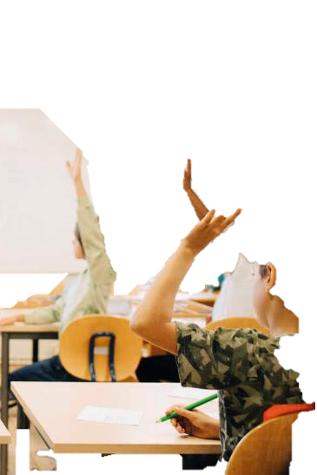

?
?
Notes:
Talking points:
“Now it’s time for a quick quiz to see what you’ve learned.”

Slide 22
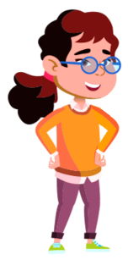

Flaticons by pikepicture
If you think the answer is…
A
Put your hands on your HIPS!
B
Put your hands
in the AIR!
Notes:
Talking points:
“If you think the answer is A, put your hands on your hips!”
“If you think the answer is B, put your hands in the air!”

Slide 23
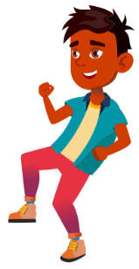
Flaticons by pikepicture
If you think the answer is…
A – Put your hands on your HIPS
B – Put your hands in the AIR
Question 1
It is safe to play on and walk along railway tracks:
A. True
B. False
Notes:
Talking points:
“Question 1, it is safe to play on and walk along railway tracks, true or false?
“If you think the answer is ‘true’, put your hands on your hips.”
“If you think the answer is ‘false’, put your hands in the air.”

Slide 24

The answer is…
Notes:
Talking points:
“The answer is…”

Slide 25
Flaticons by pikepicture
Question 1
It is safe to play on tracks
A. True
B. False ✓✓✓
Notes:
Talking points:
“FALSE! It is unsafe and against the law to walk or play on the train tracks.”

Slide 26
If you think the answer is…
A – Put your hands on your HIPS
B – Put your hands in the AIR
Question 2
What should you always do before crossing the railway tracks?
A. Stop. Look. Listen. Think.
B. Stop. Wait. Walk. Cross.
Notes:
Talking points:
“Question 2, what should you always do before crossing the railway tracks?”
“If you think the answer is ‘Stop. Look. Listen. Think.’, put your hands on your hips.”
“If you think the answer is ‘Stop. Wait. Walk. Cross.’ put your hands in the air.”

Slide 27
The answer is…
Notes:
Talking points:
“The answer is…”

Slide 28


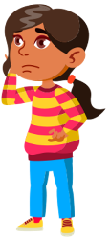

Flaticons by pikepicture
Question 2
What should you always do before crossing the railway tracks?
A. Stop. Look. Listen. Think. ✓✓✓
B. Stop. Wait. Walk. Cross.
Notes:
Talking points:
“Stop. Look. Listen. Think. You must always follow these rules before you cross the tracks.”

Slide 29
If you think the answer is…
A – Put your hands on your HIPS
B – Put your hands in the AIR
Question 3
Trains can come at any time,
and they cannot stop quickly:
A. True
B. False
Notes:
Talking points:
“Question 3, trains can come at any time, and they cannot stop quickly, true or false?”
“If you think the answer is ‘true’, put your hands on your hips.”
“If you think the answer is ‘false’, put your hands in the air.”

Slide 30
The answer is…
Notes:
Talking points:
“The answer is…”

Slide 31
Question 3
Trains can come at any time,
and they cannot stop quickly:
A. True ✓✓✓
B. False
Notes:
Talking points:
“TRUE! Trains do not always run to schedule, so you should expect them at any time. Trains can also take up to one minute to stop, even in an emergency.”

Slide 32


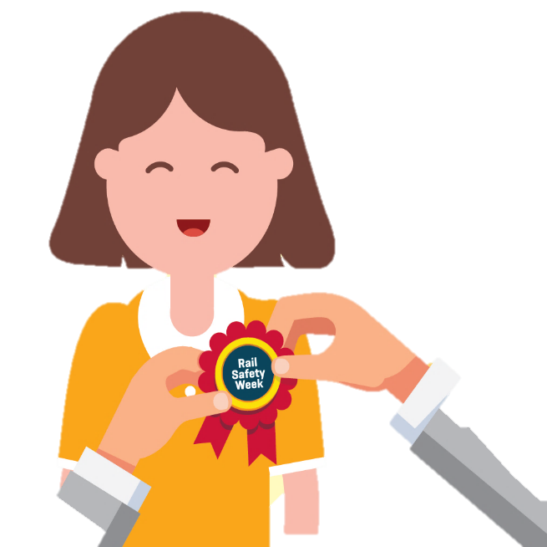
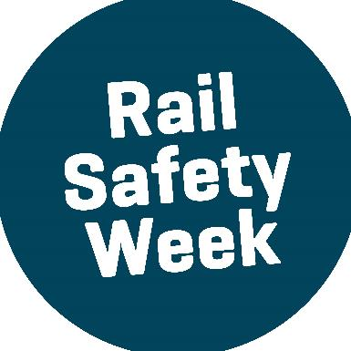

Notes:
Talking points:
“Ka pai everyone!” (good job)
“You are all Rail Safety Week champions!”

Slide 33
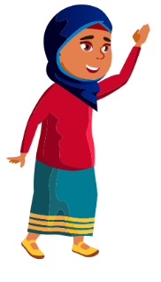
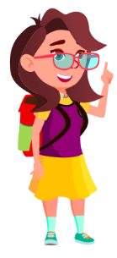
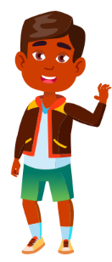

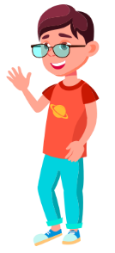
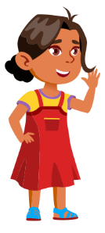


Flaticons by pikepicture
Any questions?
Notes:
Talking points:
“Any questions?”

