Slide 1

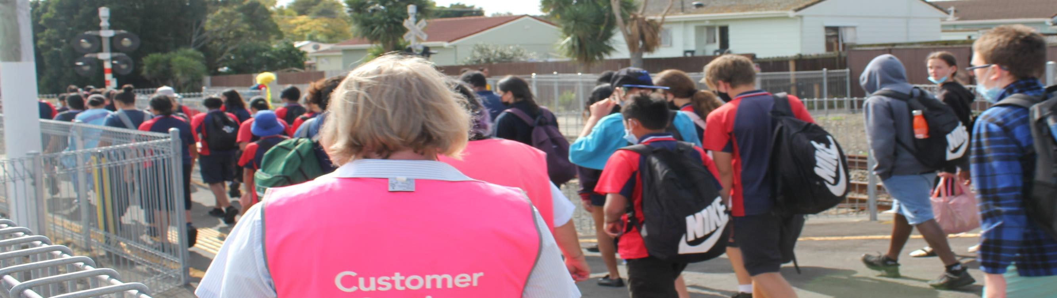

Staying Safe on the Auckland Metro Rail Network

Slide 2
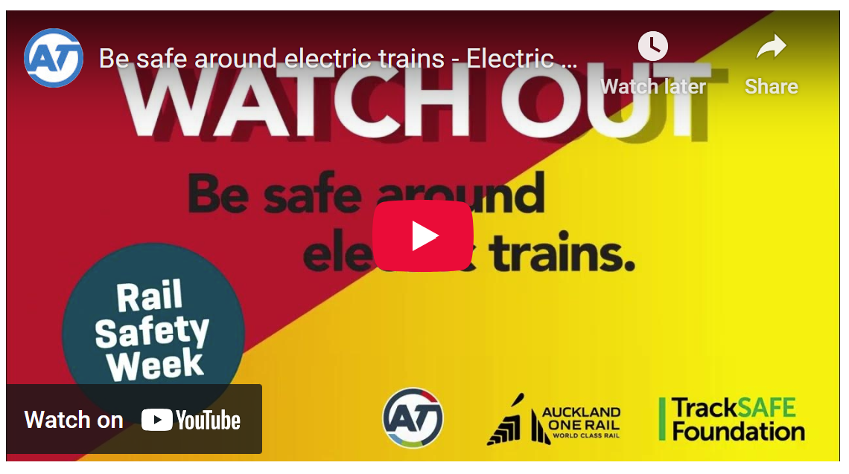

Safety around trains, stations & tracks

Slide 3
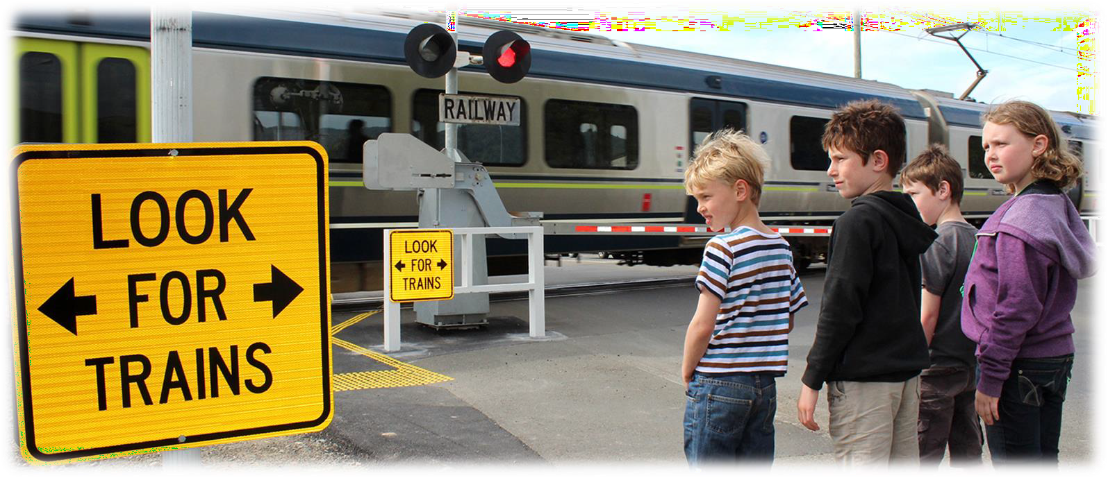
At Level Crossings
Always look both ways
Wait for alarm bells and flashing lights to stop before crossing

Slide 4
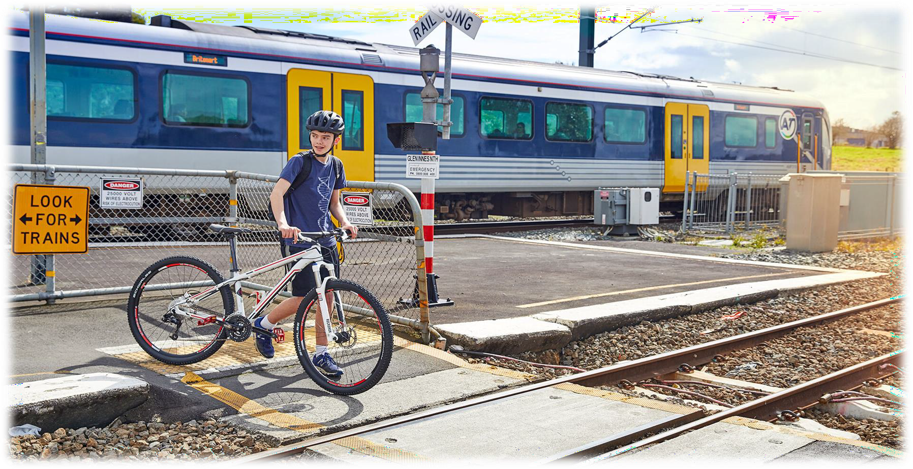
Near Railway Lines
Remove headphones and put your phone in your pocket
Keep hold of your sports or other gear including a ball that could roll on to the tracks
Always use paths, bridges that go over train lines and official pedestrian crossings
Keep on the footpath

Slide 5
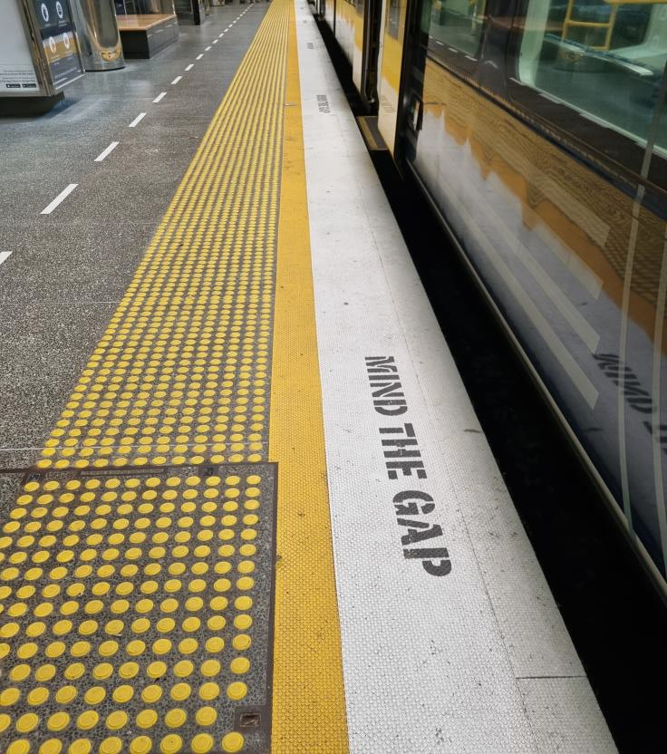
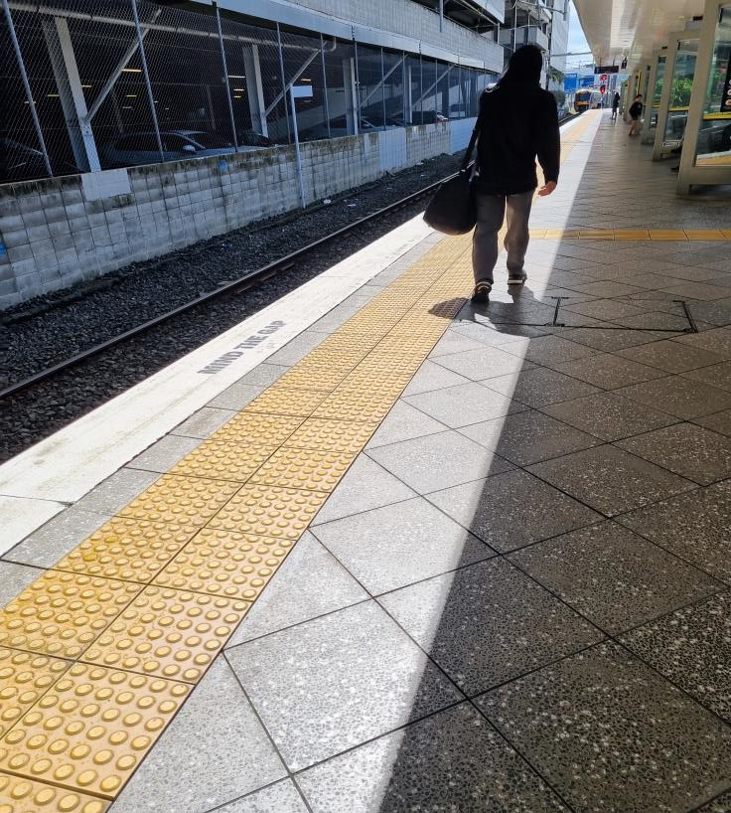
At Train Stations
Mind the gap when getting
on or off a train
Stay behind the yellow line until the doors have opened and you’re ready to get on
Stay clear of closing doors –
do not try to reopen
Take a seat if you can

Slide 6
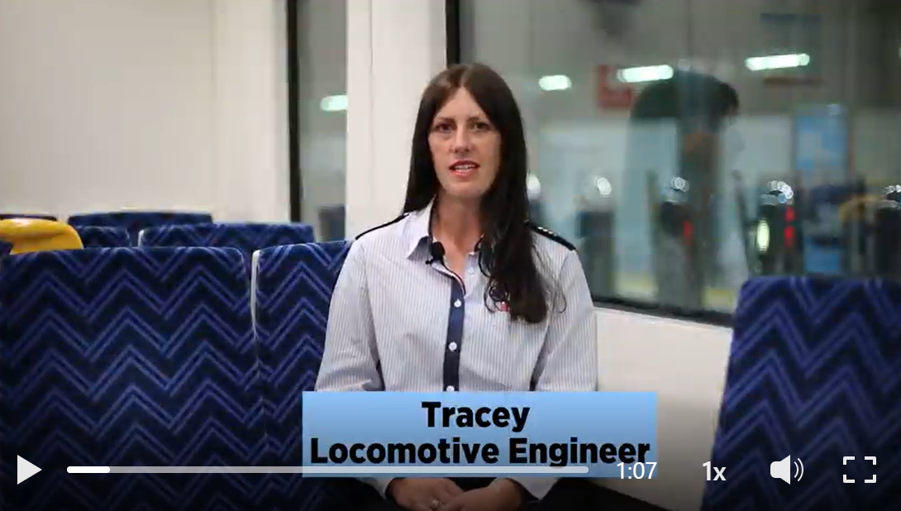
“Locomotive Engineers”
Rail Safety Messages
L.E. Tracey Musson

Slide 7
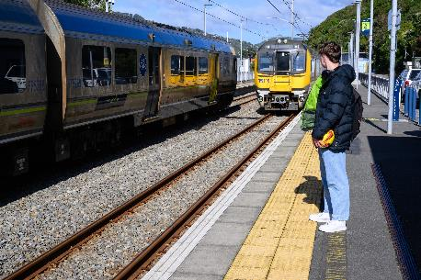
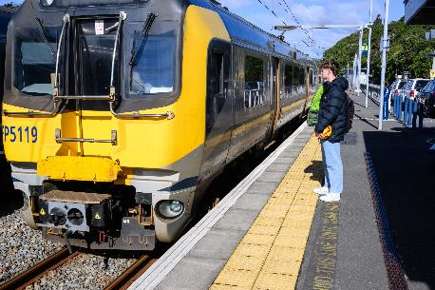
Activity 5 Safety risks Answers
What are the safety risks shown in these photos?
Notes:
Standing too close to the incoming train
Not standing behind the yellow line
The ball.

Slide 8
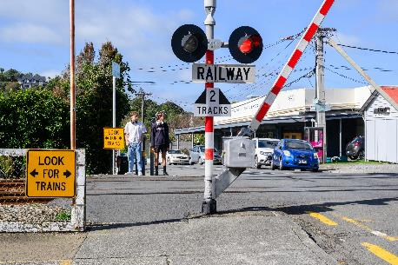
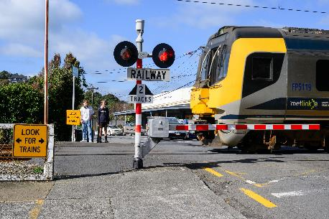
Activity 5 Safety risks Answers
What are the safety risks shown in these photos?
Notes:
Bells and lights are on
Barrier arm is coming down
There is no physical barrier to stop them walking across the tracks before the train gets there.

Slide 9

Thank you

