Slide 1


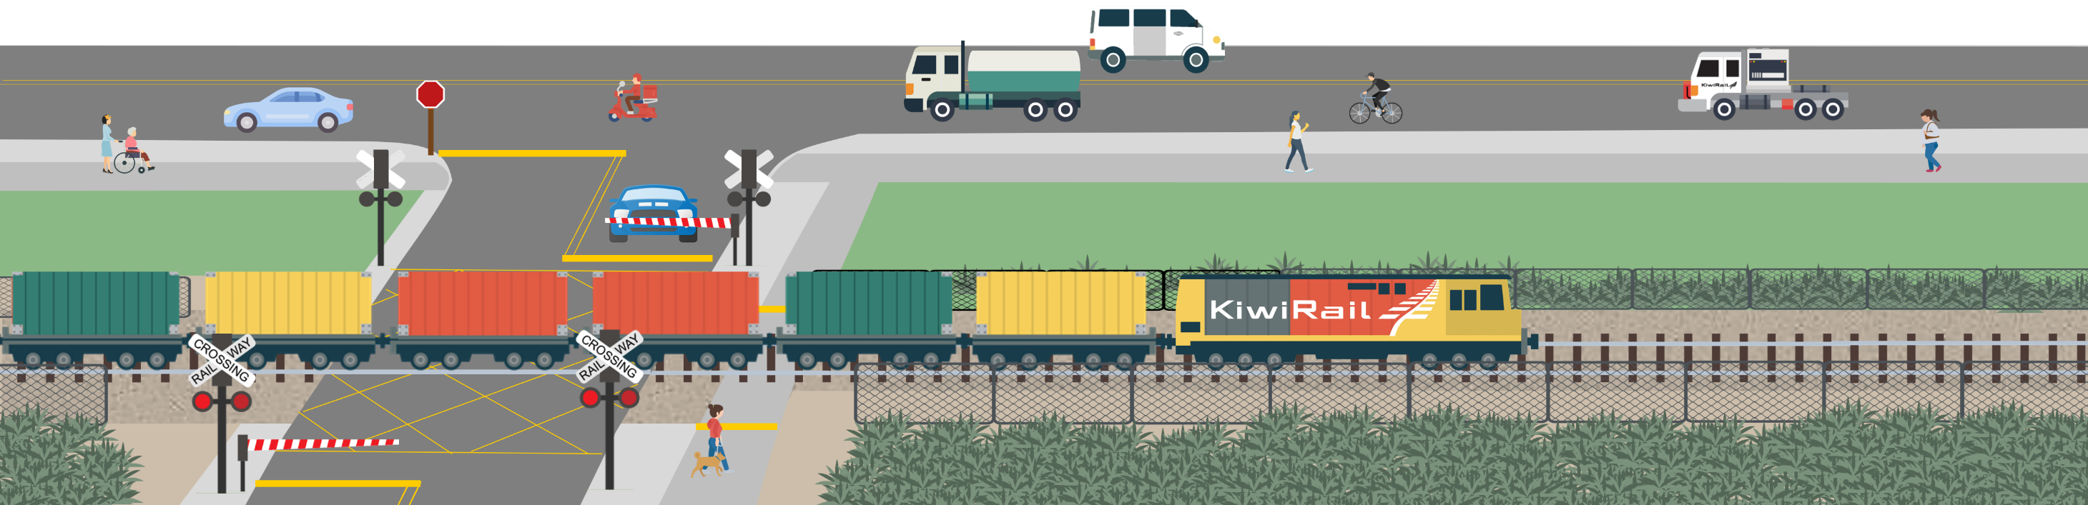
The Community Rail Safety Awards
Finding an idea that will make a real‑world impact.

Slide 2
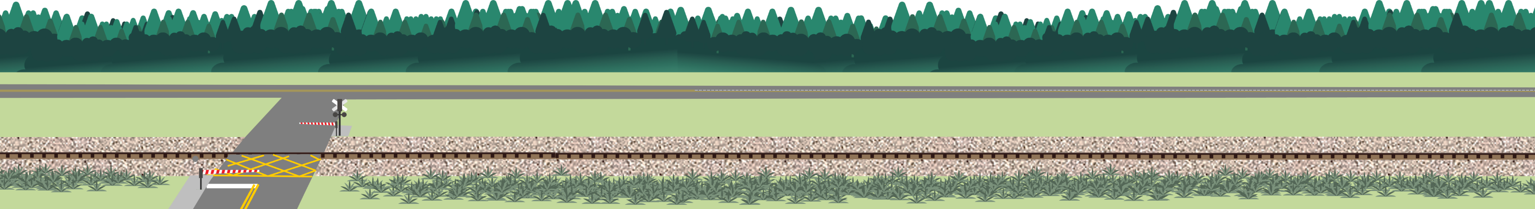
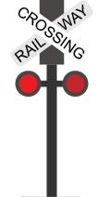
Are you… not sure what you need to do to apply?
You can think of any activity/project you’d like to do that raises awareness and promotes safe behaviours around the rail corridor with younger students, your peers, or your wider community.
On the following slides are some ideas to help you get started. Try starting small:
  Pick one slide that has a topic that feels like ‘you’.
  Choose one idea from it.
  Talk to one teacher or friend and start brainstorming.
Still stuck? KiwiRail’s Community Engagement team are always keep to help! Email contactus@kiwirail.co.nz
Remember:
  Trespassing near or on the tracks is illegal and very dangerous.
  Your project must not involve entering or encouraging others to enter the rail corridor.

Slide 3
Are you… a fan of art/photography/drama?
Design a mural or footpath stencil.
Incorporate some key rail safety messages into the design.
Make sure you get permission from the right people first!
Host a rail safety art or photography competition.
Ask students to submit work that shows what “Stay off. Stay safe.” means to them.
Display entries in the school hallway, local library, or online gallery.
Remember, track photography is illegal.
Film a skit or short story, or create a dance or song.
Focus on raising rail safety awareness in an engaging way.

Slide 4
Are you… a designer/writer?
Create your own rail safety activity.
For younger students, make a word search, crossword, or even design a colouring in page.
If you want to dial up the creativity, create a board/card game.
Make a rail safety calendar.
Include a different rail safety fact/message for each month.
Share printed/digital copies to use in classrooms or staff rooms.
Write an article.
Draw attention to risks in the rail corridor, and the behaviours that keep us safe.
Share it in your school or community newsletter.

Slide 5
Are you… keen to practice your presentation skills?
Lead a session with junior students using the Rail Safety Interactive Graphic Novel.
Pause at key moments to discuss safe vs risky decisions, and get students thinking about what they'd do in real life.
Present the rail safety Slideshow for years 9-13 to your classmates.
Discuss the risks of trespassing in the corridor, and the behaviours that keep us safe.
Watch the video of train drivers talking about how near misses and collisions impact them.
Go through the interactive “Pick Your Pathway” resource with your classmates.
Help them think through safe choices on their way to school.
Present it during Health class or form time.

Slide 6
Are you… good at connecting with people?
Create a rail safety pledge wall at your school.
Encourage your peers/teachers to sign a real or digital board promising to behave safely around the rail corridor.
Create a rail safety reflection wall at your school.
Get people to answer the question, “Who or what motivates you to stay safe?”
Ask them to reflect on why rail safety matters to them personally.
Display the responses on a wall, school social media, or as part of a digital slideshow.
  Adapt one of the Students Against Dangerous Driving (SADD) activities to a rail safety context using the Rail Safety Activities resource and run a session with your classmates.

Slide 7
Are you… a fan of facts/trivia?
Arrange a safety/rail/transport-themed quiz night at your school.
Mix safety facts with fun pop culture questions (e.g., about movies/games featuring trains, ‘The Polar Express’, ‘Unstoppable’, ‘Murder on the Orient Express’ etc.).
Create a “Did You Know?” campaign using the Stats & Facts resource.
Turn key facts into posters, social media tiles, or quick announcements to be shared during school notices, assemblies, or on digital screens around school.
Curate a rail safety display for the school library.
Use books, facts, quotes, posters, and student art to build a themed display.

Slide 8
Are you… passionate about your community?
Run a creative rail safety session for kids.
Team up with your local library, after-school club, holiday programme, or youth centre.
Design some rail safety flyers/posters specific to your local community.
You could draw attention to a particularly dangerous section of the rail corridor, or translate your rail safety messaging into other languages.
Team up with a local business.
Ask cafes or dairies to display your rail safety posters or hand out flyers with takeaway orders.

Slide 9
Are you… keen to get some outside help?
Arrange for your class to go on a virtual field trip.
Explore rail safety, technology, and sustainable transport with free online experiences from LEARNZ.
Reach out to a local stakeholders.
Share your project idea and ask them to back it, help promote it, or speak at your event.
You could connect with KiwiRail, Auckland Transport, Auckland One Rail, Metlink, Transdev, MPs, councillors, Police, Fire and Emergency, St John etc.

Slide 10
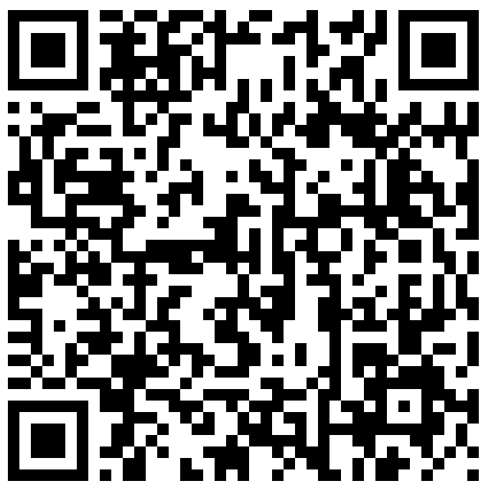
Are you… wanting to check out all of the resources?
The online version of the document with links to all of the resources and the application
form can be found on KiwiRail’s Secondary School Rail Safety Awards page.
https://www.kiwirail.co.nz/communities/safety-in-the-community/school-rail-safety-awards/

Slide 11
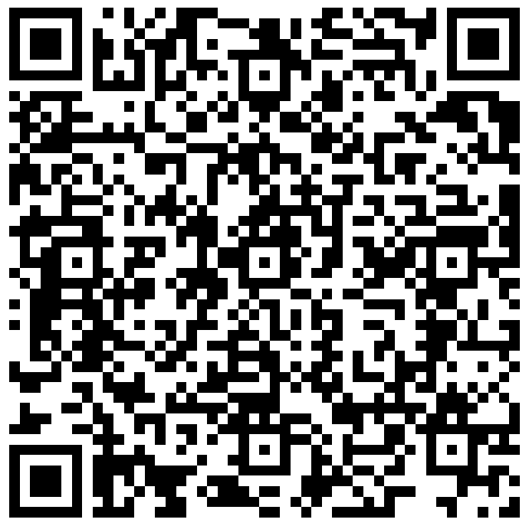
Are you… finished with your project and ready to apply?
Click here to complete the application form or scan the QR code!
Applications close: 30 September.
Winners notified: 1 November.
For our winners, we’ve got:
For two year 13 students: $500 Prezzy card.
For three years 9-12 students: Fully-funded registration for the SADD Conference in the following year (valued at $185) and a $300 Prezzy card.
The application form link and application criteria can be found on KiwiRail’s Secondary School Rail Safety Awards page.

