Slide 1


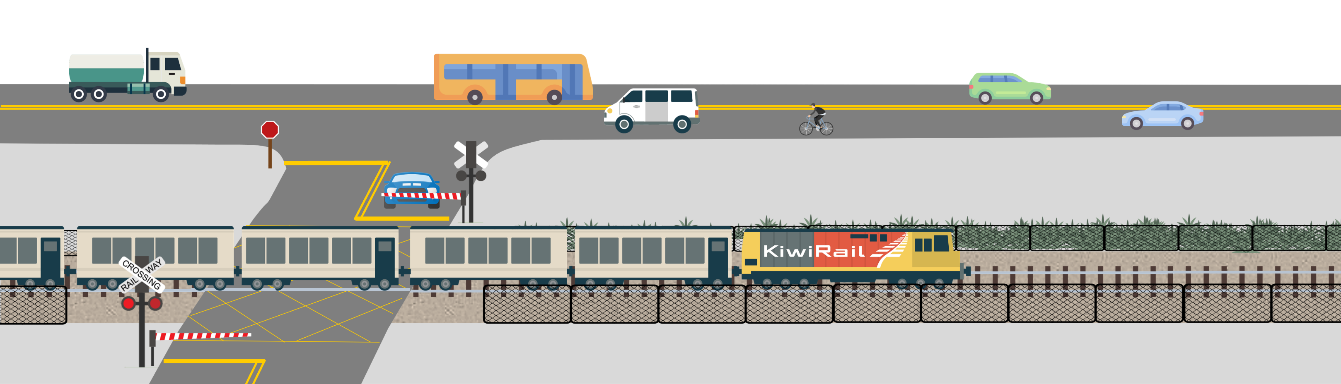
Do you have what it takes to stay safe around the rail corridor?
Let’s put it to the test…

Slide 2
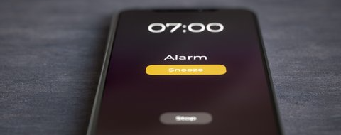
You wake up to your phone buzzing and see that it’s 7.00am, time to get up and get ready for school!
What do you do next?
Hit snooze and go back to sleep it doesn’t really matter if you have to rush later to get to school in time.
Get up and get ready for school, you don’t want to be late!
A - Snooze your alarm
B - Get out of bed
Notes:
A0

Slide 3

Now that you’re out of bed and getting sorted for school, you can’t shake that rundown feeling. You’re knackered and you have a splitting headache!
What do you do next?
Hop in the car, it doesn’t matter if you’re not feeling up to it and it’ll be way easier to just drive to school.
Walk to the train station, it’ll take a little longer, but you’ll be able to chill once you’re on the train.
A - Get in the car
B - Walk to the station
Notes:
B1

Slide 4
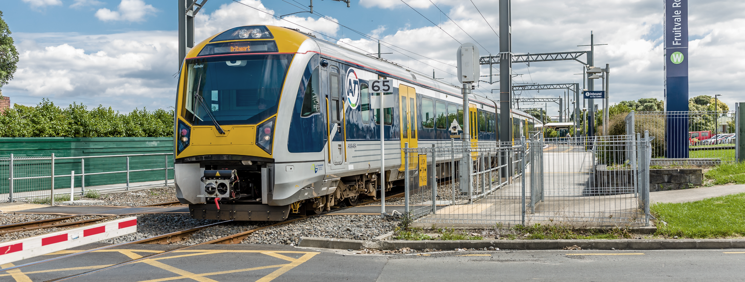
As you approach the level crossing you see a train leaving the station and worry that your train might be arriving soon at the other platform. The lights and bells are still turned on at the crossing.
What do you do next?
Wait for the bells and lights to stop before crossing over and walking to the platform.
Cut behind the train that’s gone past and cross over, the lights and bells are going to turn off soon anyway.
A - Wait to cross
B - Cut behind train
Notes:
C1

Slide 5
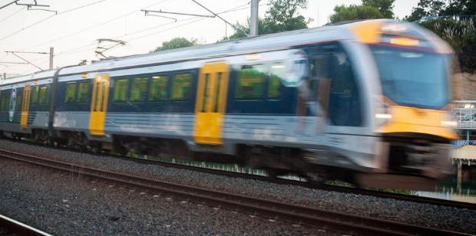
A second train was coming on the other track!
You notice just in time and leap backwards.
Phew, that was a close call!
Go back and try again
Notes:
F1

Slide 6
Lucky you waited before crossing, because a second train was coming on the other track!
Next
Notes:
D1 (1)

Slide 7
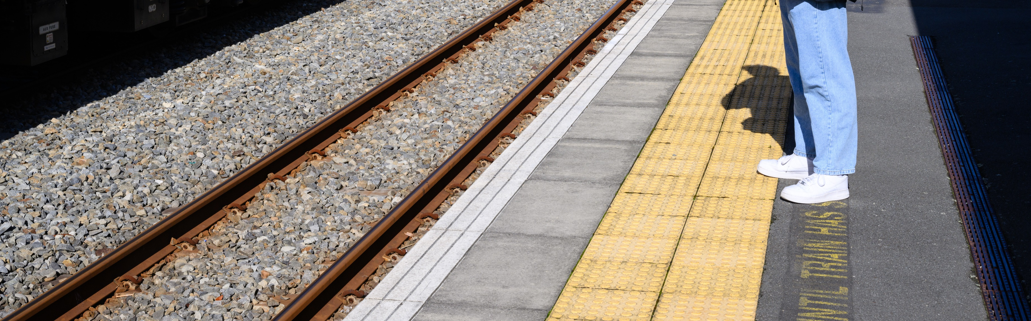
Damn, you’ve missed your train! After you cross you walk to the platform to wait for the next one.
What do you do next?
Stand at the edge, you’re keen to make sure you get on first and nab a seat before they’re all taken.
Stand back behind the yellow line.
A - Stand at the edge
B - Stand back
Notes:
D1 (2)

Slide 8
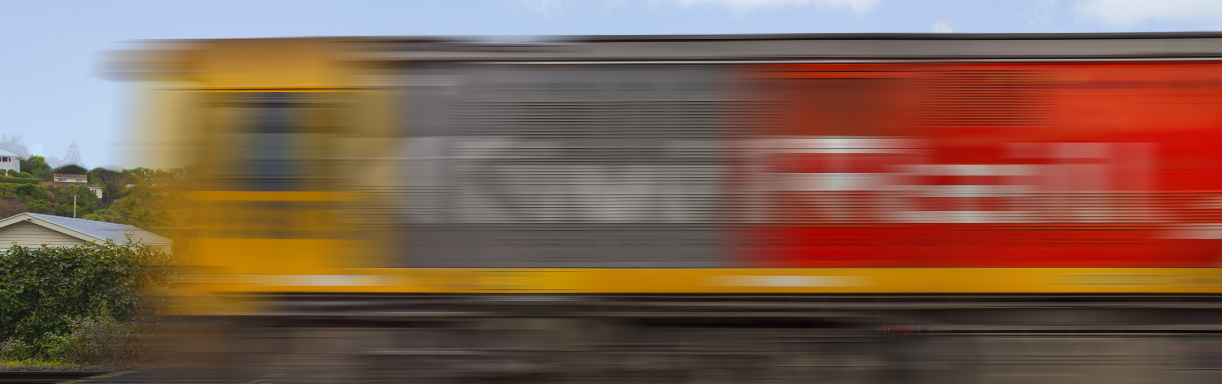
An express freight train comes past and creates a massive vacuum. You lose your balance, but luckily someone else on the platform grabs your arm and stops you from falling. Phew, that was a close call!
Go back and try again
Notes:
F2

Slide 9
Lucky you stood back, because an express freight train came past and created a massive vacuum!
Next
Notes:
E1 (1)

Slide 10
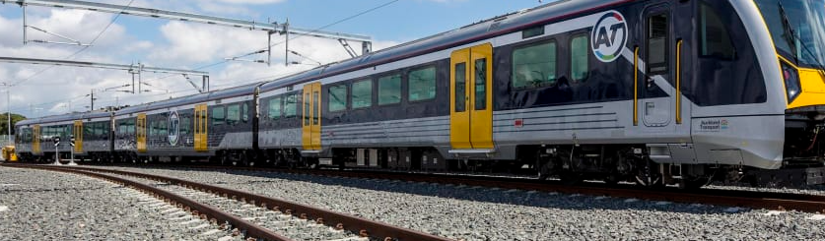
Once your train pulls into the station you spot your mates onboard and go and sit with them. When you all get off the train, they say they’re going to cut across the tracks to save time getting to school.
What do you do next?
Take the shortcut, everyone else is doing it and it will save you walking 10 minutes to the overpass.
Tell your mates you should all go the long way around, it’s better to play it safe.
A - Take the shortcut
B - Go around
Notes:
E1 (2)

Slide 11
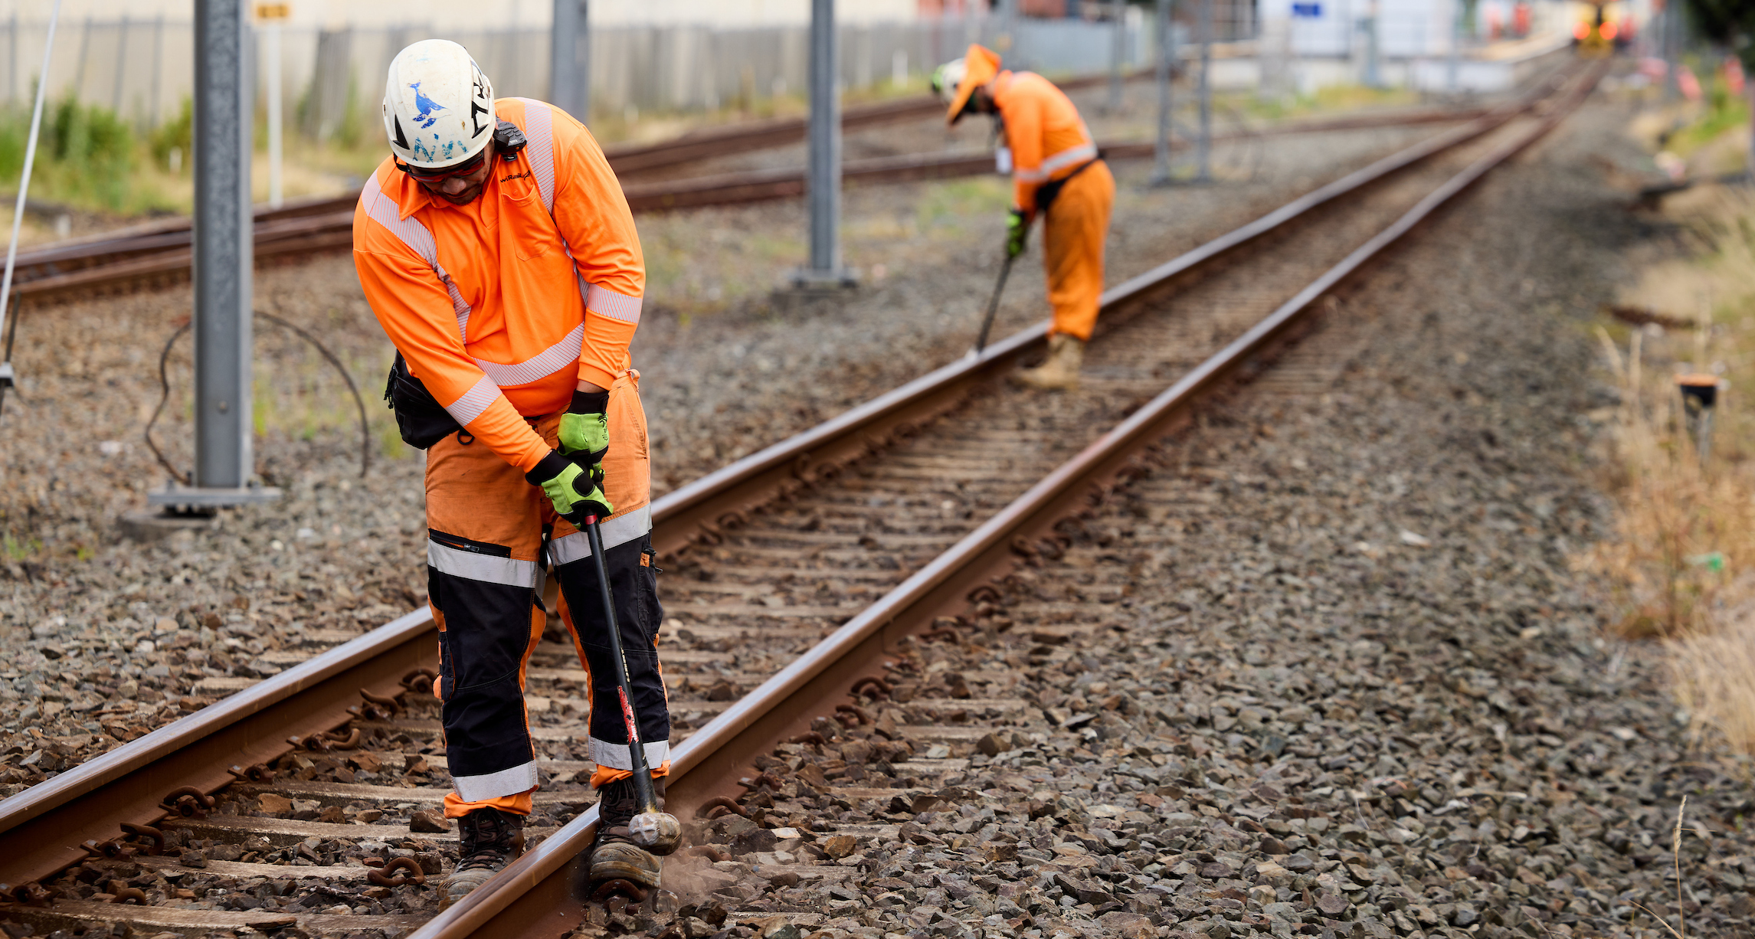
A maintenance crew spots you and shouts at you to stop. You trip and fall on the rough stones, but your mates keep running. The maintenance worker catches up to you and tells you that the penalty for trespassing in the rail corridor is $10,000.
Go back and try again
Notes:
F3

Slide 12
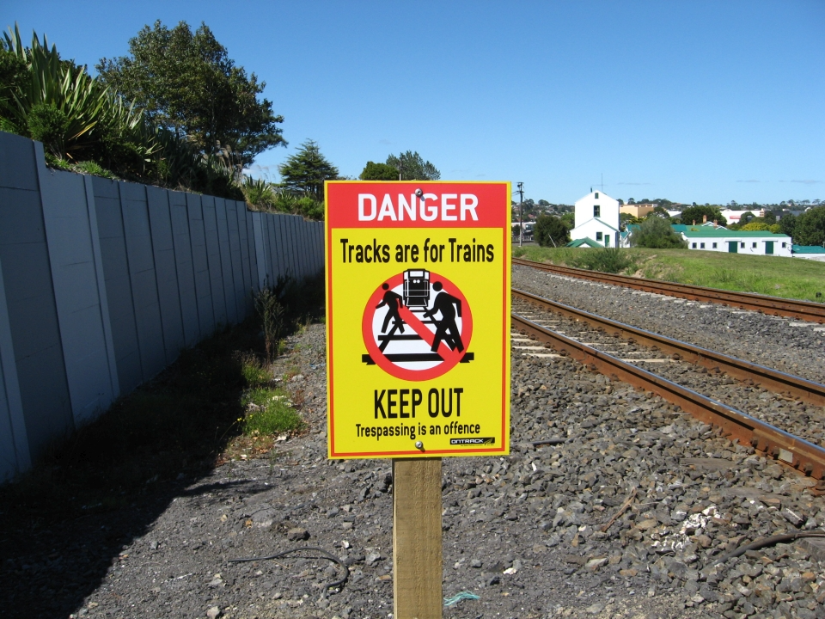
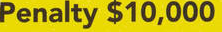
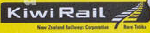
Your mates ignore you and hop down onto the tracks. As you watch them cross to the other side you notice some maintenance workers spot them and follow them out of sight. You see a sign at the edge of the platform and realise that the penalty for trespassing in the rail corridor is $10,000.
You turn around and take the long way to get to school, hoping that your friends will be let off with just a warning.
Go to end
Notes:
F4

Slide 13
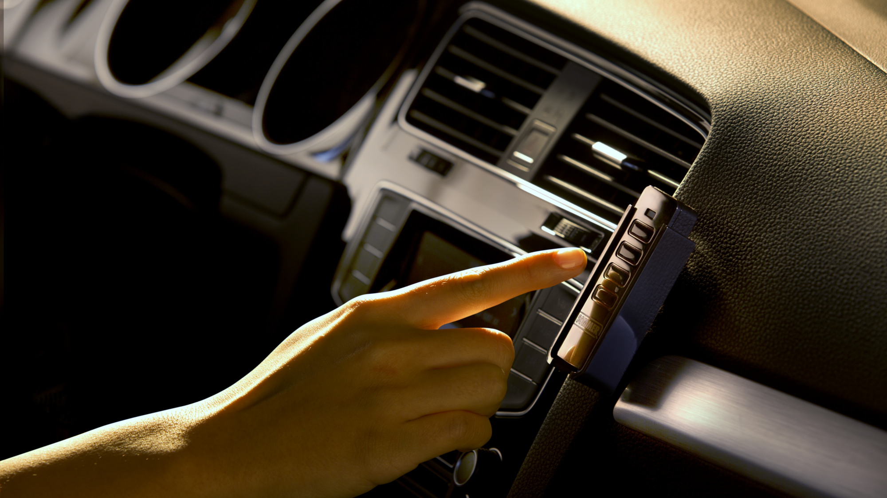
When you left the house, you decided to turn your music up super loudly. You don’t want to get a detention for sleeping in class and you’re still feeling drowsy. As you approach a level crossing you think about turning the music back down since you’re feeling a bit distracted.
What do you do next?
Keep the music turned up loud, it’ll amp you up before you get to school.
Turn it down to a normal volume.
A – Keep it loud
B – Turn it down
Notes:
C2

Slide 14
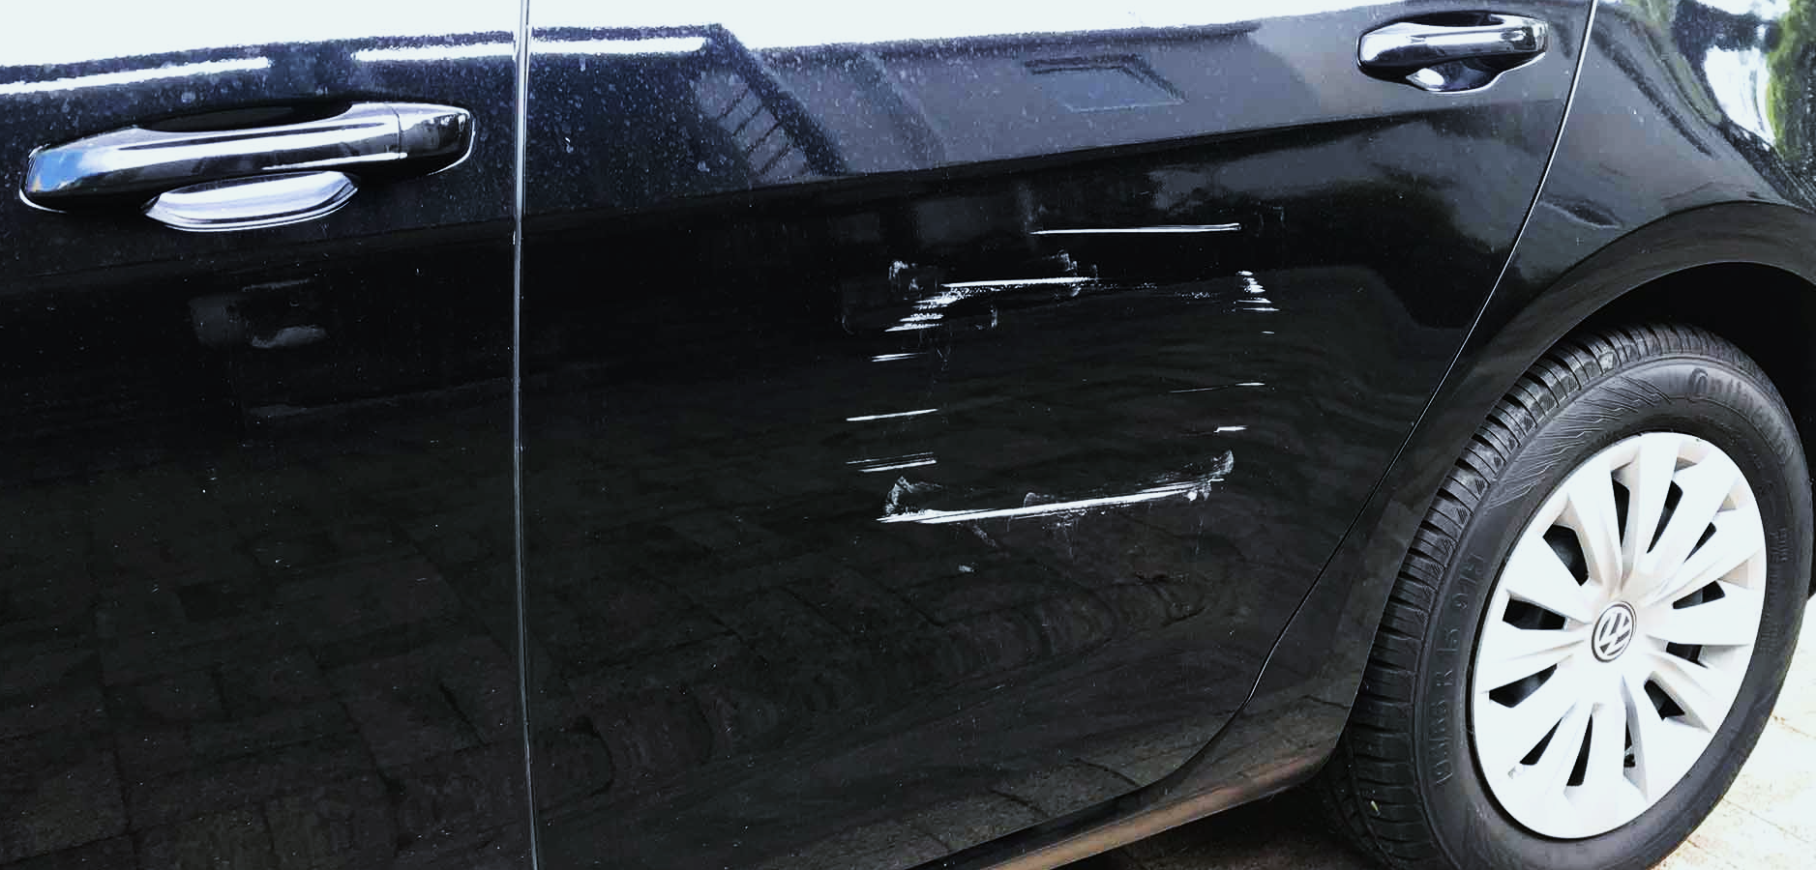
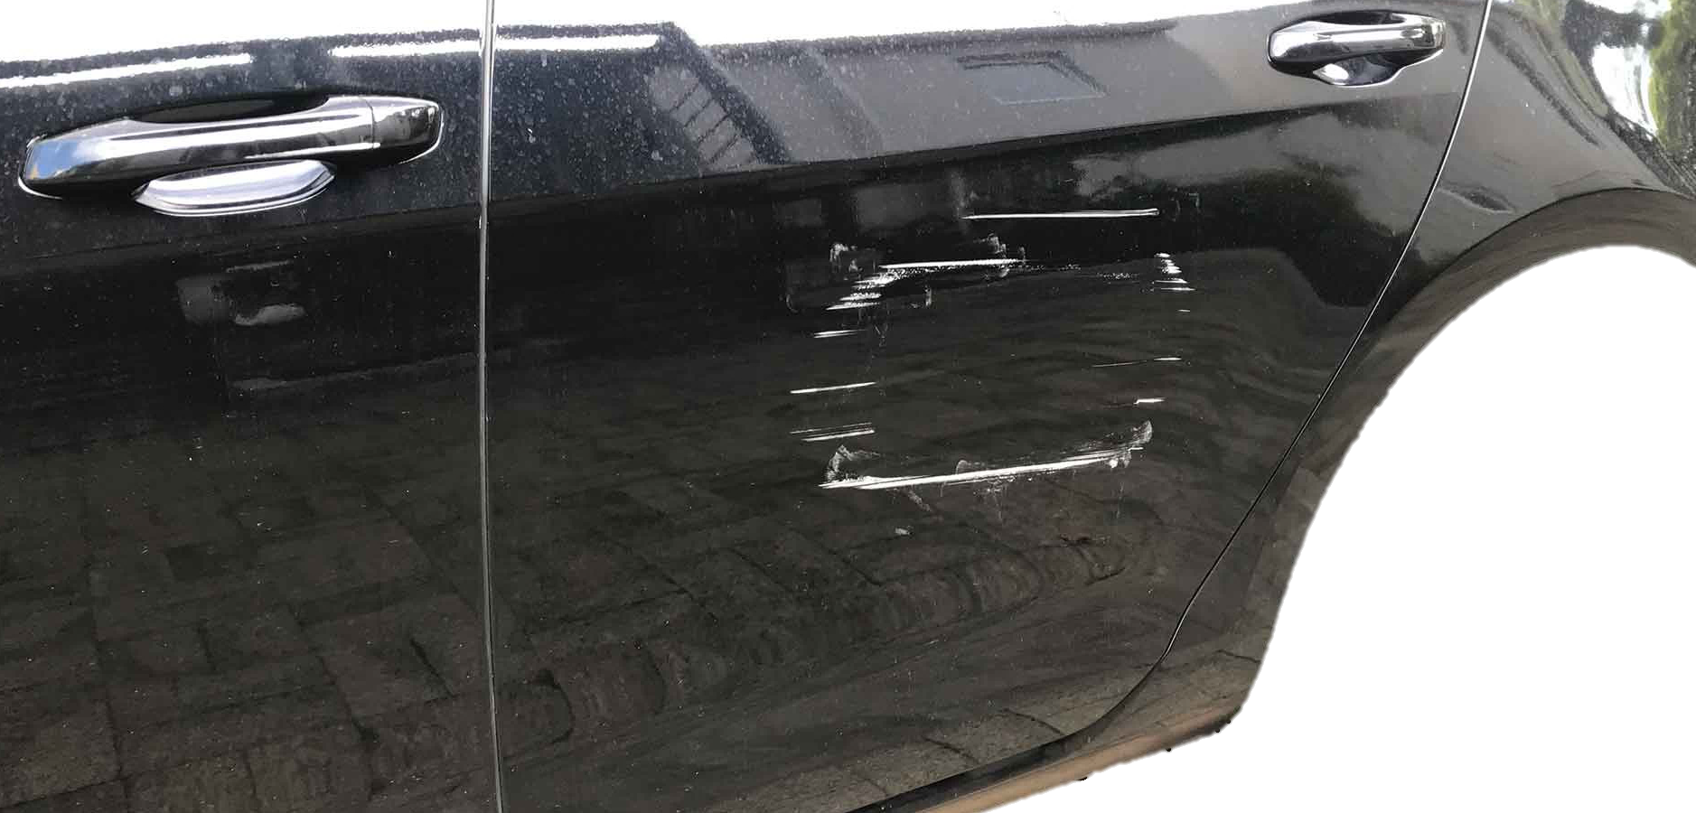
You drive onto the tracks and suddenly realise that the crossing has been activated, you hadn’t heard the bells or noticed the barrier arms coming down! You drive on the other side of the road to get around the barrier and off the crossing. You clip the end of the barrier arm and scrape the side of your car! The cars waiting at the crossing are honking, and you see someone taking a picture of your number plate. What are your parents going to say when they see the scratch?!
Go back and try again
Notes:
F5

Slide 15
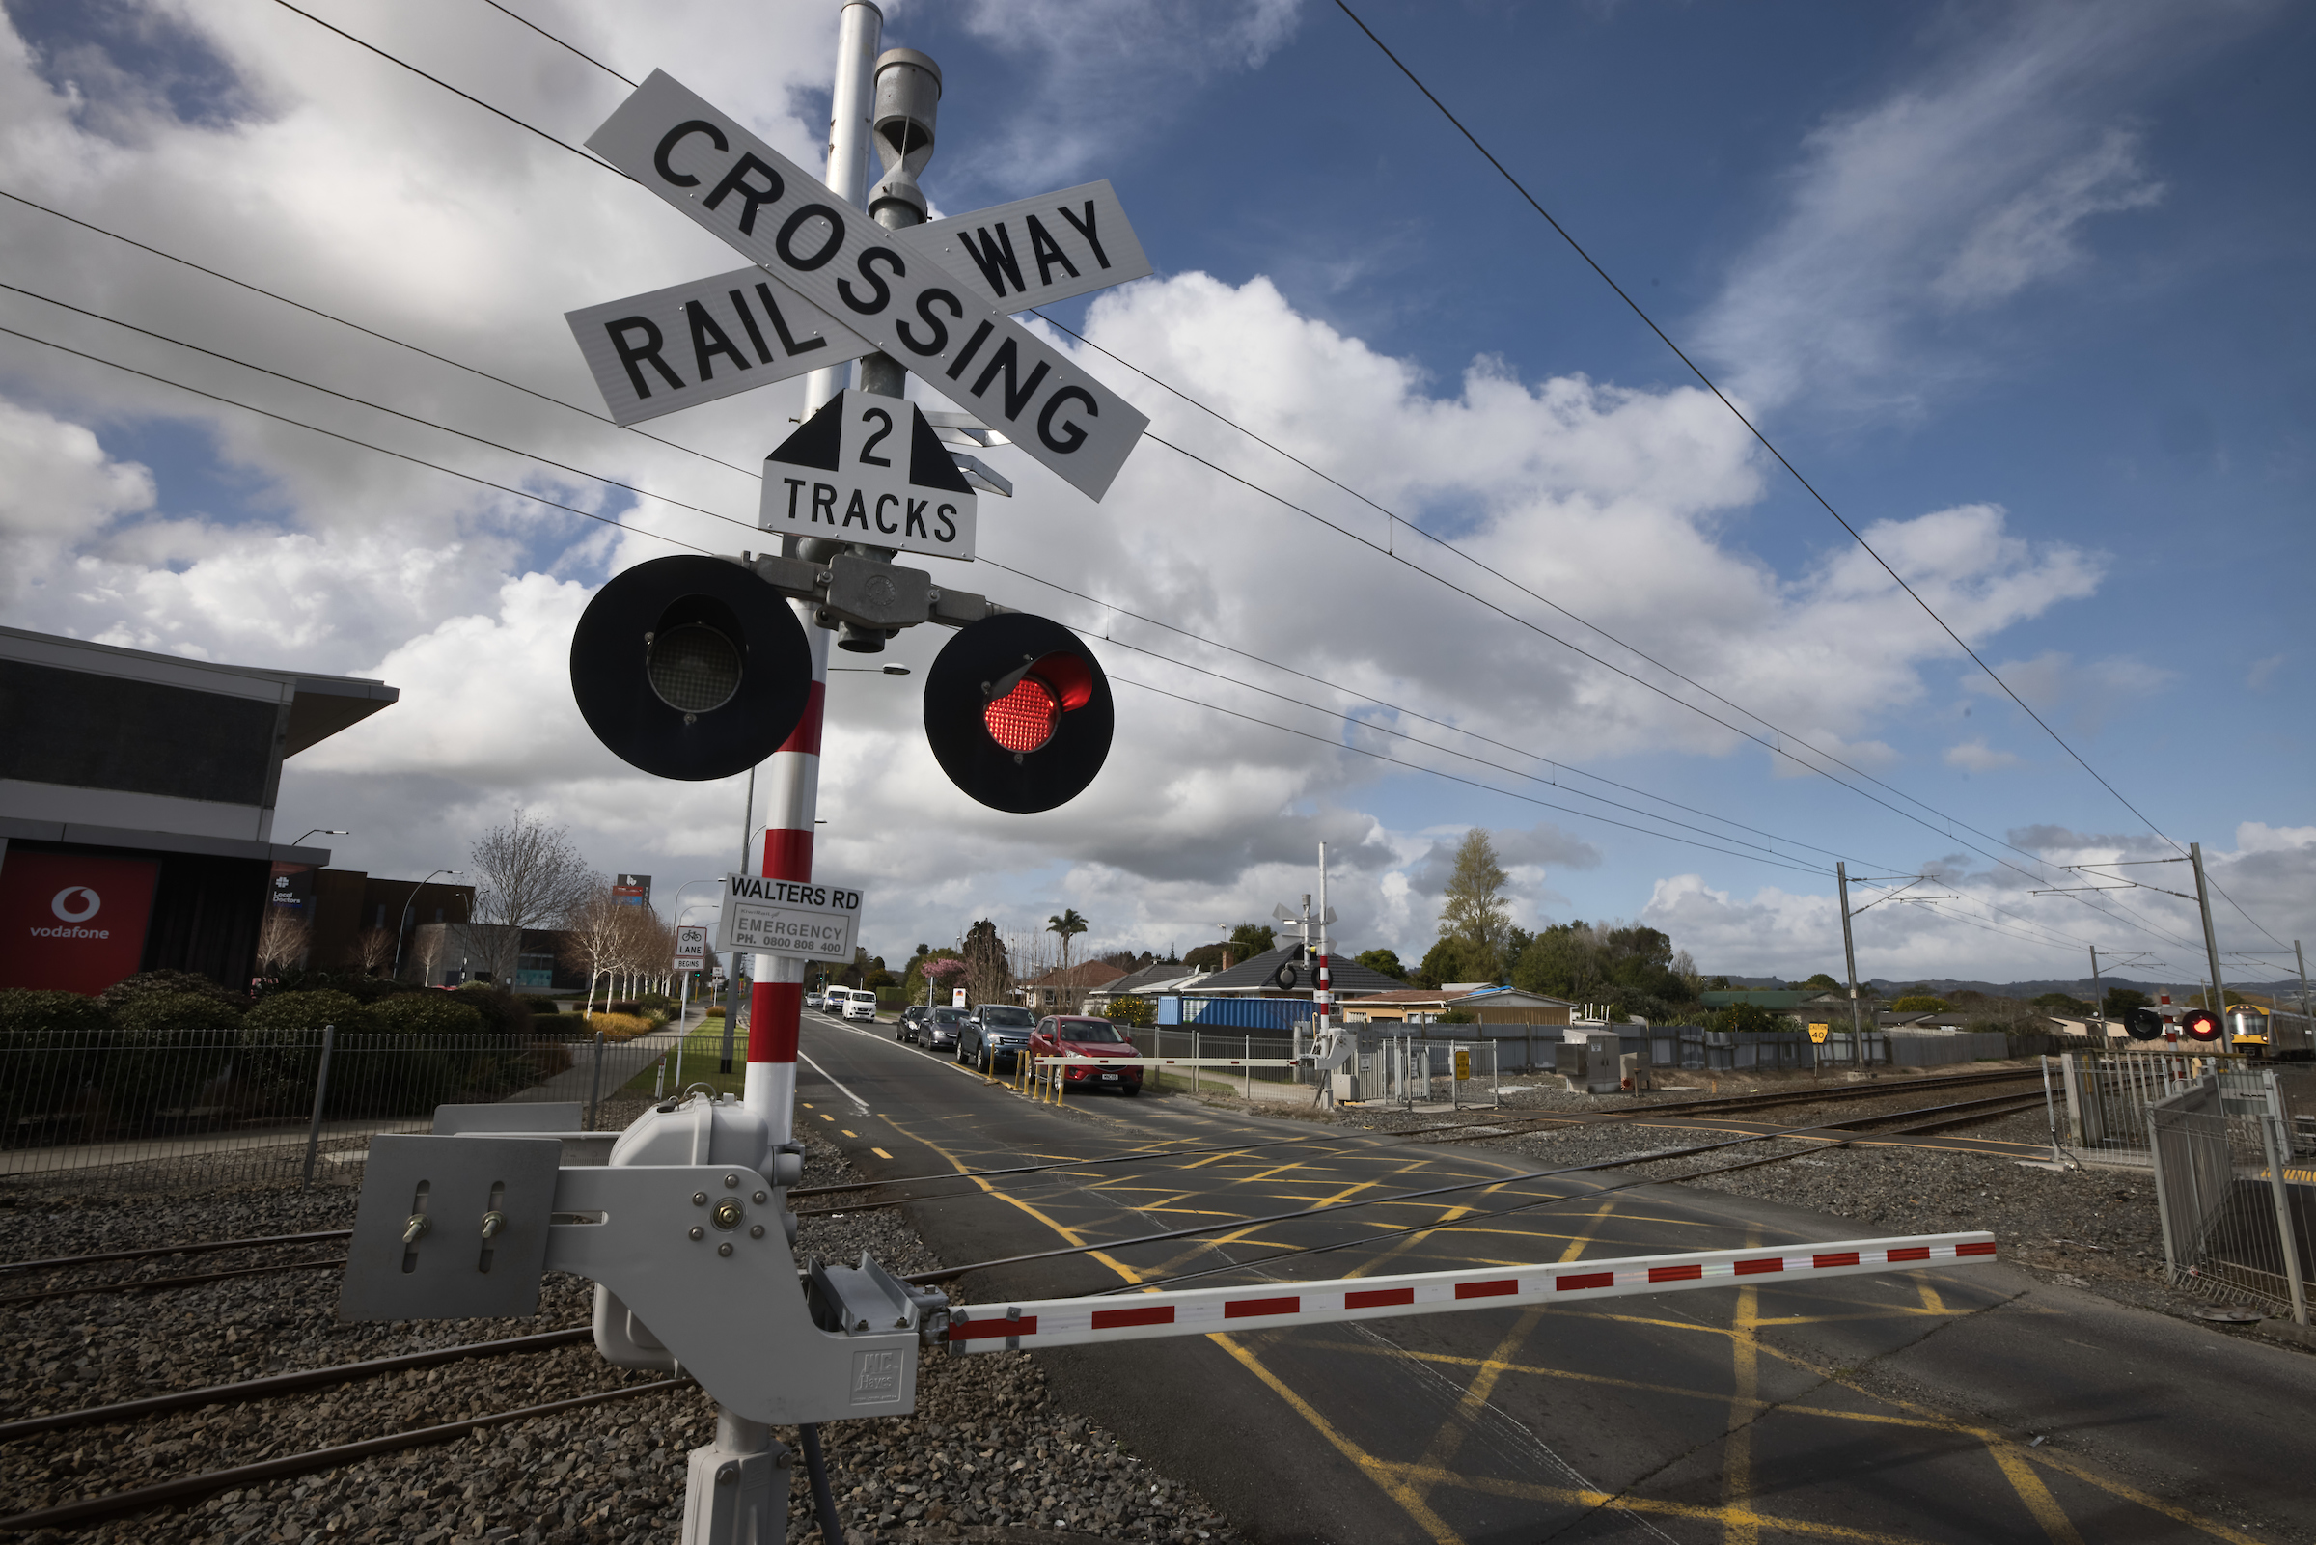
Lucky you turned it down, because the crossing activated and you’re not sure if you would have heard the bells over your loud music!
Next
Notes:
D2 (1)

Slide 16
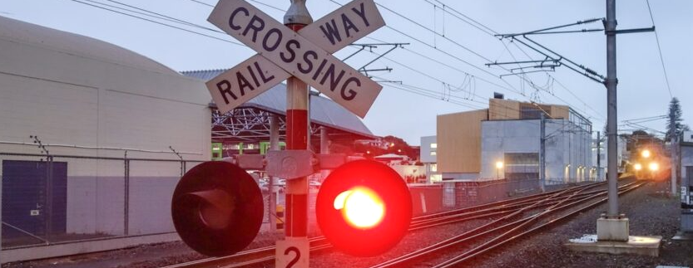
You spot the train along the track and notice that it’s a long freight train moving pretty slowly. You think about shutting your eyes for just a bit while you wait. The traffic’s stopped, and you’ll hear when the bells turn off, so you should be sweet.
What do you do next?
Sit back and shut your eyes.
Sit up straight and open your window to get some fresh air.
A – Shut your eyes
B – Open the window
Notes:
D2 (2)

Slide 17
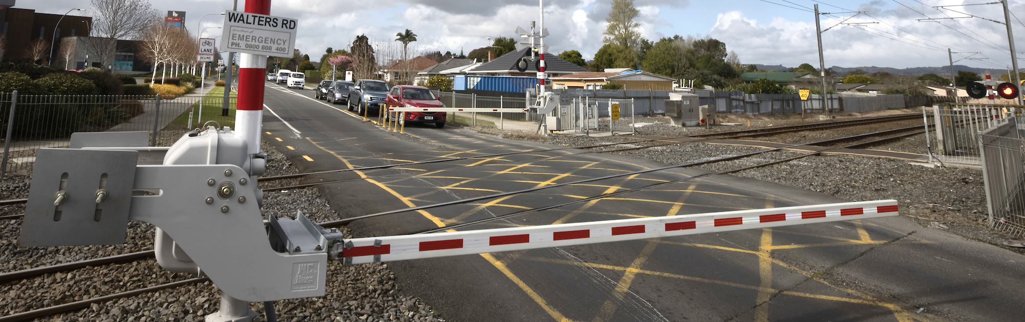
As you sit back and shut your eyes, the gentle rumbling of the train wagons lulls you to sleep. Your foot slips off the brake and the car starts rolling forwards. You jolt awake when you hear the loud crunch of the barrier. You quickly reverse but the barrier is twisted and dangling awkwardly, and it doesn’t go back up when the train goes past. You get out to have a look and decide to call the emergency number on the sign. They tell you to wait while they call out a technician. Traffic is backing up and people are beeping at you and trying to turn around to go another way. As you sit and wait you hope you won’t get in too much trouble…
Go back and try again
Notes:
F6

Slide 18
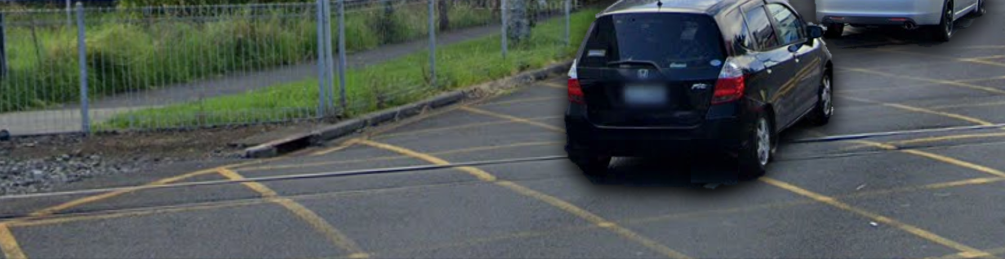
As you roll down the window your mind starts to wander, thinking about the homework you didn’t finish last night. The train comes through, and the barrier arms come up again. There are cars stopped on the far side of crossing, but you think about crossing anyway and idling on the yellow cross-hatched lines until the traffic clears. You should be sweet if you just stop for a moment, right?
What do you do next?
Drive across and idle on the yellow lines for a moment.
Stay back and wait for the traffic to clear.
A – Drive across
B – Stay back
Notes:
E2

Slide 19
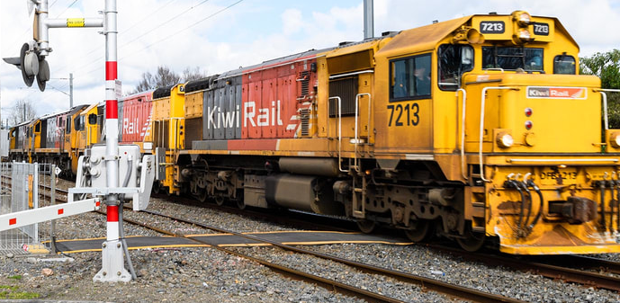
You’re idling on the crossing when the lights start flashing, and the barrier arms begin to come down, then you hear the freight train coming! You try to drive around the car in front of you but there’s no room. The train’s blaring its horn and screeching as it applies the emergency brakes. It’s still going pretty fast though and you’re not out of the way yet! It clips your rear bumper, sending the car spinning and tossing you around.
Go back and try again
Notes:
F7

Slide 20
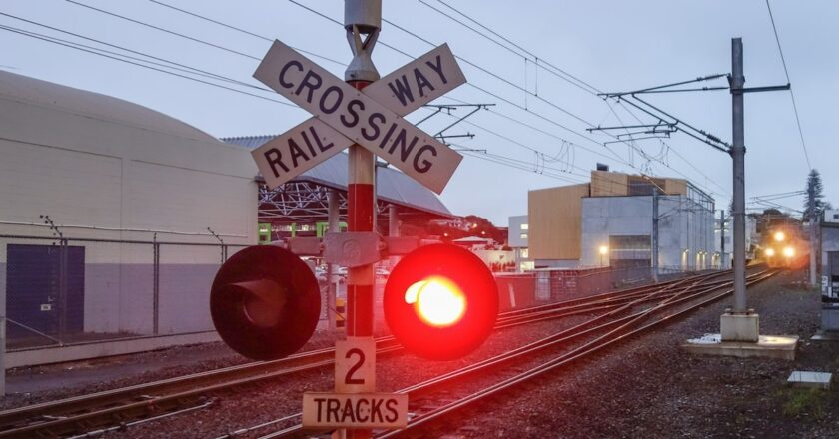
Lucky you didn’t go, because the crossing activated again, and the traffic ahead still hadn’t moved. You would have been stuck on the tracks and right in the path of a freight train if you’d been idling on the yellow lines!
As you drive the rest of the way to school you realise how much being tired has affected your driving this morning. You decide to go to bed earlier tonight.
Go to end
Notes:
F8

Slide 21
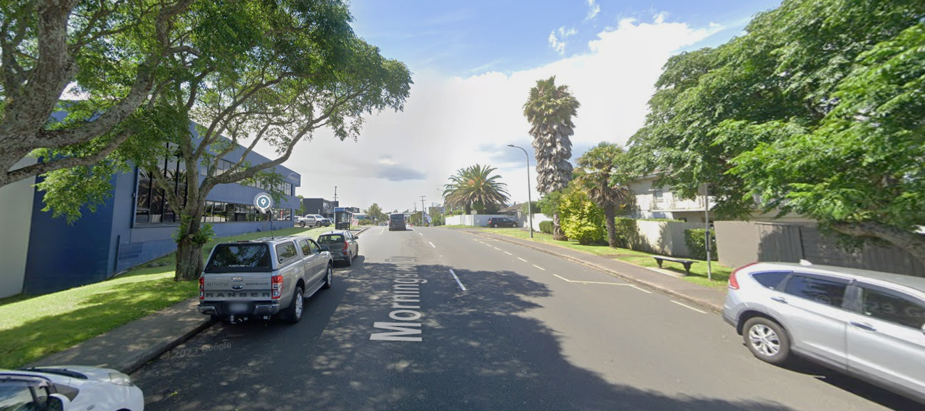


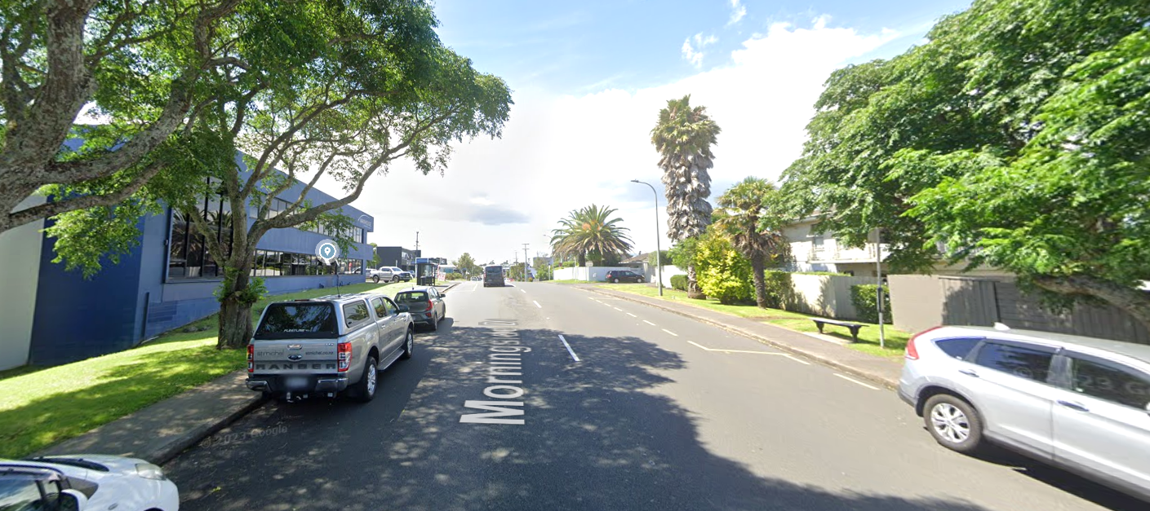
You wake up and realise you’ve slept in way more than you expected, it’s already 8.15 and you’re going to be late!
You quickly get ready, rush out the door and jump in the car.
Next
Notes:
B2 (1)

Slide 22
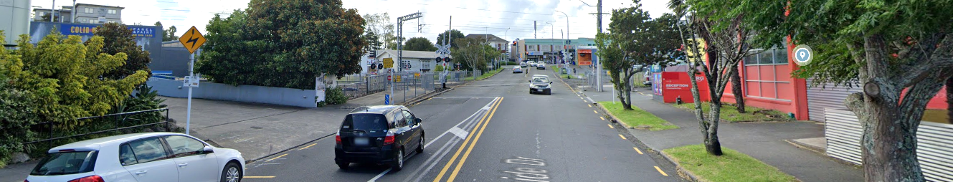
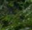
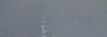
Halfway to school you approach a level crossing. The car in front of you has slowed right down even though the crossing is clear, so you honk at them to hurry up. Knowing that you’re going to be late for school, you think about overtaking the car so that you won’t stay stuck behind them.
What do you do next?
Overtake the car, both lanes are pretty wide you won’t need to drive that fast, so you should be all good.
Wait behind them, you’re going to be late anyway.
A – Overtake the car
B – Wait behind the car
Notes:
B2 (2)

Slide 23
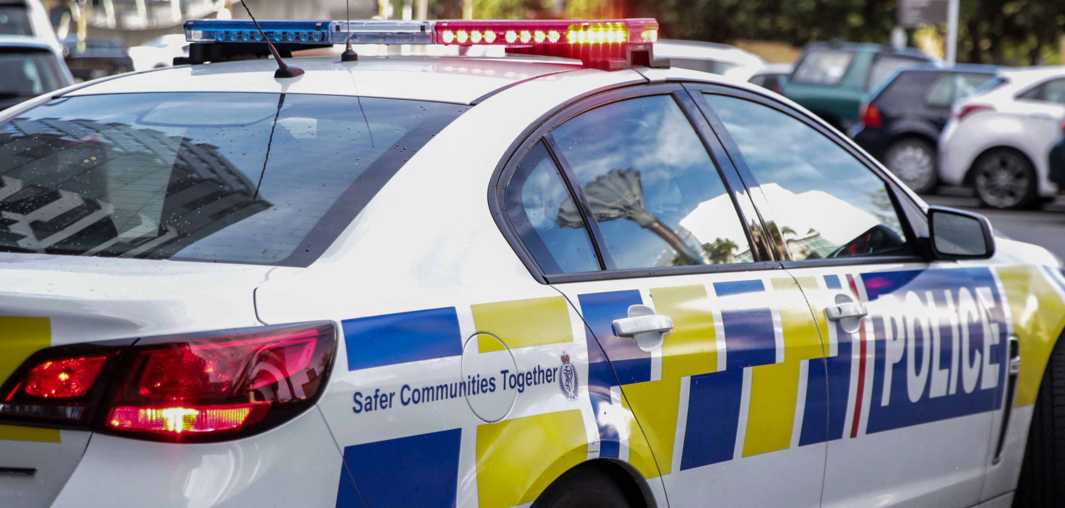
You overtake the car in front of you, and drive across the crossing. You hear the woop of a siren and see flashing lights, a cop’s pulling you over! They say that it’s illegal to overtake within 60 metres of a level crossing, and they’re going to ticket you!
Great, now you're just hoping your parents don't catch it when it shows up in the mail...
Go back and try again
Notes:
F9

Slide 24
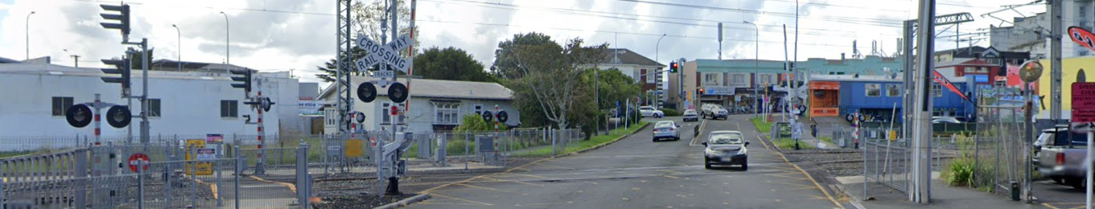

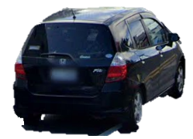
The car ahead of you speeds up and makes it across just as the bells start ringing, lights start flashing, and the barrier arm starts coming down. You’re mad about the hold-up, and now you’re going to be even more late for school! You reckon you can you can still nip across in time.
What do you do next?
Carry on and follow the car across, you’ll still have a while before a train comes through anyway.
Brake hard and stop in front of the barrier coming down.
A – Carry on
B – Brake hard
Notes:
C3

Slide 25
The barrier arms come down faster than you think! You drive on the other side of the road to get around the barrier and off the crossing. You clip the end of the barrier arm and scrape the side of your car! The cars waiting at the crossing are honking, and you see someone taking a picture of your number plate.
What are your parents going to say when they see the scratch?!
Go back and try again
Notes:
F10

Slide 26
Lucky you stopped, because the barrier arms came down much faster than you thought!
Next
Notes:
D3 (1)

Slide 27
The train comes through and the barrier arms come up again. The cars on the far side of crossing haven’t budged yet, so you think about crossing anyway and idling on the yellow cross-hatched lines until the traffic clears. You should be sweet if you just stop for a moment, right?
What do you do next?
Drive across and idle on the yellow lines for a moment.
Stay back and wait for the traffic to clear.
A – Drive across
B – Stay back
Notes:
D3 (2)

Slide 28
You’re idling on the crossing when the lights start flashing, and the barrier arms begin to come down, then you hear the freight train coming! You try to drive around the car in front of you but there’s no room. The train’s blaring its horn and screeching as it applies the emergency brakes. It’s still going pretty fast though and you’re not out of the way yet! It clips your rear bumper, sending the car spinning and tossing you around.
Go back and try again
Notes:
F11

Slide 29
Lucky you didn’t go, because the crossing activated again, and the traffic ahead still hadn’t moved. You would have been stuck on the tracks and right in the path of a freight train if you’d been idling on the yellow lines! As you pull up at school you realise you’re 15 minutes late—damn, that means a detention.
At least you got there in one piece though…
Go to end
Notes:
F12

Slide 30
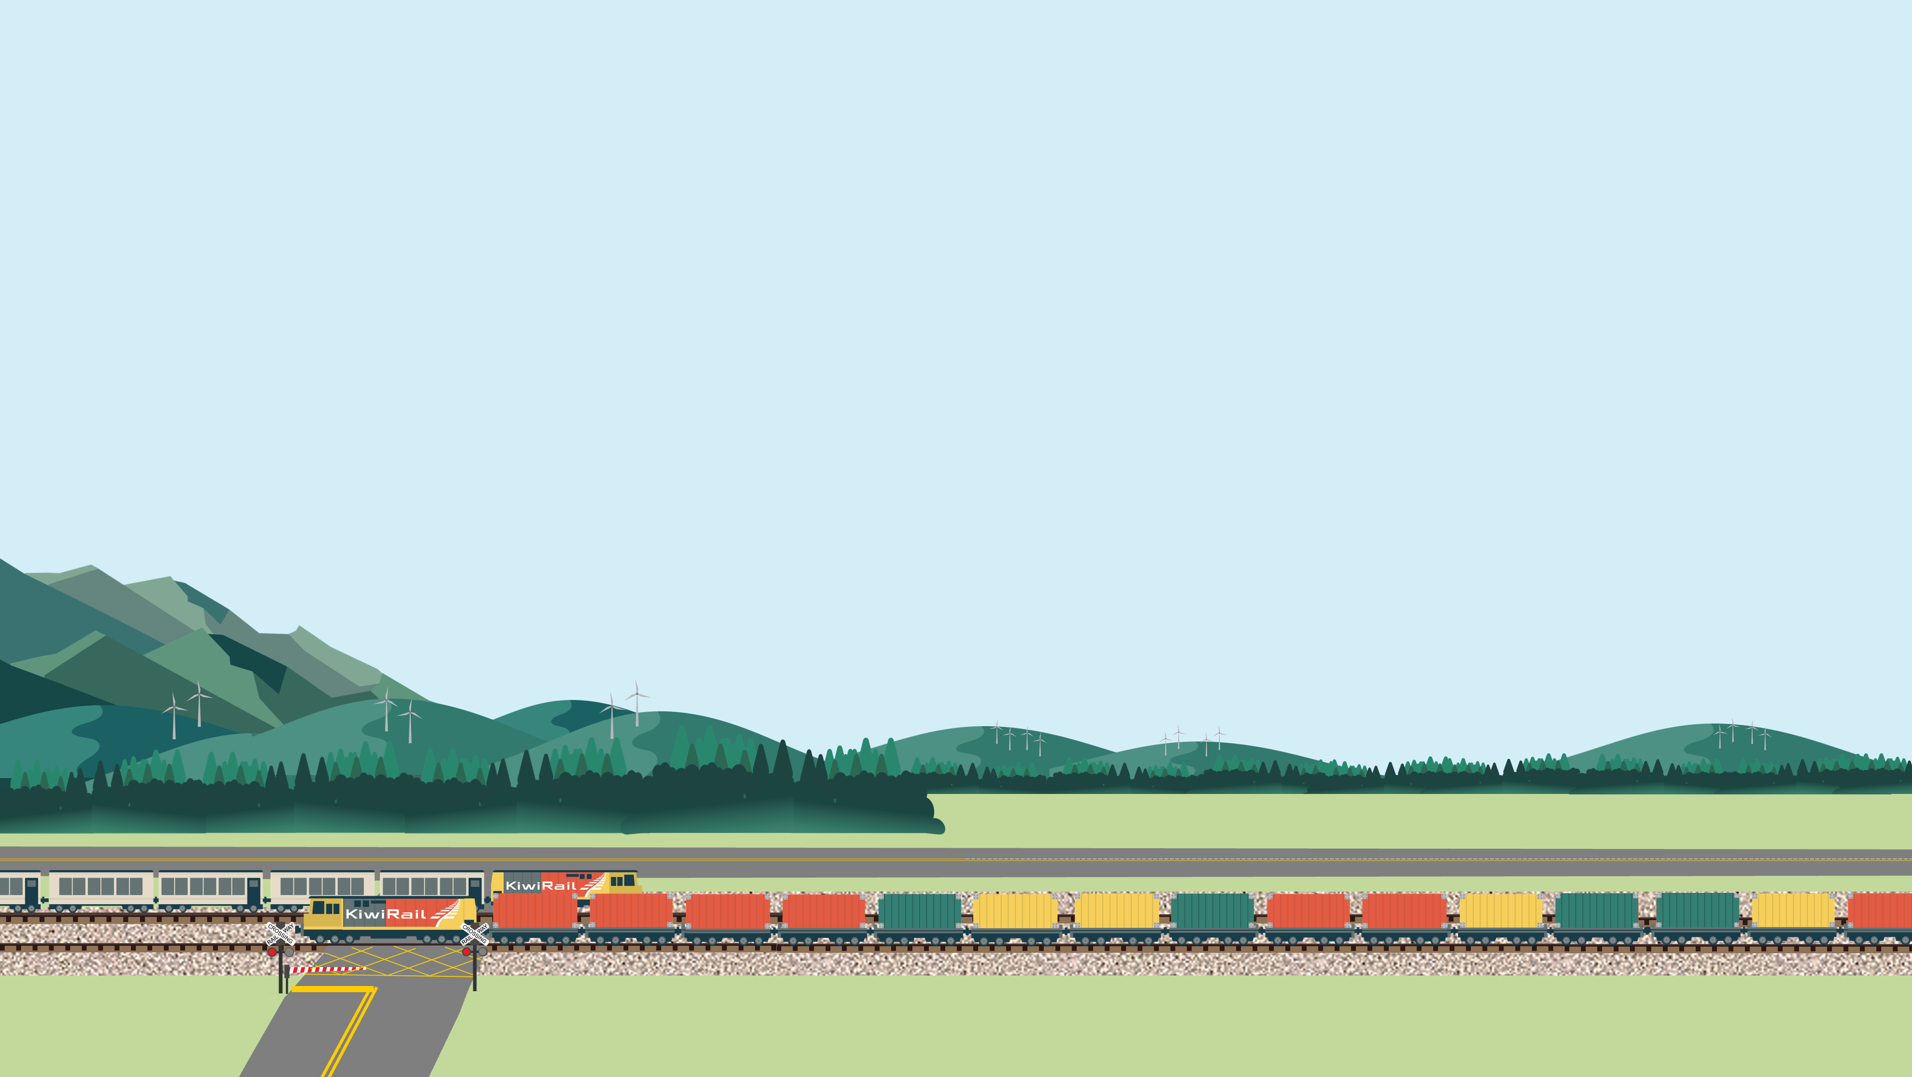
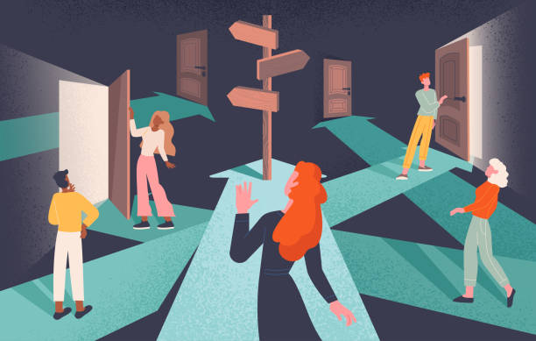
Want to see what could have happened if you had made different choices?
Want to learn more about the penalties for making unsafe decisions around railways and level crossings?
Go back to beginning
Learn more

Slide 31
You can be fined up to $1,000
if you...
You can be fined up to $10,000
if you…
Fail to comply with a stop or give-way sign at a level crossing.
You can be fined up to $20,000
if you...
Trespass on railway tracks, bridges or railway infrastructure.
Enter a level crossing when the red signal is displayed, or the barrier arm is lowered.
Fail to give way to a rail vehicle at a level crossing while driving.
Interfere with or damage a rail vehicle, container, property or infrastructure.
Enter a level crossing when the exit is blocked.
Walk along or cross tracks (not at a proper crossing.
Stop on a level crossing or near a level crossing to obscure other drivers’ view.
Walk across a level crossing and risk a collision with a rail vehicle.
Pass a vehicle stopped at a level crossing or within 60m of a crossing.
Learn more
Railways Act 2005 (Section 73, 92); Land Transport (Offences and Penalties) Regulations 1999 (Schedule 1)

Slide 32
KiwiRail’s emergency number is 0800 808 400
Use this number for level crossing emergencies and faults, blocked railway lines, damaged overhead wires, faulty alarms or barrier arms.
KiwiRail’s contact email is contactus@kiwirail.co.nz
Use this email to get in touch with our community engagement team.
Go back to beginning

Slide 33
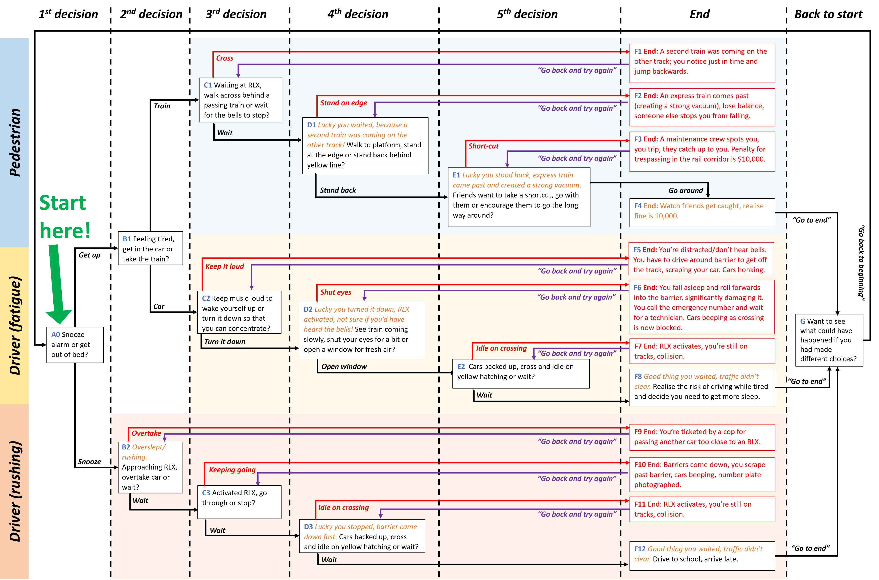
This decision tree map is for reference only.
Note, the box titles in this map (e.g., A0) match the notes section at the bottom of each decision/outcome slide.
The following three slides are templates you can use if you wish to adapt this decision tree or create your own one.

Slide 34
TEXT
Go back and try again
Notes:
Template slide – Negative consequence (near miss, collision, penalty etc.).
How to add the link to the go back and try again button:
Right click on go back and try again button.
Click ‘link’ or ‘hyperlink’ from the menu.
Click ‘place in this document’.
Select the slide number to link to.
Click ‘OK’.
Test the link in slideshow mode.

Slide 35
TEXT
Next
Notes:
Template slide – Avoided potential negative consequence (near miss, collision, penalty etc.).
How to add the link to the next button:
Right click on next button.
Click ‘link’ or ‘hyperlink’ from the menu.
Click ‘place in this document’.
Select the slide number to link to.
Click ‘OK’.
Test the link in slideshow mode.

Slide 36
Text
What do you do next?
Option A
Option B
A –
B –
Notes:
Template slide – Decision.
How to add the link to the choice buttons:
Right click on the choice button.
Click ‘link’ or ‘hyperlink’ from the menu.
Click ‘place in this document’.
Select the slide number to link to.
Click ‘OK’.
Test the link in slideshow mode.

