Slide 1
Notes:
Whakamotuhaketanga:
Tāpiritia te ingoa o te kura.
Whakakapia ki te pikitia o te tohu ā-kura.
Hei tohu kōrero:
“Kia ora tatou”
Customisation:
Add school name.
Replace picture with school logo.
Talking points:
“Kia ora tatou!” (hello everyone)

Slide 2
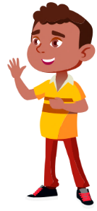
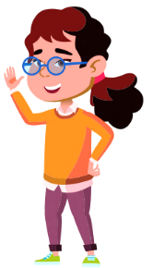
Kua toro mai mātou ki a koutou inā hoki…
Ko te Wiki Rerewhenua Haumaru
Notes:
Whakamotuhaketanga:
Tāpiritia ngā ingoa o ngā kaimahi.
Hei tohu kōrero:
“Ko ...., ko.... ō māua ingoa (for two people) / Ko..., ko..., ko... ō mātou ingoa (for 3 or more people), ā, he kaimahi mātou i KiwiRail”
“Kei konei māua/mātou nā te mea ko te Wiki Rerewhenua Haumaru tēnei, ā, kei te pīrangi mātou ki te kōrero mō te haere haumaru i ngā rerewhenua”
Customisation:
Add names of visiting staff.
Talking points:
“Our names are … and we work for KiwiRail.”
“We’re here because it is Rail Safety Week and we want to talk to you about staying safe around trains and train tracks.”

Slide 3
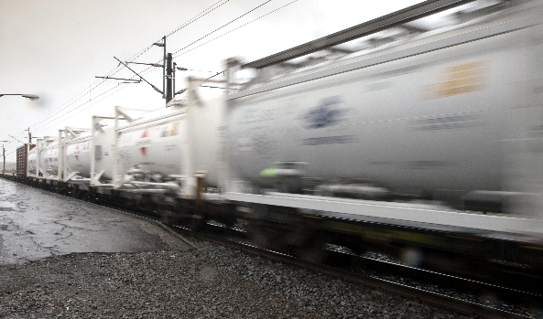
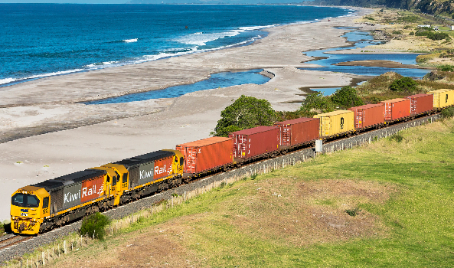
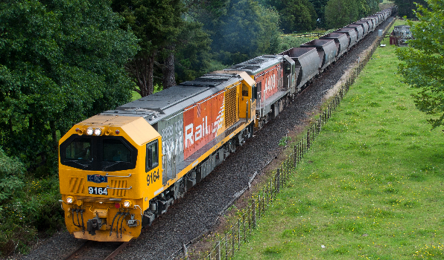
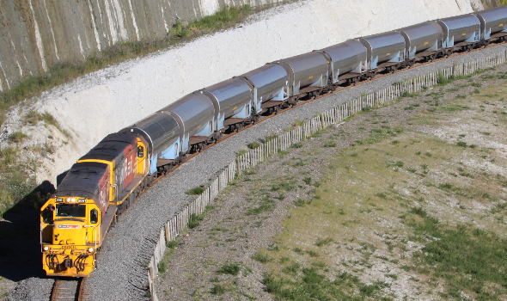
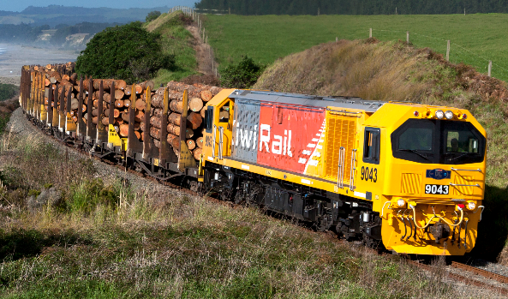
HAUREHU
HARINGA
WARO
MIRAKA
KŌPORO
Notes:
Whakamotuhaketanga:
Whakakapia ngā anga kōrero ki ngā ingoa e tika ana
whakakapia te pikitia kei te taha mauī ki tētahi whakaahua o tētahi whakawhitinga ara rerewhenua i te tirowhenua Kūkara
Whakakapia te pikitia kei te taha matau ki tētahi whakaahua o tētahi rerewhenua e kawe haringa nō te rohe ake (Kei waho atu o te mata ētahi whiringa whakaahua, kei te pito whakararo o te ata)
Hei tohu kōrero:
“Arā tētahi ara rerewhenua e pātata ana ki tō kura. Ko tāna, he kawe [tūmomo utanga] atu i [tūwāhi] ki [tūwāhi].” (hei tauira, ko tāna, he kawe kōporo atu i Te Tai Poutini ki Ōtautahi).
“Whakatūria tō ringa mehemea kei te mōhio koe ki te ara rerewhenua i te taha mauī. He ara whakawhiti e pātata ana ki tō kura hei whakamahi mā te waehīkoi, mā te kaieke paihikara, mā te motokā, mā te taraka anō hoki hei whakawhiti i ngā ara rerewhenua.”
Customisation:
Replace textbox with appropriate place names.
Replace left picture with screenshot of local RLX from google street view.
Replace right picture with image of a train carrying local freight type. (Some photo options are off screen to the bottom of the slide).
Talking points:
“There is a railway line quite close to your school. It transports [freight type] from [location] to [location].” (e.g., It transports coal from the West Coast to Christchurch).
“Put your hand up if you recognise the crossing on the left. It is a crossing close to your school that pedestrians, cyclists, cars, and trucks use to cross over the railway lines.”

Slide 4
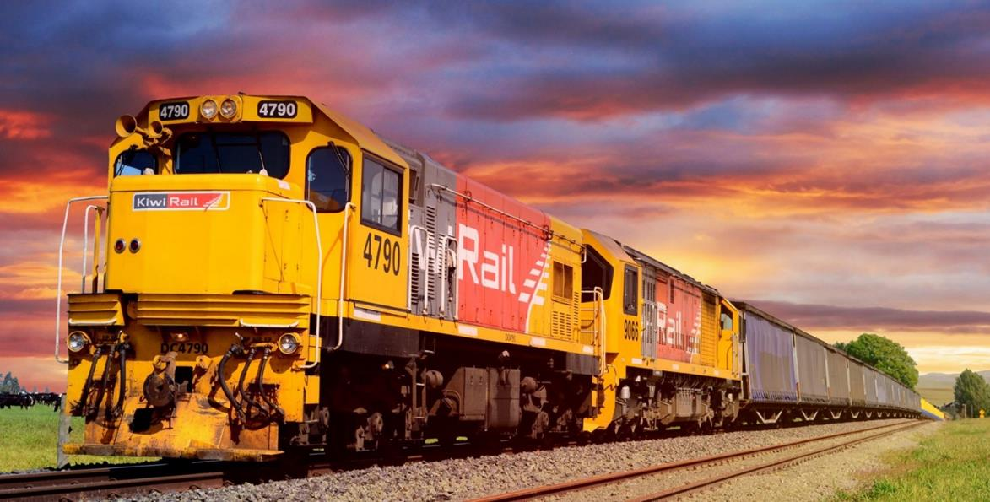
Notes:
Hei tohu kōrero:
“Koia nei tētahi o ā mātou pūkaha rerewhenua. Kei te mōhio rānei tētahi ki tōna tangi?”
[mā ngā tamariki te momo tangi e whakatauira]
“Ka whakatangihia e te kaihautū rerewhenua tana pūtangi hei whakamataara i te tangata ka ahu atu ana ki te ara whakawhiti. Ka kōhikotia hoki ōna rama.”
Talking points:
“This is one of our locomotive engines. Can anyone tell me what noise they make?”
[Kids make noises]
“Train drivers sound the horn to warn people when they are approaching a level crossing. They also flash their headlights.”

Slide 5
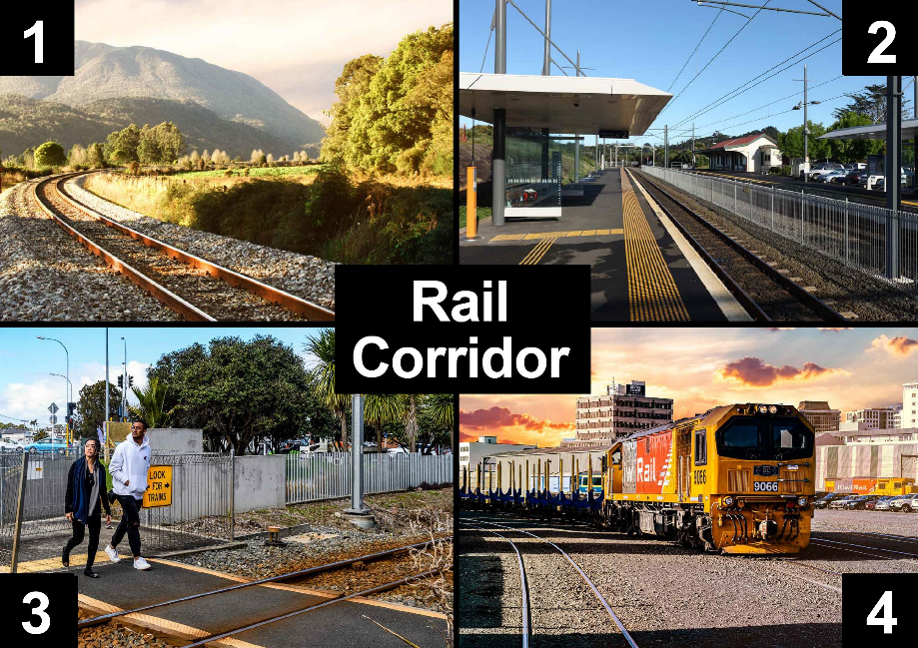
Te ara tauārai
Notes:
Hei tohu kōrero:
“E whai wāhi ana ki te ara tauārai ko te ara tonu, ko ngā taupuni, ko ngā whakawhiting me ngā takanga utanga. E whakaaetiea ana koe ki ngā ara tauārai mehemea kei tētahi whakawhitinga, kei tētahi taupuni rānei koe. Ko ērā atu wāhi kua rāhuitia. He haere poka noa, he takahi ture hoki.”
He tuhipoka:
Pikitia 1 he whakaatu i te ara tauārai Ko te tauārai te whenua e kapi ana te 5 mita i ia taha o te ara.
Pikitia 2 he whakaatu i te tauārai i tētahi taupuni E rua ngā ara e wāhia ana e tētahi taiapa.
Pikitia 3 he whakaatu i tētahi whitinga waehīkoi.
Pikitia 4 he whakaatu i tētahi takanga utanga.
Talking points:
“The rail corridor includes the tracks at train stations, level crossings, and our freight yards. You are only allowed to be near the rail corridor if you are at level crossings or at a train station. Anywhere else is out of bounds. It is trespassing and it is against the law to be there.”
Note:
Picture 1 shows the rail corridor. The corridor includes the area of land at least 5 metres on either side of the middle of the track.
Picture 2 shows the rail corridor at a train station. There are two sets of tracks separated by a fence.
Picture 3 shows a pedestrian level crossing.
Picture 4 shows a freight yard.

Slide 6
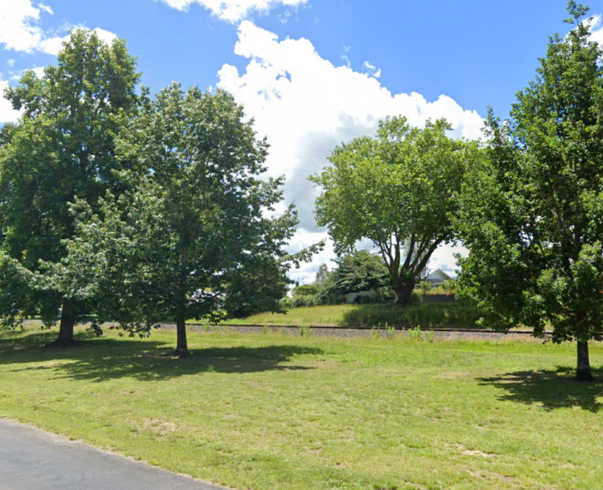
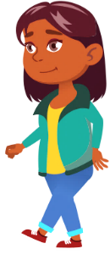
Flaticons by pikepicture
Kaua rawa atu e haere tata ki te ara.
Kia 5 mita (kia 10 ngā hīkoinga) tō tawhiti i te ara i ngā wā katoa.
Notes:
Hei tohu kōrero:
“Kaua rawa atu e haere tata ki te ara Kia 5 mita (kia 10 ngā hīkoinga) tō tawhiti i te ara i ngā wā katoa. Mā wai ahau e āwhina ki te whakaatu he pēhea nei te tawhiti o te 10 hīkoinga wae?”
[Kōwhiria tētahi ākonga. Takahia kia 10 ngā hīkoi, mā te toenga e tatau. He tuhipoka: Kei te āhua o te wāhi e wātea ana]
Talking points:
“Never walk near the tracks. You must be at least 5 metres, or ten big steps away from the tracks at all times. Who wants to help me show everyone how far away ten big steps is?”
[Choose student. Pace out ten big steps and have the rest of the students count along. Note: This will be dependent on the available space.]

Slide 7
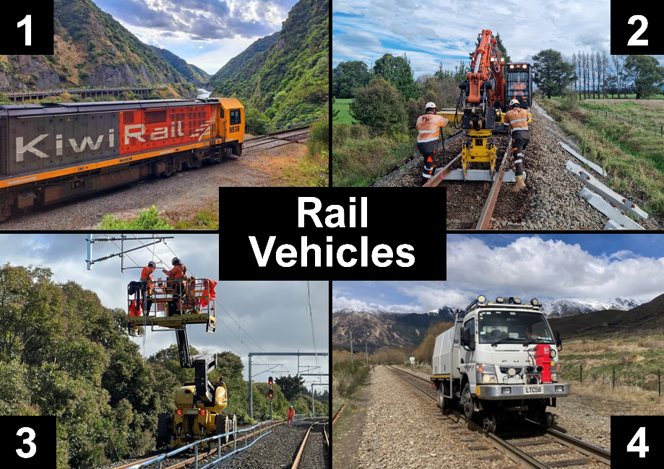
Ngā waka rerewhenua
Notes:
Hei tohu kōrero:
“Kua kite rānei koe i ēnei waka i ngā ara rerewhenua? Mehemea āe, whakatūria tō ringa.”
“Kāore pea ētahi o koutou i te mōhio, engari ehara i te mea o te rerewhenua anake ka haere i ngā ara. Arā ko ngā waka keri, ngā, waka hāpai, ngā taraka me ētahi atu tūmomo waka. Me tautuku koe ki ngā waka haere i ngā ara, kaua noa iho ko ngā rerewhenua. Me mataara koe ki ēnei momo waka katoa."
He tuhipoka:
Pikitia 1 he whakaatu i tētahi pūkaha rerewhenua.
Pikitia 2 he whakaatu i tētahi waka haukeri haere-rua e whatika kurupae ana.
Pikitia 3 he whakaatu i tētahi waka hāpai haere-rua e mahi ana i ngā ahohiko.
Pikitia 4 he whakaatu i tētahi taraka haere-rua.
Talking points:
“Have you seen any of these vehicles on the train tracks? If you have, put your hand up.”
“Some of you might not know that it is not just trains that run on the tracks. There are also diggers, aerial lifts, trucks, and lots of other types of vehicles that run on the tracks. You must always give way to all rail vehicles, not just trains. You must be careful around all of these vehicles.”
Note:
Picture 1 shows a locomotive engine.
Picture 2 shows a Hi-Rail excavator replacing sleepers.
Picture 3 shows a Hi-Rail aerial lift working on the overhead wires.
Picture 4 shows a Hi-Rail truck.

Slide 8
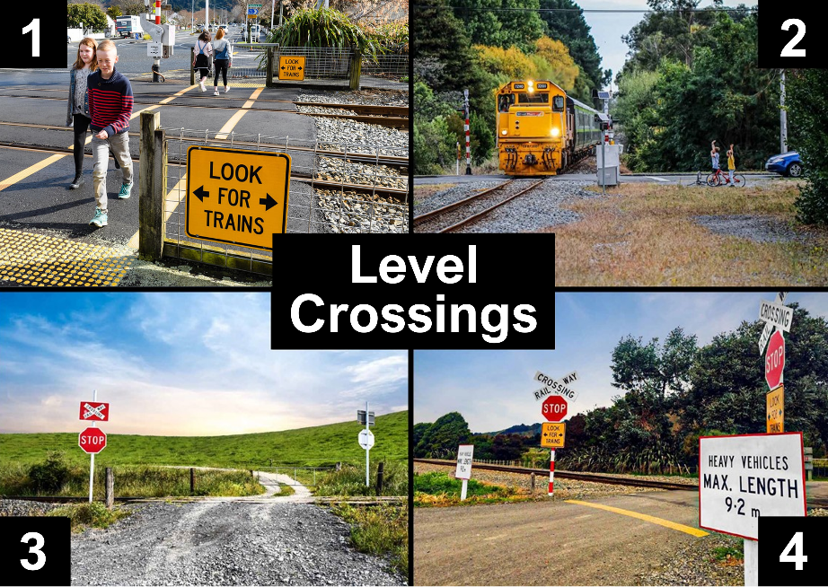
Ngā ara whakawhiti
Notes:
Hei tohu kōrero:
“Anei e kitea nei ētahi ara whakawhiti rerekē. Koia nei anake ngā wāhi r whakaaetia ai tō whakawhiti i ngā ara rerewhenua. He tūrama, he pere ō ētahi hei tohu i te ahunga mai o te rerewhenua. Kāore ō ētahi, he tohu TAUTŪ, tohu Tautuku kē. Mehemea e haere tahi ana koutou ko tō whānau, ko ō hoa rānei, me mātua tautū, ka titiro ai ki ngā taha e rua. Ka whakaaetia te whakawhiti mehemea ka kore ana he rerewhenua e kitea ana.”
He tuhipoka:
Pikitia 1 he whakaatu i tētahi whitinga waehīkoi. Me tautū ki muri tonu o te ripa kōwhai, ka titiro ai ki ngā taha e rua i mua i te whakawhitinga. E whakaaetia ana te whakawhiti mehemea kāore ngā tūrama me ngā pere e mahi ana.
Pikitia 2 he whakaatu i tētahi whitinga kei te tuawhenua whai tūrama, pere anake.
Pikitia 3 he whakaaku i tētahi whitinga kei runga papa tūmataiti, me te aha, e ai ki te ture me whai tohu e tika ana mō te nui o ngā waka haere.
Pikitia 4 he whakaatu i tētahi whitinga whai tohu rerewhenua, tohu Tautū, tohu 'Kia mataara ki ngā rerewhenua'. Ko tētahi tohu anō hei whakahere i ngā waka taumaha e roa atu ana i tētahi momo tautohunga.
Talking points:
“Here you can see different examples of level crossings. These are the only places where you are allowed to cross the train tracks. Some level crossings have lights and bells that tell you when a train is coming. Others do not have lights and bells, they only have STOP or Give Way signs. If you’re driving in the car with your parents/whanau they need to stop and look both ways. They must only drive across when there are no trains in sight.”
Note:
Picture 1 shows a pedestrian level crossing. You must stop behind the yellow line and look both ways before crossings. You can only cross if the lights and bells are not operating.
Picture 2 shows a rural level crossing with lights and bells only.
Picture 3 shows a crossing on private land which is required by law to have signage appropriate to the heaviness of the traffic flow.
Picture 4 shows a level crossing with a crossbuck, a Stop sign, and a ‘Look for trains’ sign. Another sign restricts heavy vehicles over a certain length.

Slide 9


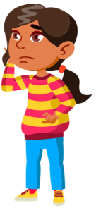
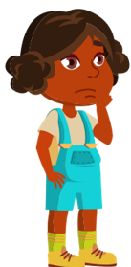
Flaticons by pikepicture
I te wā e whakawhiti ana i tētahi ara whakawhiti, me...
Whakarongo ki te ahunga mai o te rerewhenua
Whakaaro, e haumaru ana ki te whakawhiti?
Tautū ki muri atu o te ripa
Titiro ki ngā taha e rua
Notes:
Hei tohu kōrero:
“I te wā e whakawhiti ana i tētahi ara whakawhiti, me Tautū ki muri atu o te ripa Titiro ki ngā taha e rua Whakarongo ki te ahunga mai o te rerewhenua, ā Whakaaro, e haumaru ana ki te whakawhiti?”
Talking points:
“When crossing the train tracks at a railway level crossing, you must always STOP behind the line, LOOK both ways for trains, LISTEN for trains coming, and THINK, is it safe to cross?”

Slide 10
Flaticons by pikepicture
I te wā e whakawhiti ana i tētahi ara whakawhiti, me...
Whakarongo ki te ahunga mai o te rerewhenua
Whakaaro, e haumaru ana ki te whakawhiti?
Tautū ki muri atu o te ripa
Titiro ki ngā taha e rua
Me whakawhiti ka kore ana he rerewhenua e kitea ana!
Notes:
KAUA E ARO KI NGĀ INAKI - HE HĀKORI Ō TE ATA
Hei tohu kōrero:
“Me whakawhiti ka kore ana he rerewhenua e kitea ana.”
“Ka tirohia anō ēnei hātepe, i ngā ata e whai atu nei, e hiahia ana au kia karangahia e koutou te hātepe hei māu i te wā o te whakawhiti i te ara rerewhenua.”
IGNORE OVERLAP – SLIDE HAS ANIMATIONS
Talking points:
“You must only cross when there are no trains in sight!”
“Now we’re going to go over these steps again, for the next few slides I want you to call out the steps you must always follow when crossing.”

Slide 11
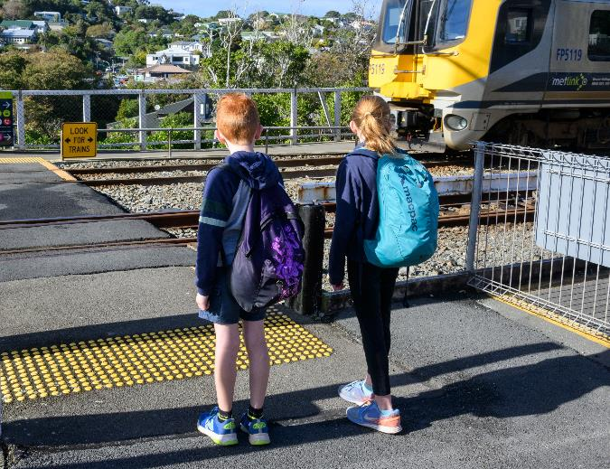

Flaticons by pikepicture
TAUTŪ
ki muri atu o te ripa
Notes:
Hei tohu kōrero:
“Tuatahi ake, me...”
[Ka karanga ake ngā tamariki "TAUTŪ"]
[Pāwhiria kia kitea ngā kupu.]
”Me tautū ki muri tonu o te ripa kōwhai.”
Talking points:
“First, you must…”
[Kids call out “STOP”]
[Click to show text.]
“Stop behind the line.”

Slide 12
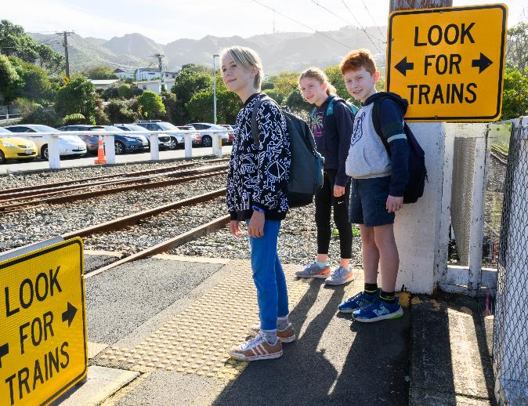

Flaticons by pikepicture
TITIRO
ki ngā taha
e rua
Notes:
Hei tohu kōrero:
“Kātahi, me…”
[Ka karanga ake ngā tamariki "TITITRO"]
[Pāwhiria kia kitea ngā kupu.]
“Titiro ki ngā taha e rua.”
Talking points:
“Then you must…”
[Kids call out “LOOK”]
[Click to show text.]
“Look both ways for trains.”

Slide 13
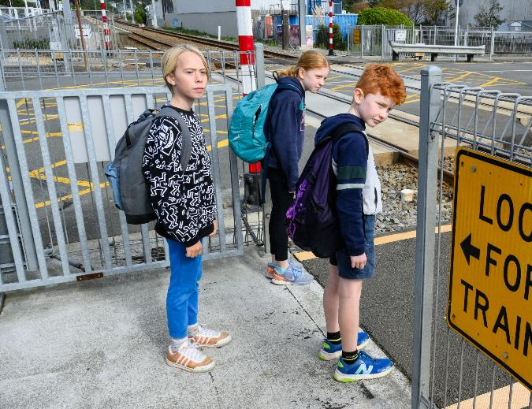
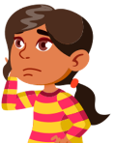
Flaticons by pikepicture
WHAKARONGO ki te ahunga mai o te rerewhenua
Notes:
Hei tohu kōrero:
“Kātahi, me…”
[Ka karanga ake ngā tamariki "WHAKARONGO"]
[Pāwhiria kia kitea ngā kupu]
“Whakarongo ki te ahunga mai o te rerewhenua. Ko ngā rerewhenua hineheu, whai hiko hoki kāore e tino hoihoi, ā, tērā ka tūpono noa kāore e rangona.”
Talking points:
“Then you must…”
[Kids call out “LISTEN”]
[Click to show text.]
“Listen for trains coming. Diesel and electric trains can both be very quiet and can sneak up on you without you hearing them.”

Slide 14
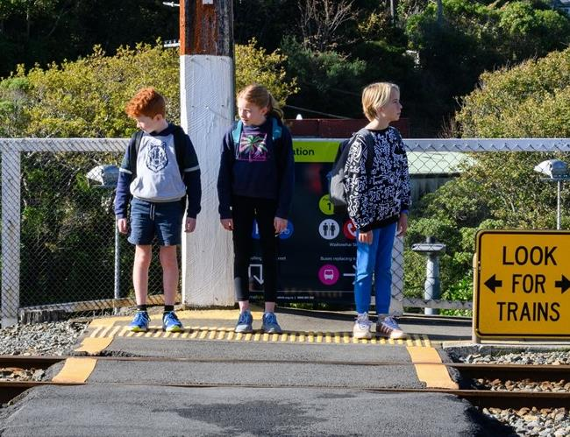
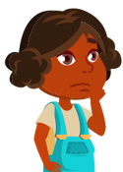
Flaticons by pikepicture
Whakaaro, e haumaru ana ki te whakawhiti?
Notes:
Hei tohu kōrero:
“Kātahi, me…”
[Ka karanga ake ngā tamariki "WHAKAARO"]
[Pāwhiria kia kitea ngā kupu]
“Whakaaro, e haumaru ana ki te whakawhiti?”
Talking points:
“Then you must…”
[Kids call out “THINK”]
[Click to show text.]
“Think, is it safe to cross?”

Slide 15
Ka whakawhiti mehemea...
Notes:
Hei tohu kōrero:
“I te mutunga iho, ka whawhiti mehemea...”
Talking points:
“Finally, you must ONLY cross…”

Slide 16
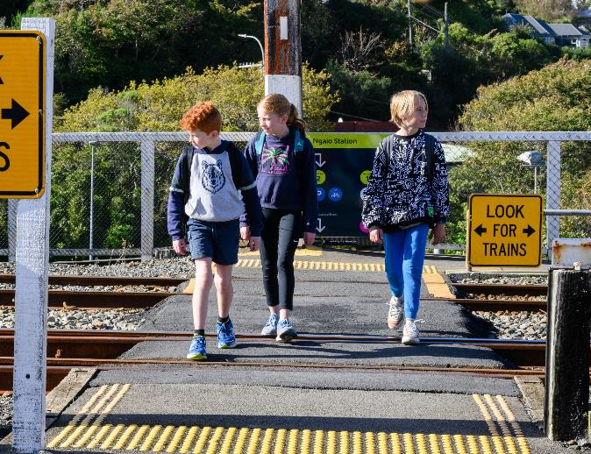
Ka whakawhiti mehemea...
kāore e kitea ana he rerewhenua!
Notes:
Hei tohu kōrero:
“…kāore e kitea ana he rerewhenua!”
Talking points:
“…when there are no trains in sight!”

Slide 17
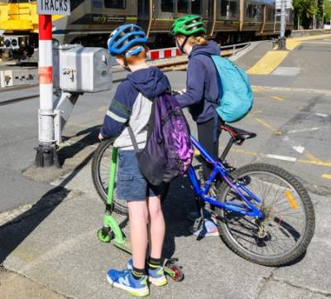
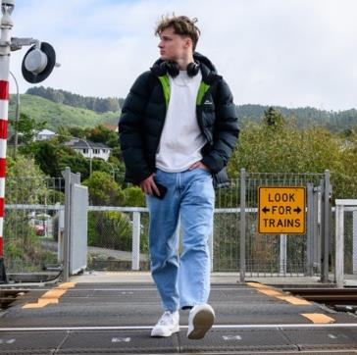
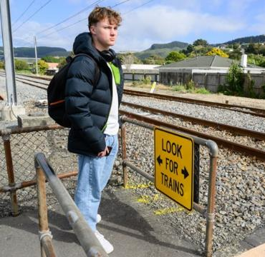
I te wā o te whakawhiti, me…
Heke koe i tō paihikara, i tō kuta rānei
Unuhia ō pokitaringa
Hoatu tō waea ki tō pūkoro
Notes:
Hei tohu kōrero:
"Arā ētahi atu āhuatanga e haumaru ai koe ka whakawhiti ana koe i te ara whitinga."
"Me heke koe i i tō paihikara, i tō kuta, i tō papareti rānei ka tōpanahia ai."
"Me unu koe i tō pokitaringa kia rongo ai koe i pere e tangi ana, i ngā rerewhenua e ahu mai ana."
"Me hoatu tō waea ki tō pūkoro kia kore ai koe e warea i a koe e whakawhiti ana i te ara."
Talking points:
“There are a few other things you to do to keep yourself safe when crossing the train tracks.”
“You must always get off your bike, scooter, or skateboard and push it across the crossing.”
“You must remove your headphones so that you can hear the bells ringing or any trains coming.”
“You must put your phone in your pocket so that you are not distracted when you are crossing.”

Slide 18
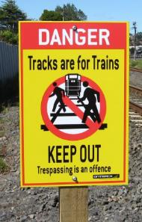
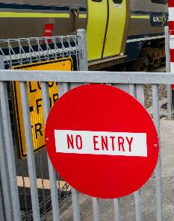
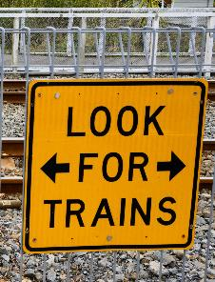
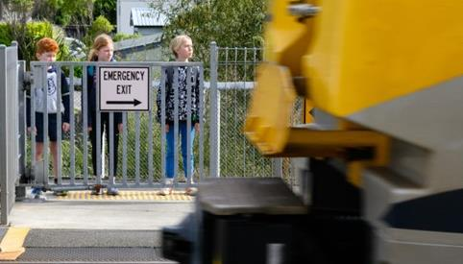
Ka whakawhiti ana koe, me...
Whai i ngā tohu katoa.
Matara ki te ahunga mai o te rerewhenua.
Āta whakawhiti i te ara whitinga.
Notes:
Hei tohu kōrero:
“Ka whakawhiti ana koe, me whai i ngā tohu katoa, matara ki te ahunga mai o te rerewhenua, āta whakawhiti i te ara whitinga.”
Talking points:
“When crossing, you must always obey the signs, expect trains from either direction at any time, and always be careful when you’re crossing.”

Slide 19
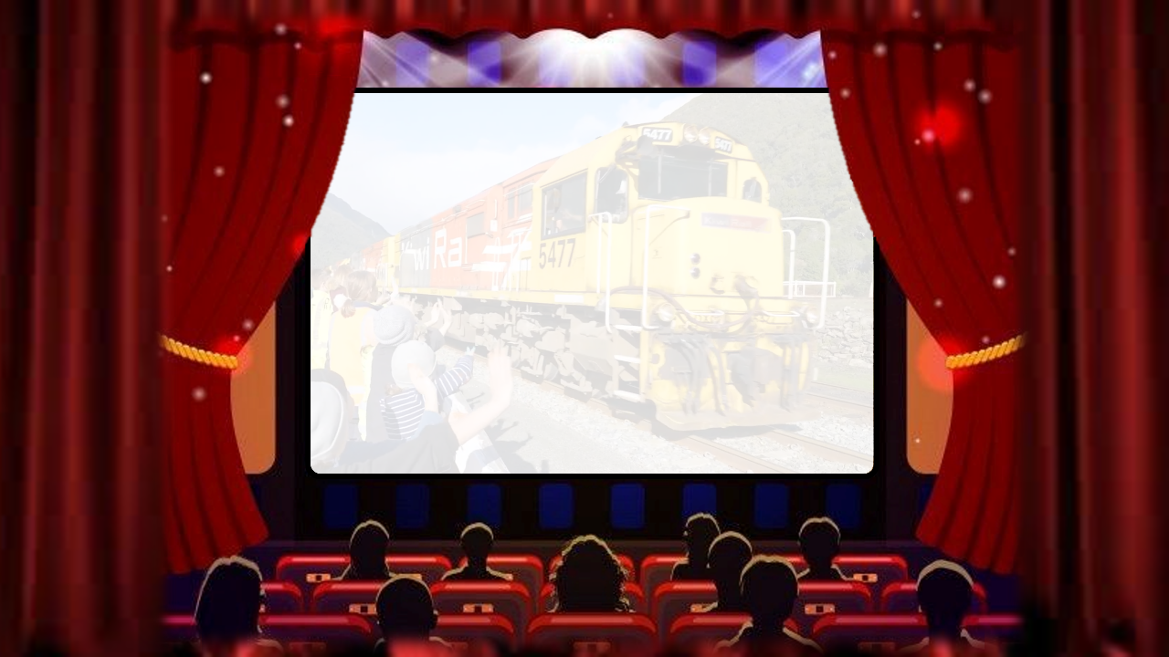



Notes:
Hei tohu kōrero:
“Inaianei ka matakitaki matou i tetahi ataata o etahi tamariki e korero ana mo te haumaru rerewhenua.”
Talking points:
“Now we will watch a video of some children talking about rail safety.”

Slide 20

Notes:
SLIDE WILL TRANSITION AUTOMATICALLY.

Slide 21
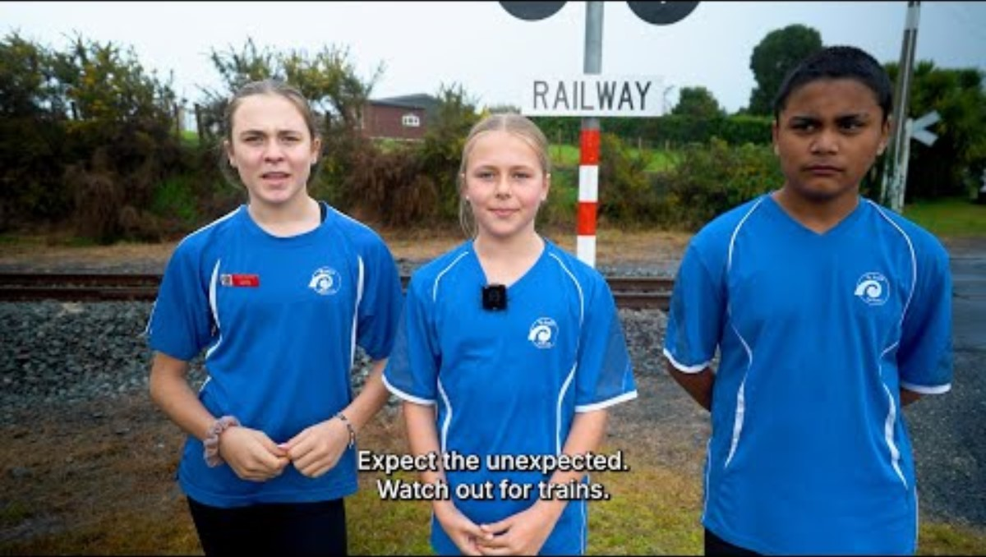

Notes:
VIDEO WILL PLAY AUTOMATICALLY.
Link to video ‘Expect the unexpected, watch out for trains’
https://www.youtube.com/watch?v=K4sN3I1A-V8

Slide 22
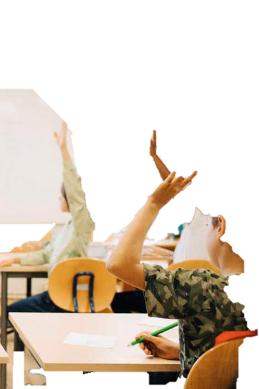
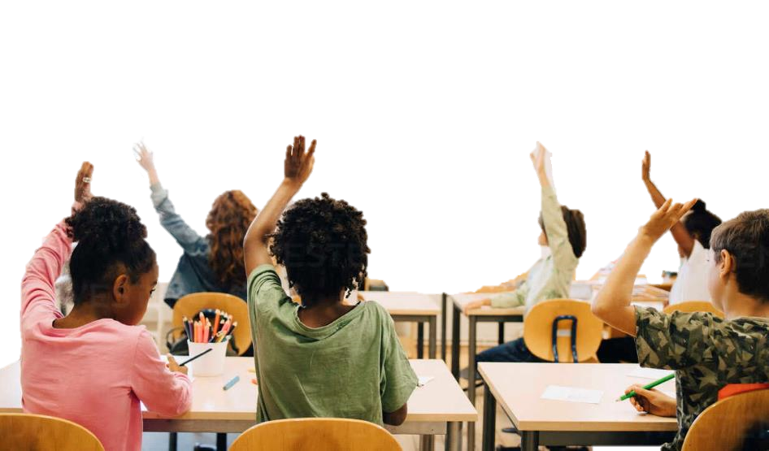
Kia whakamātauria koutou!
Notes:
Hei tohu kōrero:
“Kua eke te wā ki te whakamātautau i a koutou ki ngā akoranga kua mau i a koutou.”
Talking points:
“Now it’s time for a quiz to see what you’ve learned.”

Slide 23
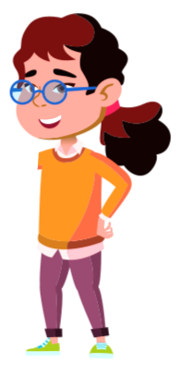

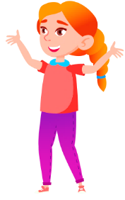

Flaticons by pikepicture
E rua, e toru pea ngā momo whakautu e taea ana.
Mehemea e whakapae ana koe ko te whakautu ko te…
1
kia mau ō ringa ki te HOPE!
2
kia tū ō ringa ki te RANGI!
3
kia hoatu ō ringa ki tō UPOKO!
Notes:
Hei tohu kōrero:
“E rua, e toru pea ngā momo whakautu e taea ana. Mehemea e whakapae ana koe ko te whakautu ko te...”
“Tahi, kia mau ō ringa ki te HOPE!”
“Rua, kia tū ō ringa ki te RANGI!”
“Toru, kia hoatu ō ringa ki tō UPOKO!”
Talking points:
“The questions have two or three possible answers. If you think the answer is…”
“1, put your hands on your hips!”
“2, put your hands in the air!”
“3, put your hands on your head!”

Slide 24
Mehemea e whakapae ana koe ko te whakautu ko te...
1 – kia mau ō ringa ki te HOPE!
2 – kia tū ō ringa ki te RANGI!
3 – kia hoatu ō ringa ki tō UPOKO!
Pātai 1
Ko ēhea o ēnei e tika ana mō te taha ara rerewhenua?
1. Ko te tākaro taonga pēnei i te pōro, i te kuta me te papareti
2. Kia 10 hīkoinga te tawhiti atu i te ara i ngā wā katoa
3. Ko te karawhiu i te puoro, te whakarongo rānei ki ō pokitaringa
Notes:
Hei tohu kōrero:
Pātai 1, Ko ēhea o ēnei e tika ana mō te taha ara rerewhenua?
Ko te tākaro taonga pēnei i te pōro, i te kuta me te papareti
Kia 10 hīkoinga te tawhiti atu i te ara i ngā wā katoa
Ko te karawhiu i te puoro, te whakarongo rānei ki ō pokitaringa
"Mehemea e whakapae ana koe, ko tahi te whakautu, kia mau ō ringa ki te hope!’”
"Mehemea e whakapae ana koe, ko rua te whakautu, kia tū ō ringa ki te rangi!"
"Mehemea e whakapae ana koe, ko toru te whakautu, kia hoatu ō ringa ki te upoko!"
Talking points:
“Question 1, Which of these is safe to do around train tracks?”
Play with toys like balls, scooters, and skateboards
Stay 10 big steps away from the tracks at all times
Play music out loud or listen through your headphones
“If you think the answer is 1, put your hands on your hips!”
“If you think the answer is 2, put your hands in the air!”
“If you think the answer is 3, put your hands on your head!”

Slide 25
Anei te whakautu...
Notes:
Hei tohu kōrero:
“Anei te whakautu...”
Talking points:
“The answer is…”

Slide 26
Pātai 1
Ko ēhea o ēnei e tika ana mō te taha ara rerewhenua?
1. Ko te tākaro taonga pēnei i te pōro, i te kuta me te papareti
2. Kia 10 hīkoinga te tawhiti atu i te ara i ngā wā katoa ✓✓✓
3. Ko te karawhiu i te puoro, te whakarongo rānei ki ō pokitaringa
Notes:
Hei tohu kōrero:
“2, Kia 10 hīkoinga te tawhiti atu i te ara i ngā wā katoa.”
Talking points:
“2, Stay 10 big steps away from the tracks at all times.”

Slide 27
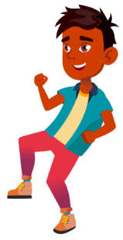
Flaticons by pikepicture
Mehemea e whakapae ana koe ko te whakautu ko te...
1 – kia mau ō ringa ki te HOPE!
2 – kia tū ō ringa ki te RANGI!
Pātai 2
E haumaru ana te tākaro, te hīkoi haere i te taha o te ara rerewhenua:
1. Kei te tika
2. Kāore i te tika
Notes:
Hei tohu kōrero:
“Pātai 2, E haumaru ana te tākaro, te hīkoi haere i te taha o te ara rerewhenua.”
“Mehemea e whakapae ana koe e Tika ana, kia mau ō ringa ki ō hope.”
“Mehemea e whakapae ana koe e Hē ana, kia tū ō ringa ki te rangi.”
Talking points:
“Question 2, It is safe to play on and walk along railway tracks, true or false?”
“If you think the answer is True, put your hands on your hips.”
“If you think the answer is False, put your hands in the air.”

Slide 28
Anei te whakautu...
Notes:
Hei tohu kōrero:
“Anei te whakautu...”
Talking points:
“The answer is…”

Slide 29
Flaticons by pikepicture
Pātai 2
E haumaru ana te tākaro, te hīkoi haere i te taha o te ara rerewhenua:
1. Kei te tika
2. Kāore i te tika ✓✓✓
Notes:
Hei tohu kōrero:
“KEI TE HĒ! He mōrearea rawa atu te tākaro, te hīkoi rānei i te taha ara rerewhenua. He takahi hoki i te ture.”
Talking points:
“FALSE! It is very unsafe to play on or walk along the railway tracks. It is also against the law.”

Slide 30

Flaticons by pikepicture
Mehemea e whakapae ana koe ko te whakautu ko te...
1 – kia ū ō ringa ki te RANGI!
Pātai 3
Me aha koe ki te kitea tētahi e tākamau ō ringa ki te HOPE!
2 – kia tro haere ana i te taha ara rerewhenua?
1. Me tākaro tahi ki a rātou.
2. Me kotahi atu ki te whākī ki tētahi pakeke
Notes:
Hei tohu kōrero:
“Pātai 3, Me aha koe ki te kitea tētahi e tākaro haere ana i te taha ara rerewhenua?
Me tākaro tahi ki a rātou.
Me kotahi atu ki te whākī ki tētahi pakeke
"Mehemea e whakapae ana koe, ko tahi te whakautu, kia mau ō ringa ki te hope!’”
"Mehemea e whakapae ana koe, ko rua te whakautu, kia tū ō ringa ki te rangi!"
Talking points:
“Question 3, What should you do if you see someone playing on the railway tracks?”
Join in with them and start playing together
Tell an adult straight away
“If you think the answer is 1, put your hands on your hips.”
“If you think the answer is 2, put your hands in the air.”

Slide 31
Anei te whakautu...
Notes:
Hei tohu kōrero:
“Anei te whakautu...”
Talking points:
“The answer is…”

Slide 32

Flaticons by pikepicture
Pātai 3
Me aha koe ki te kitea tētahi e tākaro haere ana i te taha ara rerewhenua?
1. Me tākaro tahi ki a rātou.
2. Me kotahi atu ki te whākī ki tētahi pakeke ✓✓✓
Notes:
Hei tohu kōrero:
"2, Me kotahi atu ki te whākī atu ki tētahi pakeke. He mātua pea, he kaiako pea, he mema tūmatanui tānei. Kaua rawa atu e piri atu ki te tangata e tākaro haere ana i te taha o te ara rerewhenua."
Talking points:
“2, tell an adult straight away. This could be a parent, teacher, or a member of the public. Never join in with anyone that is playing near the railway tracks.”

Slide 33
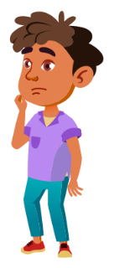
Flaticons by pikepicture
Mehemea e whakapae ana koe ko te whakautu ko te...
1 – kia mau ō ringa ki te HOPE!
2 – kia tū ō ringa ki te RANGI!
Pātai 4
Ki hea whakaaetia ai tō whakawhiti i te ara rerewhenua?
Ki tētahi ara whakawhiti, whai ripa kōwhai, whai tohu rerewhenua
Kei a koe te tikanga, ki tētahi wāhi kāore he rerewhenua e ahu mai ana
Notes:
Hei tohu kōrero:
“Pātai 4, Ki hea whakaaetia ai tō whakawhiti i te ara rerewhenua?”
Ki tētahi ara whakawhiti, whai ripa kōwhai, whai tohu rerewhenua
Kei a koe te tikanga, ki tētahi wāhi kāore he rerewhenua e ahu mai ana
"Mehemea e whakapae ana koe, ko tahi te whakautu, kia mau ō ringa ki te hope!’”
"Mehemea e whakapae ana koe, ko rua te whakautu, kia tū ō ringa ki te rangi!"
Talking points:
“Question 4, Where are you allowed to cross a railway track?”
At a formed crossing with a footpath, yellow lines, and railway signs
Anywhere that you want to cross as long as there are no trains coming
“If you think the answer is 1, put your hands on your hips.”
“If you think the answer is 2, put your hands in the air.”

Slide 34
Anei te whakautu...
Notes:
Hei tohu kōrero:
“Anei te whakautu...”
Talking points:
“The answer is…”

Slide 35
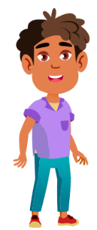
Flaticons by pikepicture
Pātai 4
Ki hea whakaaetia ai tō whakawhiti i te ara rerewhenua?
Ki tētahi ara whakawhiti, whai ripa kōwhai, whai tohu rerewhenua ✓✓✓
Kei a koe te tikanga, ki tētahi wāhi kāore he rerewhenua e ahu mai ana
Notes:
Hei tohu kōrero:
“1, Ki tētahi ara whakawhiti, whai ripa kōwhai, whai tohu rerewhenua. Ko te whakawhiti ki wāhi kē, he tino mōrearea. He haere poka noa, he takahi hoki i te ture.”
Talking points:
“1, At a formed crossing with a footpath, yellow lines, and railway signs. Crossing anywhere else is very dangerous. It is trespassing and it is against the law.”

Slide 36

Flaticons by pikepicture
Mehemea e whakapae ana koe ko te whakautu ko te...
1 – kia mau ō ringa ki te HOPE!
2 – kia tū ō ringa ki te RANGI!
3 – kia hoatu ō ringa ki tō UPOKO!
Pātai 5
He aha hei mahi māu, i a koe e whakawhiti ana i te ara rerewhenua?
Kia tere te whakawhiti atu i mua i te haerenga mai o te rerewhenua
Kia whakawhiti i te ara i te wā e kā ana ngā tūrama, e tangi ana hoki ngā pere
Tautū, titiro ki ngā taha e rua me te whakarongo kia kitea kāore he rerewhenua e ahu mai ana
Notes:
Hei tohu kōrero:
“Pātai 5, He aha hei mahi māu, i a koe e whakawhiti ana i te ara rerewhenua?”
Kia tere te whakawhiti atu i mua i te haerenga mai o te rerewhenua
Kia whakawhiti i te ara i te wā e kā ana ngā tūrama, e tangi ana hoki ngā pere
Tautū, titiro ki ngā taha e rua me te whakarongo kia kitea kāore he rerewhenua e ahu mai ana.
"Mehemea e whakapae ana koe, ko tahi te whakautu, kia mau ō ringa ki te hope!’”
"Mehemea e whakapae ana koe, ko rua te whakautu, kia tū ō ringa ki te rangi!"
"Mehemea e whakapae ana koe, ko toru te whakautu, kia hoatu ō ringa ki te upoko!"
Talking points:
“Question 5, which of these should you do when crossing a railway track?”
Run across as fast as you can to beat any trains coming
Cross when the lights are flashing or the bells are ringing
Stop, look both ways and listen to make sure there are no trains coming
“If you think the answer is 1, put your hands on your hips.”
“If you think the answer is 2, put your hands in the air.”
“If you think the answer is 3, put your hands on your head.”

Slide 37
Anei te whakautu...
Notes:
Hei tohu kōrero:
“Anei te whakautu...”
Talking points:
“The answer is…”

Slide 38
Flaticons by pikepicture
Pātai 5
He aha hei mahi māu, i a koe e whakawhiti ana i te ara rerewhenua?
Kia tere te whakawhiti atu i mua i te haerenga mai o te rerewhenua
Kia whakawhiti i te ara i te wā e kā ana ngā tūrama, e tangi ana hoki ngā pere
Tautū, titiro ki ngā taha e rua me te whakarongo kia kitea kāore he rerewhenua e ahu mai ana ✓✓✓
Notes:
Hei tohu kōrero:
“3. Tautū, titiro ki ngā taha e rua me te whakarongo kia kitea kāore he rerewhenua e ahu mai ana.”
Talking points:
“3, Stop, look both ways and listen to make sure there are no trains coming.”

Slide 39




Mehemea e whakapae ana koe ko te whakautu ko te...
1 – kia mau ō ringa ki te HOPE!
2 – kia tū ō ringa ki te RANGI!
Pātai 6
Ka ahu mai i te rerewhenua i ngā wāhi katoa, i ngā wā katoa:
1. Kei te tika
2. Kāore i te tika
Notes:
Hei tohu kōrero:
“Pātai 6, Ka ahu mai i te rerewhenua i ngā wāhi katoa, i ngā wā katoa.”
Kei te tika
Kāore i te tika
“Mehemea e whakapae ana koe e Tika ana, kia mau ō ringa ki ō hope.”
“Mehemea e whakapae ana koe e Hē ana, kia tū ō ringa ki te rangi.”
Talking points:
“Question 6, Trains can come from any direction at any time:, true or false?”
“If you think the answer is True, put your hands on your hips.”
“If you think the answer is False, put your hands in the air.”

Slide 40
Anei te whakautu...
Notes:
Hei tohu kōrero:
“Anei te whakautu...”
Talking points:
“The answer is…”

Slide 41
Pātai 6
Ka ahu mai i te rerewhenua i ngā wāhi katoa, i ngā wā katoa:
1. Kei te tika ✓✓✓
2. Kāore i te tika
Notes:
Hei tohu kōrero:
“Kei te tika! Ehara i te mea ka mau te rerewhenua ki te wātaka, nō reira kia tūtakarerewa kei ahu mai i ngā wāhi katoa, ahakoa te wā. Ehara hoki i te mea he pērā hoki ētahi atu o ngā waka haere i te ara rerewhenua.”
Talking points:
“True! Trains do not always run to schedule, so you should expect them from either direction at any time. Other rail vehicles do not run on any schedules.”

Slide 42
Mehemea e whakapae ana koe ko te whakautu ko te...
1 – kia mau ō ringa ki te HOPE!
2 – kia tū ō ringa ki te RANGI!
Pātai 7
I te ohorere, ka taea e te tereina te mutu tere.
1. Kei te tika
2. Kāore i te tika
Notes:
Hei tohu kōrero:
“Pātai 7, I te ohorere, ka taea e te tereina te mutu tere”
“Mehemea e whakapae ana koe e Tika ana, kia mau ō ringa ki ō hope.”
“Mehemea e whakapae ana koe e Hē ana, kia tū ō ringa ki te rangi.”
Talking points:
“Question 7, In an emergency, trains can stop quickly, true or false?”
“If you think the answer is True, put your hands on your hips.”
“If you think the answer is False, put your hands in the air.”

Slide 43
Anei te whakautu...
Notes:
Hei tohu kōrero:
“Anei te whakautu...”
Talking points:
“The answer is…”

Slide 44
Pātai 7
I te ohorere, ka taea e te tereina te mutu tere.
1. Kei te tika
2. Kāore i te tika ✓✓✓
Notes:
Hei tohu kōrero:
“Kāore i te tika! Ka tere tonu te rerewhenua 1000 mita te tawhiti i mua i tana tūnga, neke atu i te kotahi mēneti (60 hēkona) te roa kia pērāhia”
Talking points:
“False! Trains can keep going for up to 1000 metres before they come to a complete stop, this can take over a minute (60 seconds).”

Slide 45




Ko koutou hei Tuahangata Whakahaumaru Ara!
Ko te Wiki Rerewhenua Haumaru
Notes:
Hei tohu kōrero:
“Ka mau kē te wehi!”
“Ko koutou hei Tuahangata Whakahaumaru Ara!”
Talking points:
“Good job everyone!”
“You are all Rail Safety champions!”

Slide 46
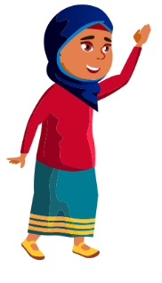

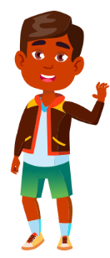


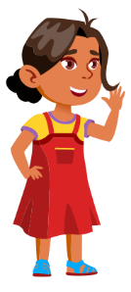


He pātai?
Notes:
Hei tohu kōrero:
“He pātai?”
Talking points:
“Any questions?”

