Slide 1
Notes:
Customisation:
Add school name.
Replace picture with school logo.
Talking points:
“Kia ora koutou!” (hello everyone)

Slide 2
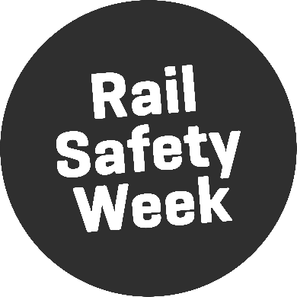
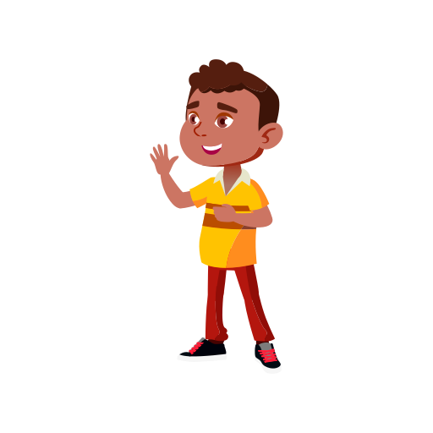
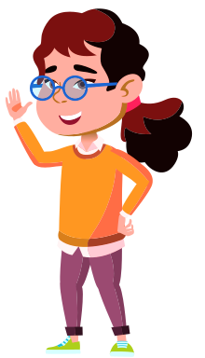
We are visiting your school because it is…
Notes:
Customisation:
Add names of visiting staff.
Talking points:
“Our names are … and we work for KiwiRail.”
“We’re here because it is Rail Safety Week and we want to talk to you about staying safe around trains and train tracks.”

Slide 3
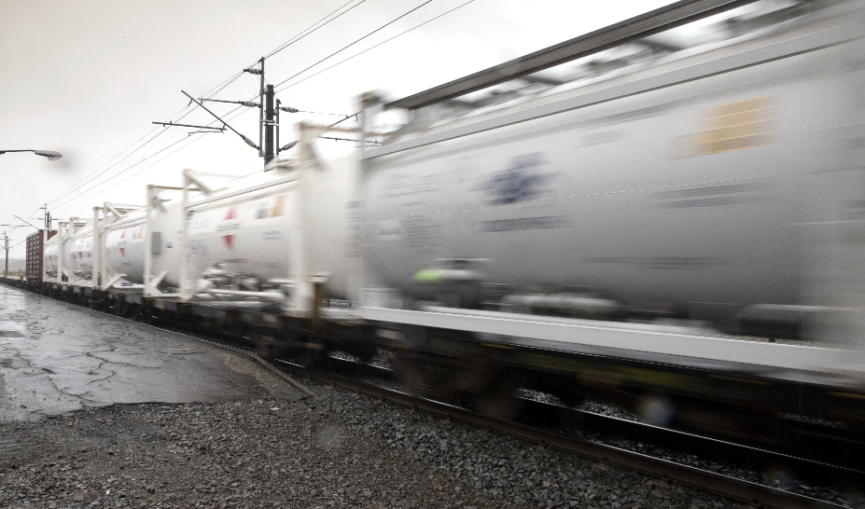
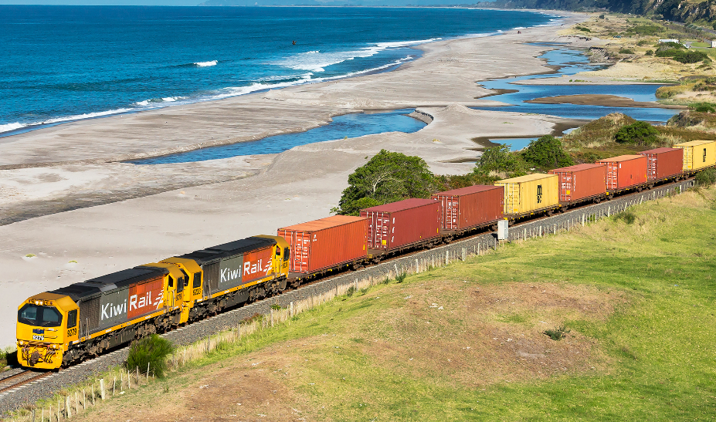
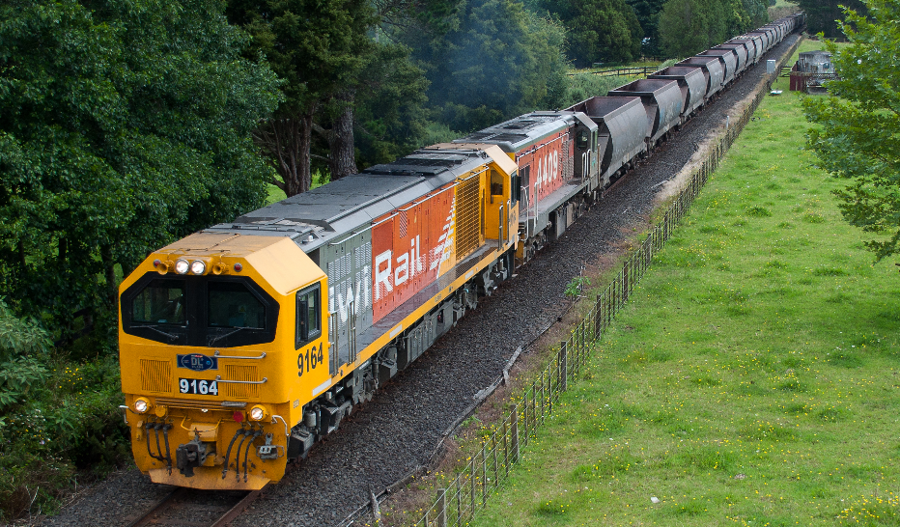
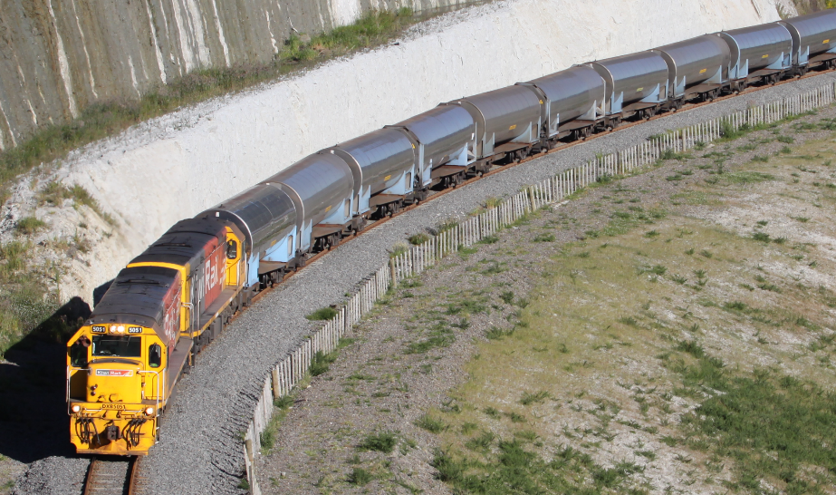
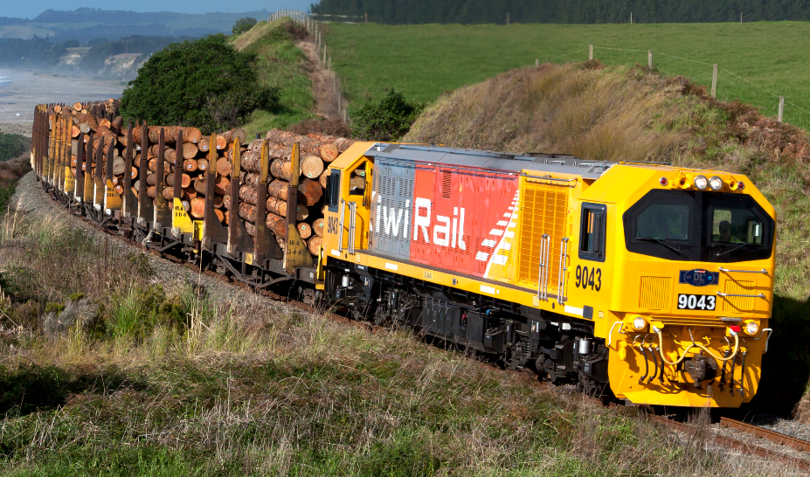
GAS
FREIGHT
COAL
MILK
LOGS
Notes:
Customisation:
Replace textbox with appropriate place names.
Replace left picture with screenshot of local RLX from google street view.
Replace right picture with image of a train carrying local freight type. (Some photo options are off screen to the bottom of the slide).
Talking points:
“There is a railway line quite close to your school. It transports [freight type] from [location] to [location].” (e.g., It transports coal from the West Coast to Christchurch).
“Put your hand up if you recognise the crossing on the left. It is a crossing close to your school that pedestrians, cyclists, cars, and trucks use to cross over the railway lines.”

Slide 4
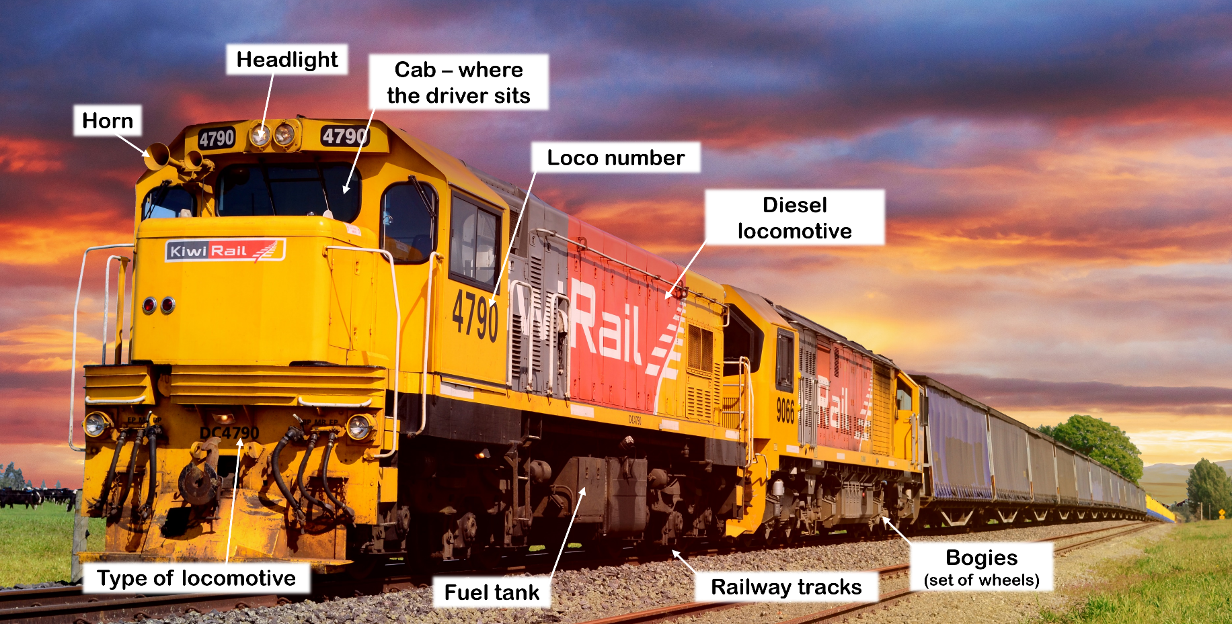
Notes:
Talking points:
“This is one of our locomotive engines. Can anyone tell me what noise they make?”
[Kids make noises]
“Train drivers sound the horn to warn people when they are approaching a level crossing. They also flash their headlights.”

Slide 5
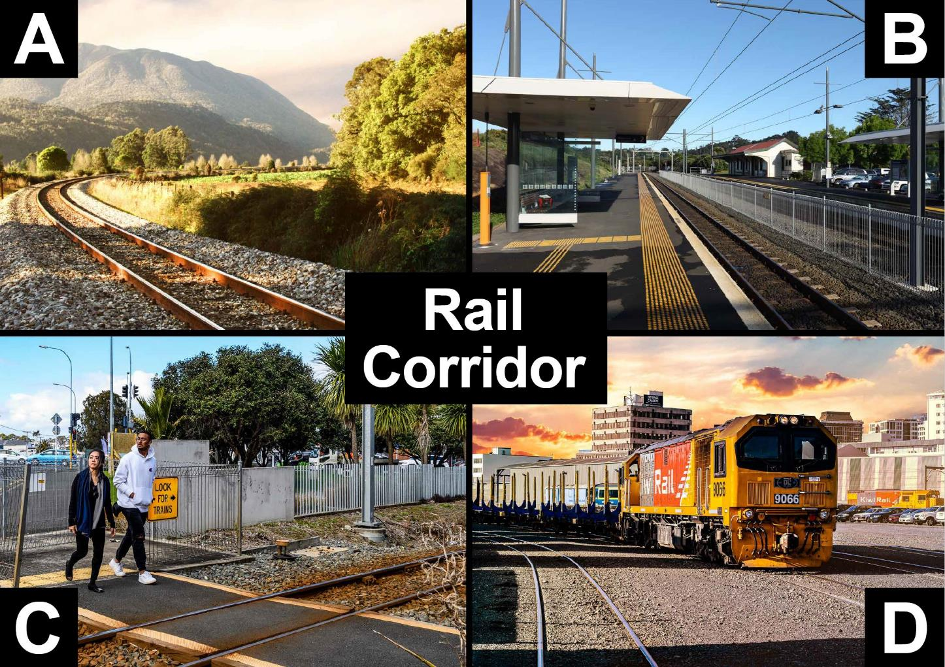
Notes:
Talking points:
“The rail corridor includes the tracks at train stations, level crossings, and our freight yards. You are only allowed to be near the rail corridor if you are at level crossings or at a train station. Anywhere else is out of bounds. It is trespassing and it is against the law to be there.”
Note:
Picture A shows the rail corridor. The corridor includes the area of land at least 5 metres on either side of the middle of the track.
Picture B shows the rail corridor with two sets of tracks separated by a fence.
Picture C shows a level crossing which is also part of the rail corridor. This is a legal place where pedestrians and traffic can cross the rail corridor provided the warning bells, lights and barrier arms are not operating.
Picture D shows a freight yard. The whole freight yard is part of the rail corridor and is out of bounds.

Slide 6
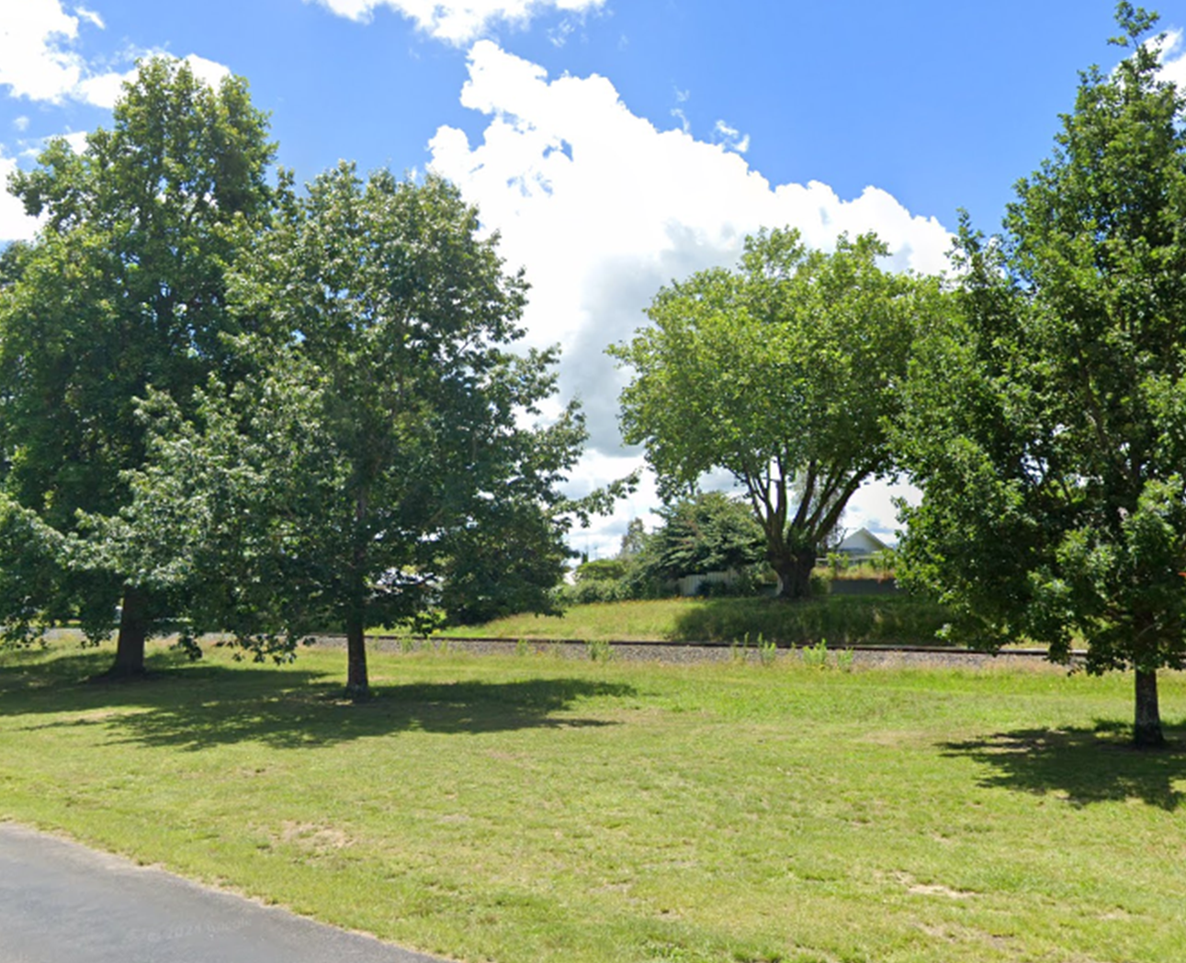
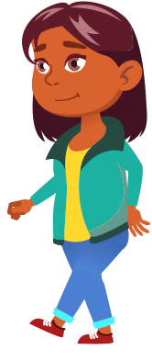







Flaticons by pikepicture
Never walk near the track.
You must be
at least
5 metres
(10 big steps) away from
the track
at all times.
Notes:
Talking points:
“Never walk near the tracks. You must be at least 5 metres, or ten big steps away from the tracks at all times. Who wants to help me show everyone how far away ten big steps is?”
[Choose student. Pace out ten big steps and have the rest of the students count along. Note: This will be dependent on the available space.]

Slide 7
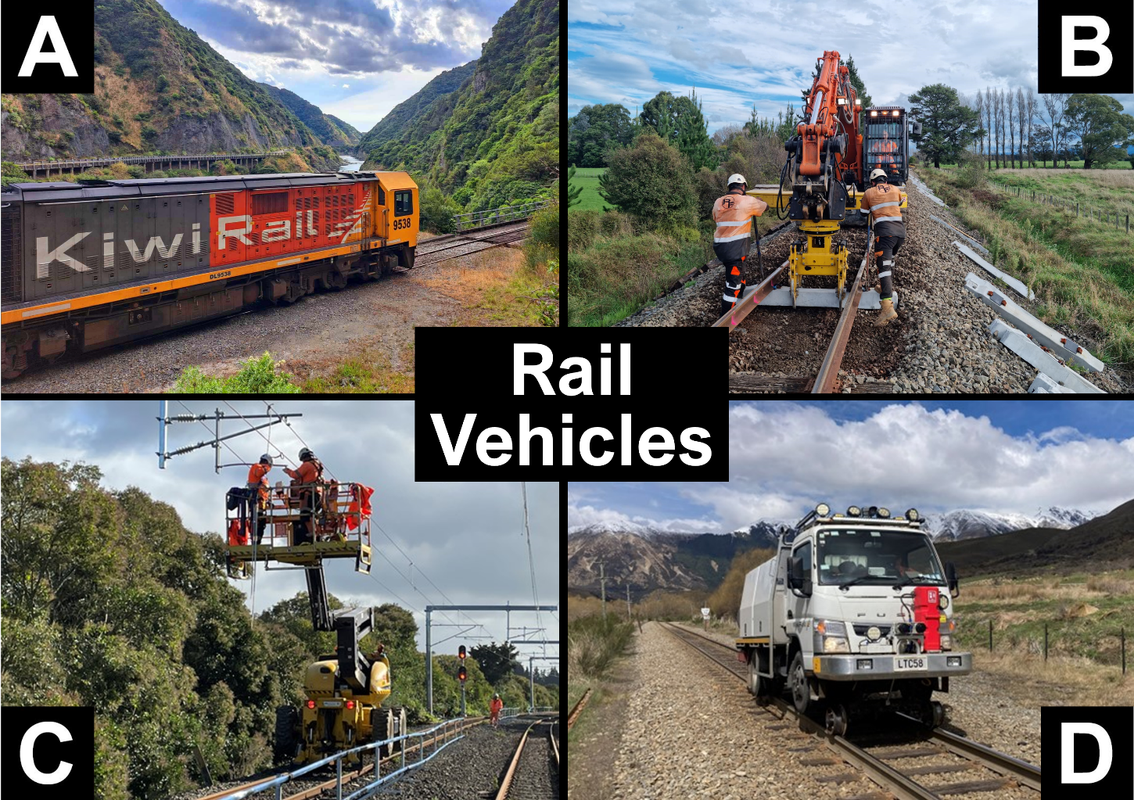
Notes:
Talking points:
“Have you seen any of these vehicles on the train tracks? If you have, put your hand up.”
“Some of you might not know that it is not just trains that run on the tracks. There are also diggers, cherry-pickers, trucks, and lots of other types of vehicles that run on the tracks. You must always give way to all rail vehicles, not just trains. You must be careful around all of these vehicles.”
Note:
Picture A shows a locomotive engine
Picture B shows a Hi-Rail excavator replacing sleepers.
Picture C shows a Hi-Rail cherry-picker working on the overhead wires.
Picture D shows a Hi-Rail truck.

Slide 8
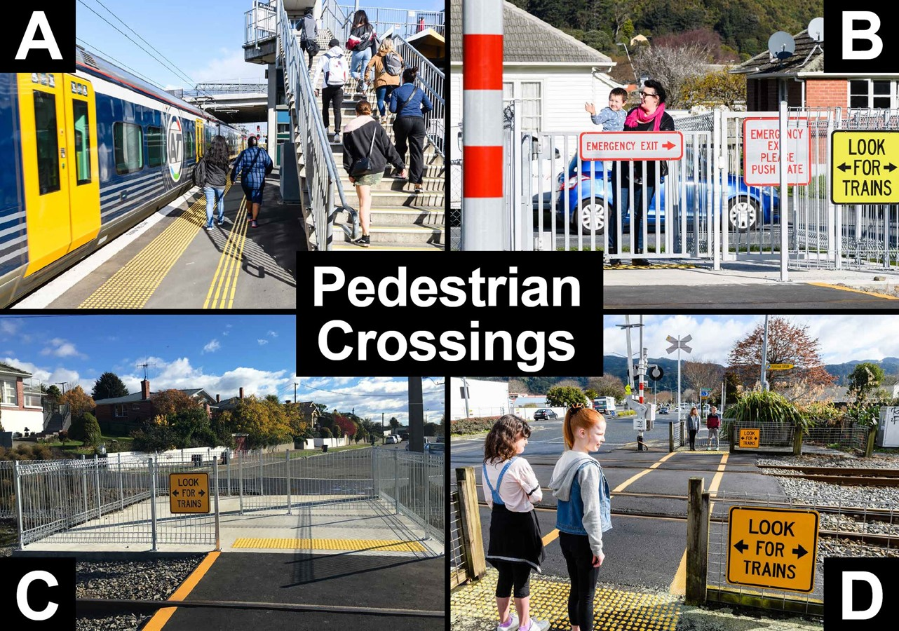
Notes:
Talking points:
“Here are some pedestrian-only level crossings. In picture A you can see a bridge that pedestrians can use to cross on top the tracks. The other pictures show crossings where you walk directly across the tracks. Some of them have automatic gates that shut when a train is coming. Others do not have gates, so you must always check for trains before crossing. It is unsafe and it is against the law to cross anywhere other than a level crossing.”
Note:
Picture A shows a pedestrian bridge. People use these to cross safely above railway tracks.
Picture B shows a pedestrian crossing with automatic gates. Flashing lights and bells activate, and gates close when a train is approaching. An emergency gate can be used if the gates start closing while someone has already started crossing.
Picture C shows a pedestrian crossing with a maze. A zigzag path with railings and warning signs before and after the railway tracks. The zigzag helps a pedestrian to look left and right before crossing.
Picture D shows a pedestrian crossing with flashing lights and bells and barrier arms on the road. The pedestrians wait behind the yellow line. Before crossing they need to wait for the alarms to stop and check that no trains are coming.

Slide 9
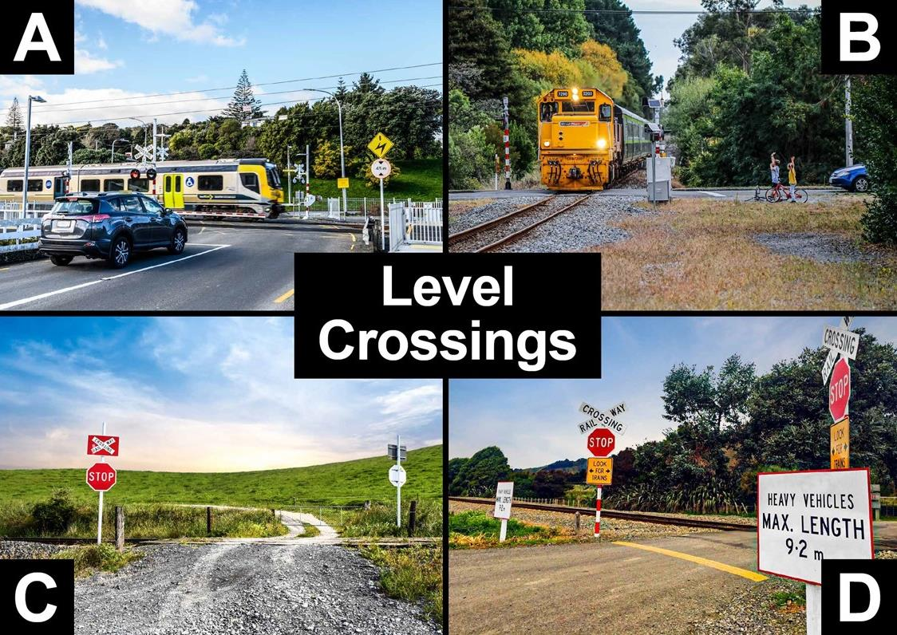
Notes:
Talking points:
“Here you can see different examples of level crossings. These are the only places where you are allowed to cross the train tracks. Some level crossings have lights and bells that tell you when a train is coming. Others do not have lights and bells, they only have STOP or Give Way signs. If you’re driving in the car with your parents/whanau they need to stop and look both ways. They must only drive across when there are no trains in sight.”
Note:
Picture A shows an urban level crossing with barrier arms, lights, and bells.
Picture B shows a rural level crossing with lights and bells only.
Picture C shows a crossing on private land which is required by law to have signage appropriate to the heaviness of the traffic flow.
Picture D shows a level crossing with a crossbuck, a Stop sign, and a ‘Look for trains’ sign. Another sign restricts heavy vehicles over a certain length.

Slide 10
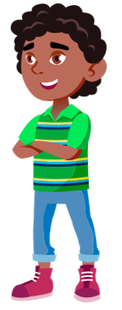

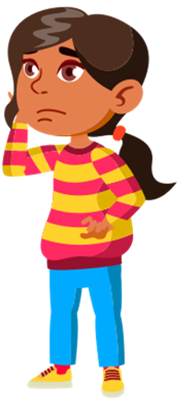
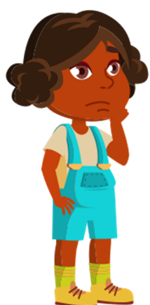
Flaticons by pikepicture
When crossing at a railway level crossing, always…
STOP behind
the line
LOOK
both ways for trains
LISTEN
for trains coming
THINK,
is it safe
to cross?
Notes:
Talking points:
“When crossing the train tracks at a railway level crossing, you must always STOP behind the line, LOOK both ways for trains, LISTEN for trains coming, and THINK, is it safe to cross?”

Slide 11
Flaticons by pikepicture
When crossing at a railway level crossing, always…
STOP behind
the line
LOOK
both ways for trains
LISTEN
for trains coming
THINK,
is it safe
to cross?
Only cross when there are no trains in sight!
Notes:
IGNORE OVERLAP – SLIDE HAS ANIMATIONS
Talking points:
“You must only cross when there are no trains in sight!”
“Now we’re going to go over these steps again, for the next few slides I want you to call out the steps you must always follow when crossing.”

Slide 12
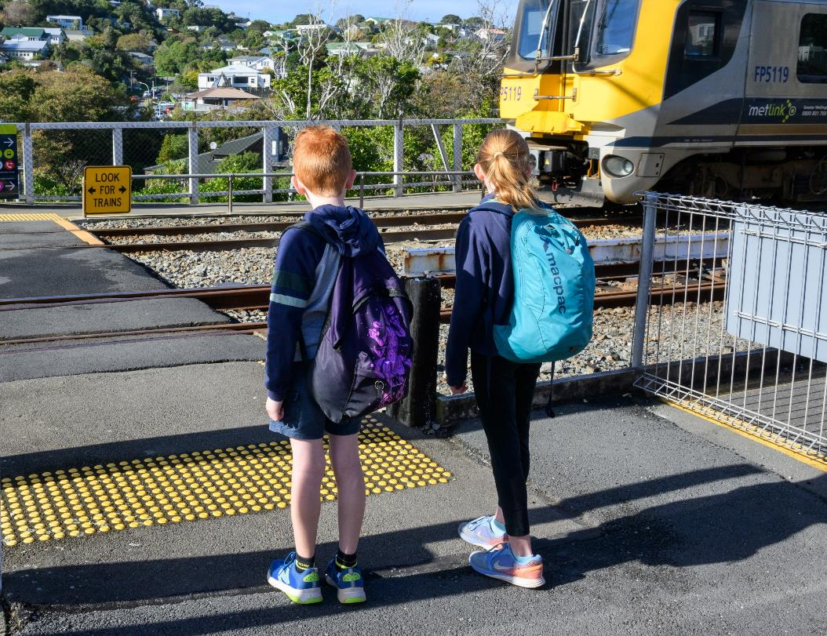

Flaticons by pikepicture
STOP
behind
the line
Notes:
Talking points:
“First, you must…”
[Kids call out “STOP”]
[Click to show text.]
“Stop behind the line.”

Slide 13
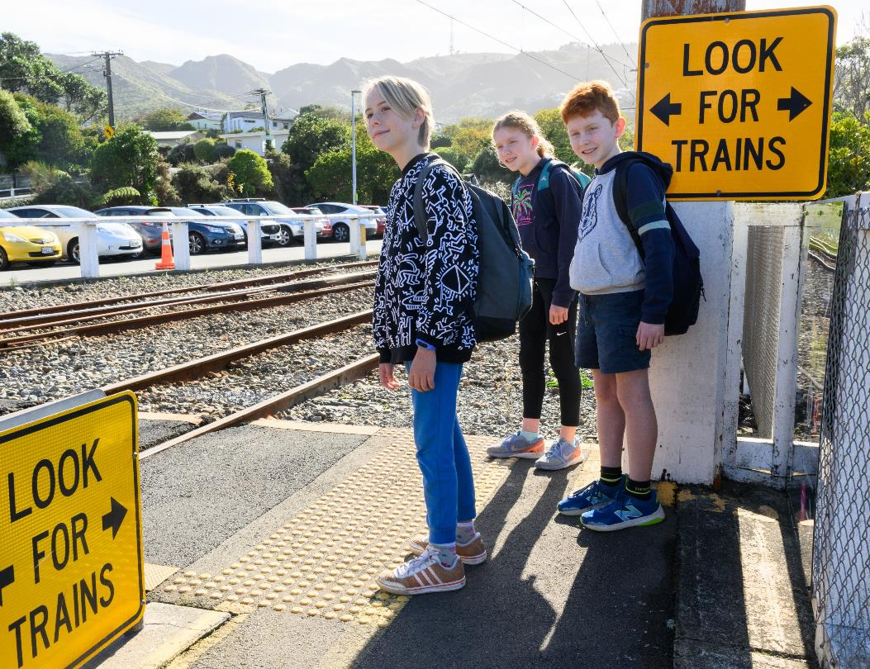

Flaticons by pikepicture
LOOK
both ways
for trains
Notes:
Talking points:
“Then you must…”
[Kids call out “LOOK”]
[Click to show text.]
“Look both ways for trains.”

Slide 14
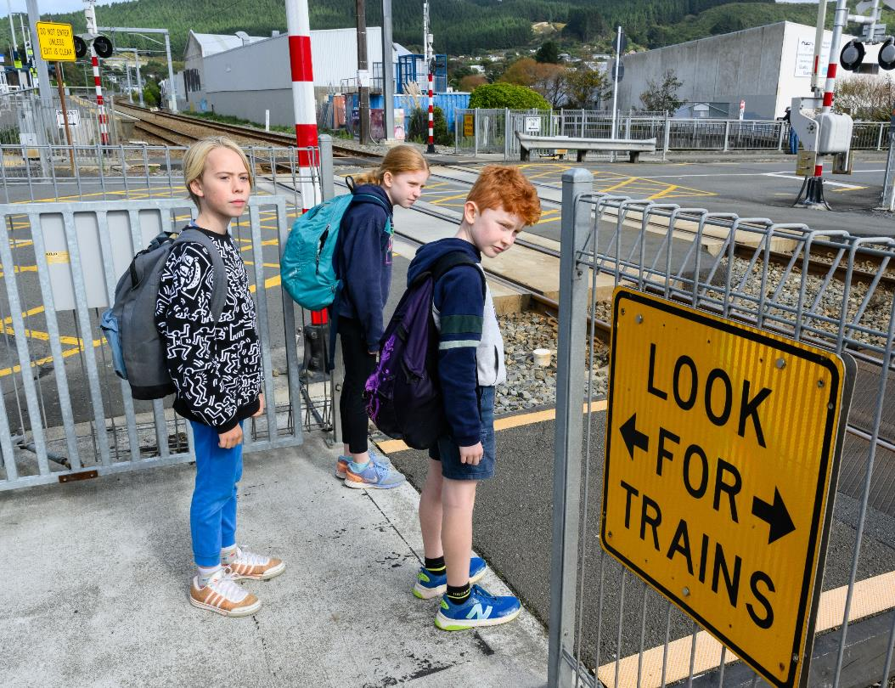
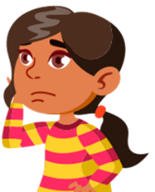
Flaticons by pikepicture
LISTEN
for trains coming
Notes:
Talking points:
“Then you must…”
[Kids call out “LISTEN”]
[Click to show text.]
“Listen for trains coming. Diesel and electric trains can both be very quiet and can sneak up on you without you hearing them.”

Slide 15
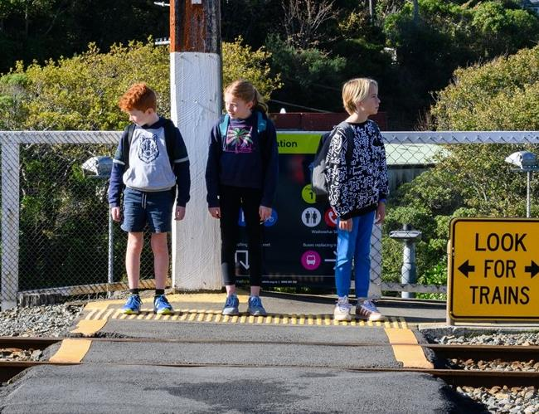
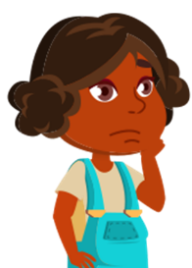
Flaticons by pikepicture
THINK,
is it safe to cross?
Notes:
Talking points:
“Then you must…”
[Kids call out “THINK”]
[Click to show text.]
“Think, is it safe to cross?”

Slide 16
Only cross…
Notes:
Talking points:
“Finally, you must ONLY cross…”

Slide 17
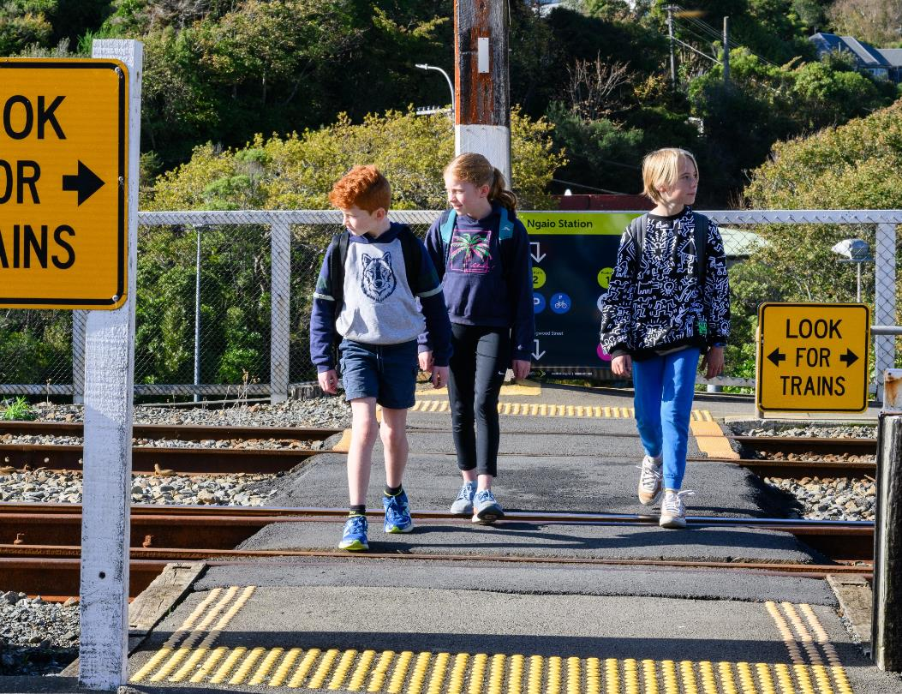
Only cross… when there are no trains in sight!
Notes:
Talking points:
“…when there are no trains in sight!”

Slide 18
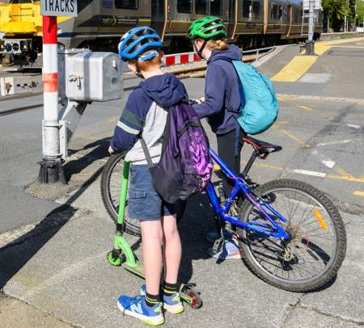
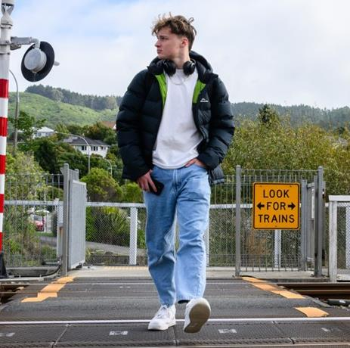
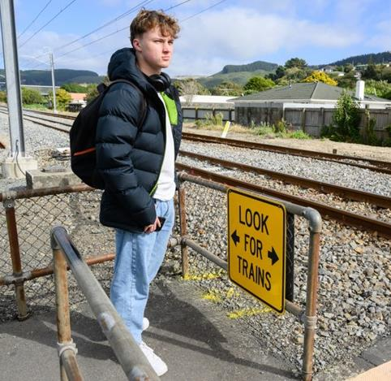
When crossing, you must always…
Get off and walk your bicycle/scooter
Remove your
headphones
Put your phone in your pocket
Notes:
Talking points:
“There are a few other things you to do to keep yourself safe when crossing the train tracks.”
“You must always get off your bike, scooter, or skateboard and push it across the crossing.”
“You must remove your headphones so that you can hear the bells ringing or any trains coming.”
“You must put your phone in your pocket so that you are not distracted when you are crossing.”

Slide 19
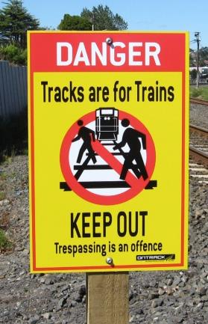
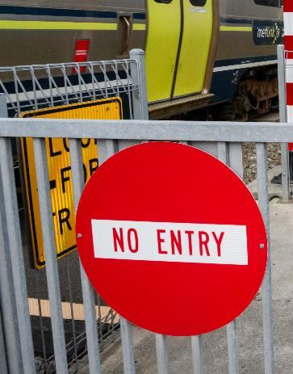
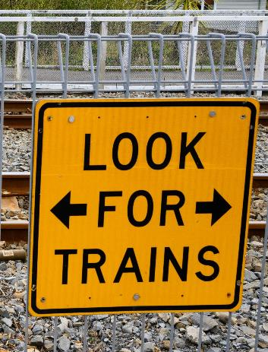
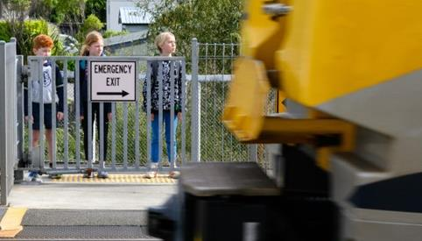
When crossing, you must always…
Obey all signs and signals.
Expect trains from either direction.
Cross with care at level crossings.
Notes:
Talking points:
“When crossing, you must always obey the signs, expect trains from either direction at any time, and always be careful when you’re crossing.”

Slide 20
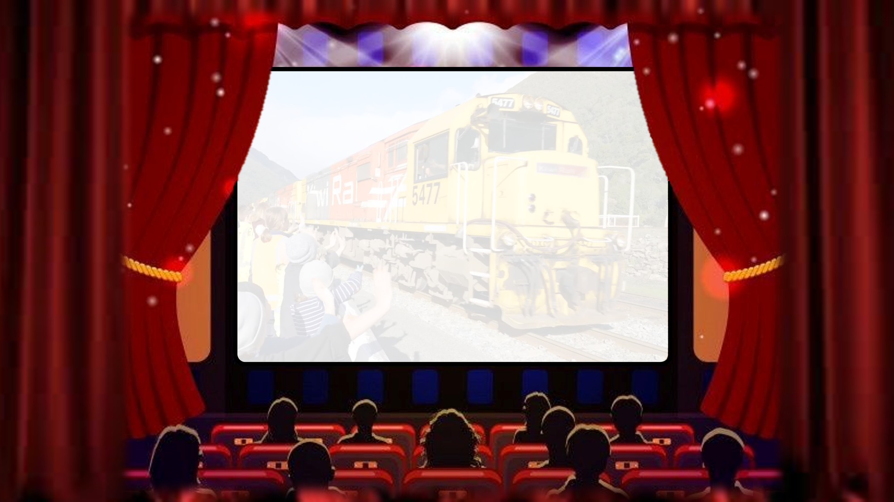



Notes:
Talking points:
“Now we’re going to watch a video of some school students asking train drivers questions.”

Slide 21

Notes:
SLIDE WILL TRANSITION AUTOMATICALLY.

Slide 22


Notes:
VIDEO WILL PLAY AUTOMATICALLY.
Link to video ‘What would you ask a train driver?’
https://www.youtube.com/watch?v=j3Aq5sZeP1M&list=PLmPgqniukFiOc5guO8AwxiHCw-81vZ2lN&index=3

Slide 23



?
?
Notes:
Talking points:
“Now it’s time for a quiz to see what you’ve learned.”

Slide 24
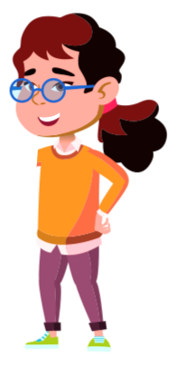



Flaticons by pikepicture
The questions have two or three possible answers.
If you think the answer is…
A
Put your hands on your HIPS!
B
Put your hands
in the AIR!
C
Put your hands on your HEAD!
Notes:
Talking points:
“If you think the answer is A, put your hands on your hips!”
“If you think the answer is B, put your hands in the air!”
“If you think the answer is C, put your hands on your head!”

Slide 25
If you think the answer is…
A – Put your hands on your HIPS
B – Put your hands in the AIR
C – Put your hands on your HEAD
Question 1
Which of these is safe to do around train tracks?
A. Play with toys like balls, scooters, and skateboards
B. Stay 10 big steps away from the tracks at all times
C. Play music out loud or listen through your headphones
Notes:
Talking points:
“Question 1, Which of these is safe to do around train tracks?”
Play with toys like balls, scooters, and skateboards
Stay 10 big steps away from the tracks at all times
Play music out loud or listen through your headphones
“If you think the answer is A, put your hands on your hips.”
“If you think the answer is B, put your hands in the air.”
“If you think the answer is C, put your hands on your head.”

Slide 26

The answer is…
Notes:
Talking points:
“The answer is…”

Slide 27
Question 1
Which of these is safe to do around train tracks?
A. Play with toys like balls, scooters, and skateboards
B. Stay 10 big steps away from the tracks at all times ✓✓✓
C. Play music out loud or listen through your headphones
Notes:
Talking points:
“B, Stay 10 big steps away from the tracks at all times.”

Slide 28
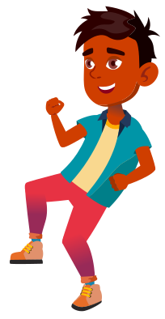
Flaticons by pikepicture
If you think the answer is…
A – Put your hands on your HIPS
B – Put your hands in the AIR
Question 2
It is safe to play on and walk along railway tracks:
A. True
B. False
Notes:
Talking points:
“Question 2, It is safe to play on and walk along railway tracks, true or false?”
“If you think the answer is True, put your hands on your hips.”
“If you think the answer is False, put your hands in the air.”

Slide 29
The answer is…
Notes:
Talking points:
“The answer is…”

Slide 30
Flaticons by pikepicture
Question 2
It is safe to play on and walk along railway tracks:
A. True
B. False ✓✓✓
Notes:
Talking points:
“FALSE! It is very unsafe to play on or walk along the railway tracks. It is also against the law.”

Slide 31
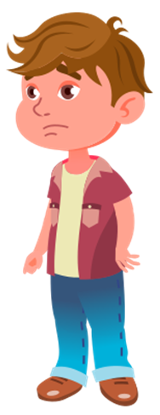
Flaticons by pikepicture
If you think the answer is…
A – Put your hands on your HIPS
B – Put your hands in the AIR
Question 3
What should you do if you see someone playing on the railway tracks?
A. Join in with them and start playing together
B. Tell an adult straight away
Notes:
Talking points:
“Question 3, What should you do if you see someone playing on the railway tracks?”
Join in with them and start playing together
Tell an adult straight away
“If you think the answer is A, put your hands on your hips.”
“If you think the answer is B, put your hands in the air.”

Slide 32
The answer is…
Notes:
Talking points:
“The answer is…”

Slide 33

Flaticons by pikepicture
Question 3
What should you do if you see someone playing on the railway tracks?
A. Join in with them and start playing together
B. Tell an adult straight away ✓✓✓
Notes:
Talking points:
“B, tell an adult straight away. This could be a parent, teacher, or a member of the public. Never join in with anyone that is playing near the railway tracks.”

Slide 34
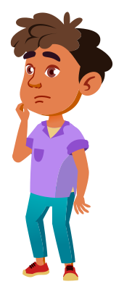
Flaticons by pikepicture
If you think the answer is…
A – Put your hands on your HIPS
B – Put your hands in the AIR
Question 4
Where are you allowed to cross a railway track?
At a formed crossing with a footpath, yellow lines, and railway signs
Anywhere that you want to cross as long as there are no trains coming
Notes:
Talking points:
“Question 4, Where are you allowed to cross a railway track?”
At a formed crossing with a footpath, yellow lines, and railway signs
Anywhere that you want to cross as long as there are no trains coming
“If you think the answer is A, put your hands on your hips.”
“If you think the answer is B, put your hands in the air.”

Slide 35
The answer is…
Notes:
Talking points:
“The answer is…”

Slide 36
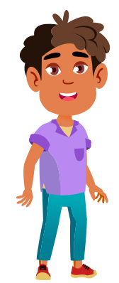
Flaticons by pikepicture
Question 4
Where are you allowed to cross a railway track?
At a formed crossing with a footpath, yellow lines, and railway signs ✓✓✓
Anywhere that you want to cross as long as there are no trains coming
Notes:
Talking points:
“A, At a formed crossing with a footpath, yellow lines, and railway signs. Crossing anywhere else is very dangerous. It is trespassing and it is against the law.”

Slide 37

Flaticons by pikepicture
If you think the answer is…
A – Put your hands on your HIPS
B – Put your hands in the AIR
C – Put your hands on your HEAD
Question 5
Which of these should you do when crossing a railway track?
Run across as fast as you can to beat any trains coming
Cross when the lights are flashing or the bells are ringing
Stop, look both ways and listen to make sure there are no trains coming
Notes:
Talking points:
“Question 5, which of these should you do when crossing a railway track?”
Run across as fast as you can to beat any trains coming
Cross when the lights are flashing or the bells are ringing
Stop, look both ways and listen to make sure there are no trains coming
“If you think the answer is A, put your hands on your hips.”
“If you think the answer is B, put your hands in the air.”
“If you think the answer is C, put your hands on your head.”

Slide 38
The answer is…
Notes:
Talking points:
“The answer is…”

Slide 39
Flaticons by pikepicture
Question 5
Which of these should you do when crossing a railway track?
Run across as fast as you can to beat any trains coming
Cross when the lights are flashing or the bells are ringing
Stop, look both ways and listen to make sure there are no trains coming ✓✓✓
Notes:
Talking points:
“C, Stop, look both ways and listen to make sure there are no trains coming.”

Slide 40




If you think the answer is…
A – Put your hands on your HIPS
B – Put your hands in the AIR
Question 6
Trains can come from either direction at any time:
A. True
B. False
Notes:
Talking points:
“Question 6, Trains can come from any direction at any time:, true or false?”
“If you think the answer is True, put your hands on your hips.”
“If you think the answer is False, put your hands in the air.”

Slide 41
The answer is…
Notes:
Talking points:
“The answer is…”

Slide 42
Question 6
Trains can come from either direction at any time:
A. True ✓✓✓
B. False
Notes:
Talking points:
“True! Trains do not always run to schedule, so you should expect them from either direction at any time. Other rail vehicles do not run on any schedules.”

Slide 43
If you think the answer is…
A – Put your hands on your HIPS
B – Put your hands in the AIR
Question 7
In an emergency, trains can stop quickly:
A. True
B. False
Notes:
Talking points:
“Question 7, In an emergency, trains can stop quickly, true or false?”
“If you think the answer is True, put your hands on your hips.”
“If you think the answer is False, put your hands in the air.”

Slide 44
The answer is…
Notes:
Talking points:
“The answer is…”

Slide 45
Question 7
In an emergency, trains can stop quickly:
A. True
B. False ✓✓✓
Notes:
Talking points:
“False! Trains can keep going for up to 1000 metres before they come to a complete stop, this can take a whole minute.”

Slide 46



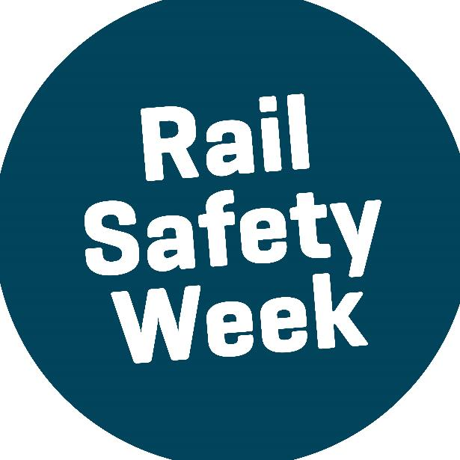

You are our Rail Safety Champions!
Notes:
Talking points:
“Ka pai everyone!” (good job)
“You are all Rail Safety Week champions!”

Slide 47
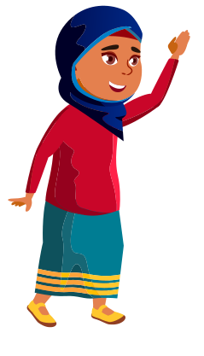
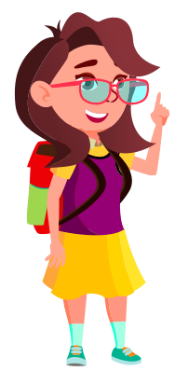
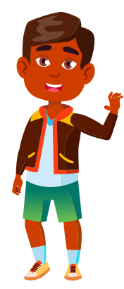
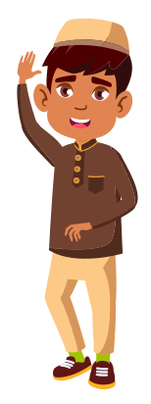
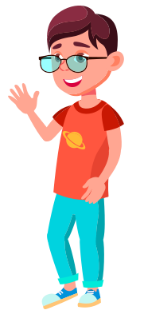
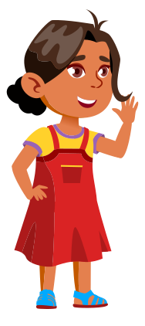


Any questions?
Notes:
Talking points:
“Any questions?”

