Slide 1
Notes:
Customisation:
Add school name.
Replace picture with school logo.
Talking points:
“Kia ora koutou!” (hello everyone)

Slide 2
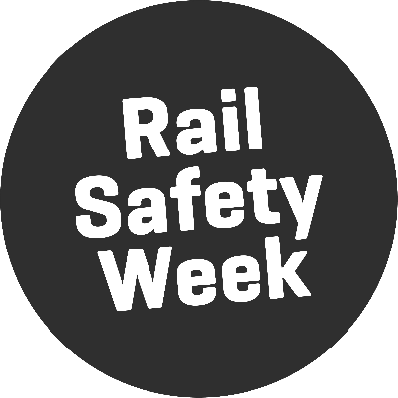
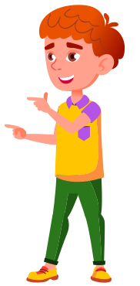
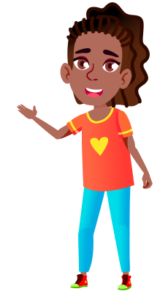
We are visiting your school because it is…
Notes:
Customisation:
Add names of visiting staff.
Talking points:
“Our names are … and we work for KiwiRail.”
“We’re here because it is Rail Safety Week and we want to talk to you about staying safe around trains and train tracks.”

Slide 3
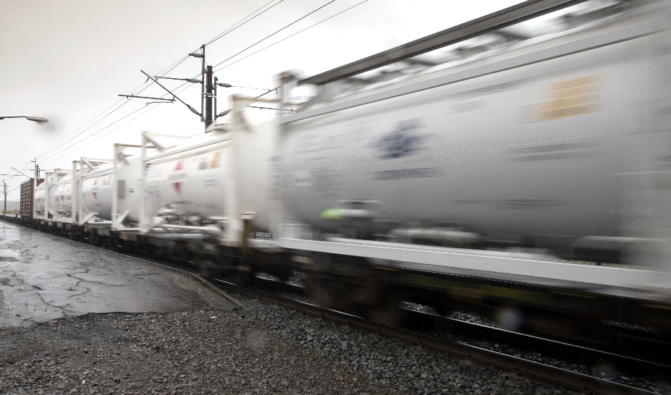
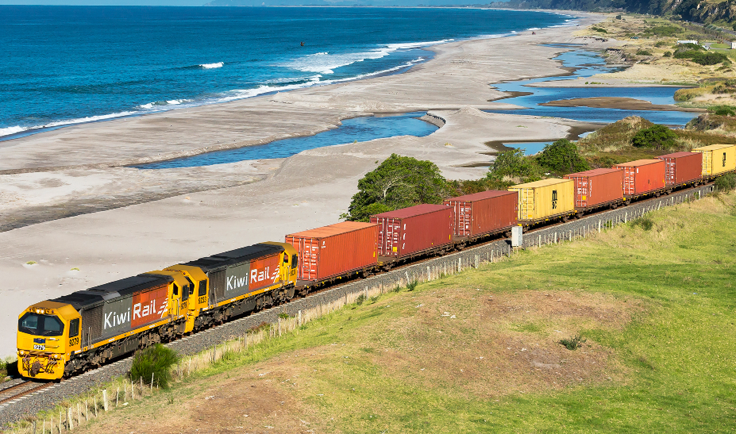
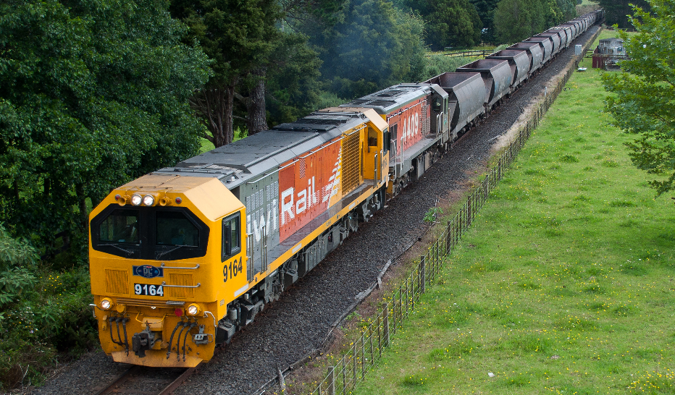
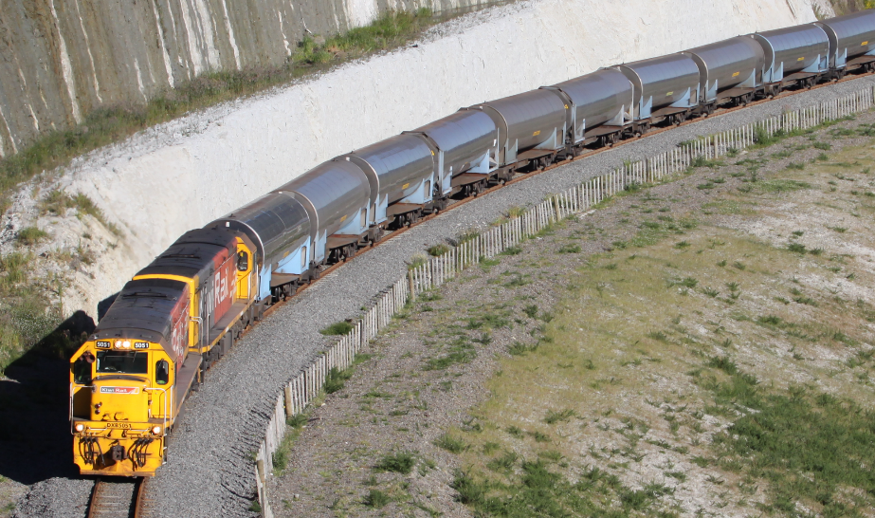
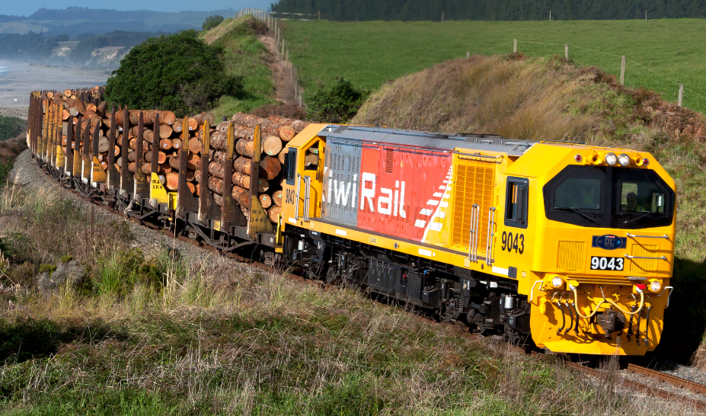
GAS
FREIGHT
COAL
MILK
LOGS
Notes:
Customisation:
Replace textbox with appropriate place names.
Replace left picture with screenshot of local RLX from google street view.
Replace right picture with image of a train carrying local freight type. (Some photo options are off screen to the bottom of the slide).
Talking points:
“There is a railway line quite close to your school. It transports [freight type] from [location] to [location].” (e.g., It transports coal from the West Coast to Christchurch).
“You might recognise the picture on the left. It is a crossing close to your school that pedestrians, cyclists, cars, and trucks use it to cross over the railway lines.”

Slide 4

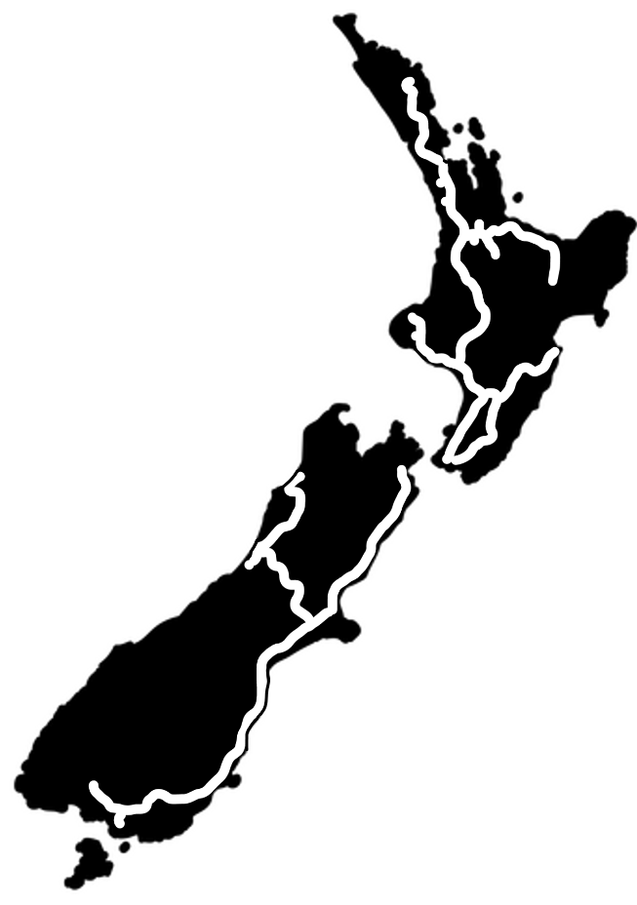
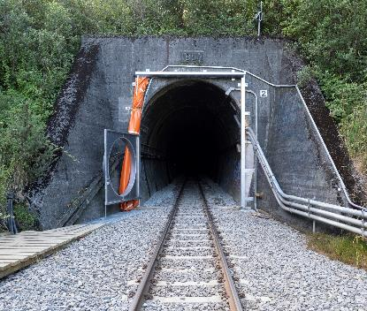
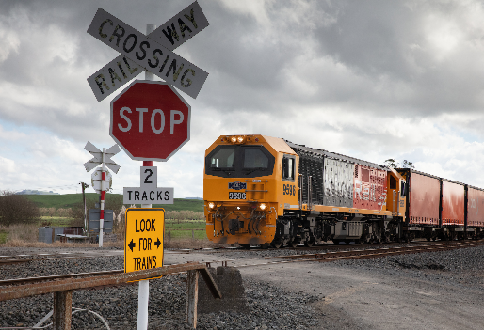
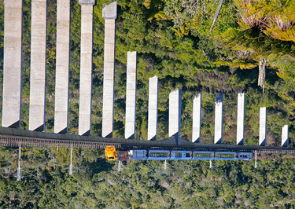

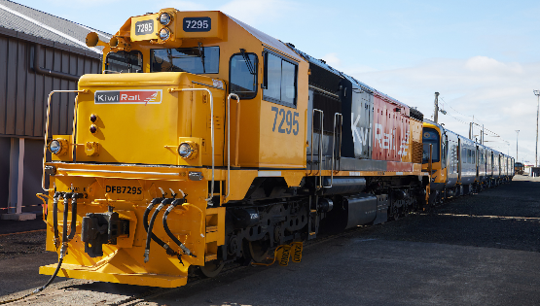
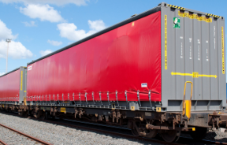

We operate and maintain 3,700 kilometres of track.
106 tunnels 2,800 level crossings 1,367 bridges
240 locomotives 4,700 wagons
Notes:
Customisation:
Drag the location pin to the location of the school you are visiting. (Pin is off screen to the right of the slide)
Talking points:
“We operate and maintain 3,700 kilometres of track all across New Zealand. Our network includes more than 100 tunnels, more than 1000 bridges, and more than 2000 crossings! We have 240 locomotives and almost 5000 wagons!”
“Can everyone see where your school is on the map?”
[Point out location]

Slide 5
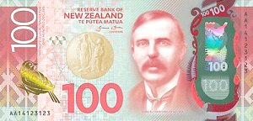

KiwiRail brings a total value to NZ of $1.7-2.1 BILLION per year
Rail has a much smaller carbon footprint than transportation by road.
It would take 54 trucks to move the same freight as 1 train!
Notes:
Talking points:
“KiwiRail brings a total value to New Zealand of 1.7 to 2.1 billion dollars every year!”
“Rail also has a much smaller carbon footprint than transporting freight by road. In fact, it would take 54 trucks to move the same amount of freight as one train!”

Slide 6
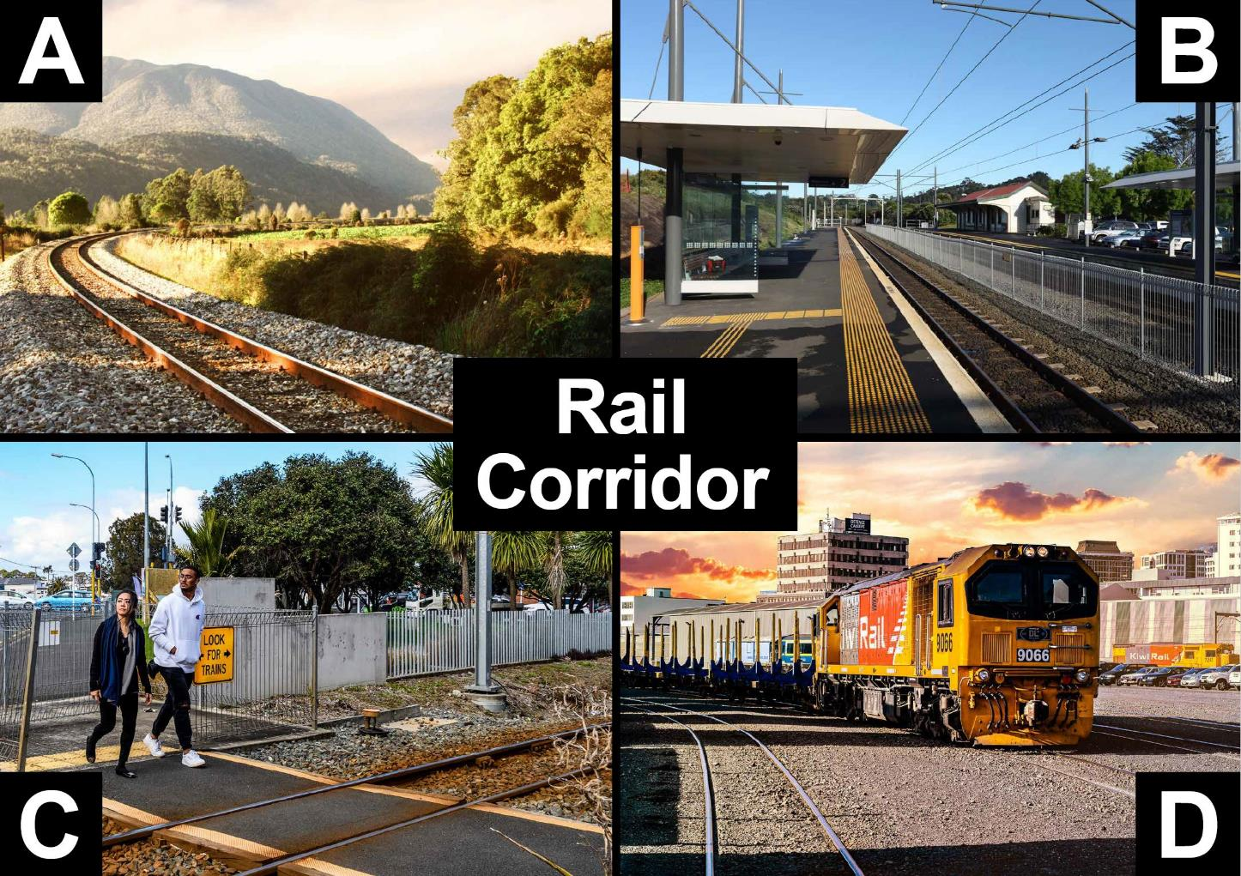
Notes:
Talking points:
“The rail corridor includes the tracks at train stations, level crossings, and our freight yards. You are only allowed to be near the rail corridor if you are at level crossings or at a train station. In any other areas you must stay at least 5 metres away from railway tracks at all times. If you do not, you are trespassing, which is against the law.”
Note:
Picture A shows the rail corridor. The corridor includes the area of land at least 5 metres on either side of the middle of the track.
Picture B shows the rail corridor with two sets of tracks separated by a fence.
Picture C shows a level crossing which is also part of the rail corridor. This is a legal place where pedestrians and traffic can cross the rail corridor provided the warning bells, lights and barrier arms are not operating.
Picture D shows a freight yard. The whole freight yard is part of the rail corridor and is out of bounds.

Slide 7
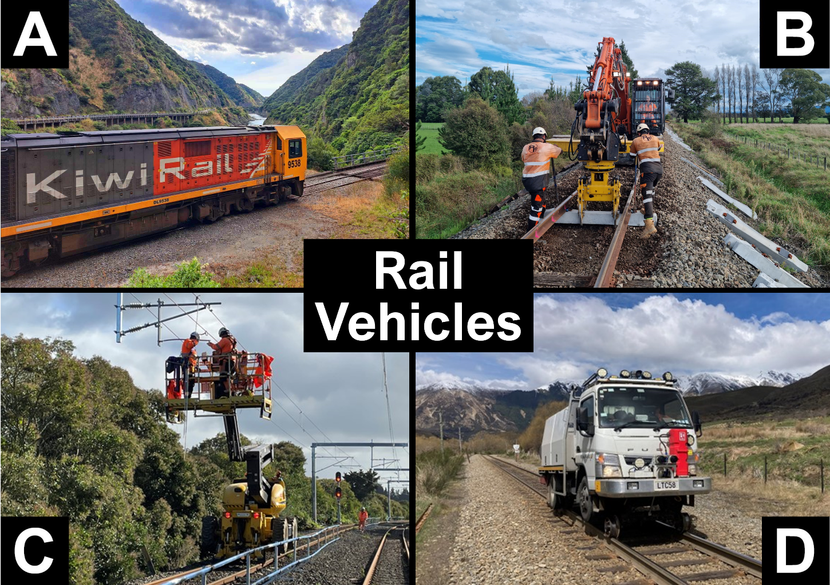
Notes:
Talking points:
“Have you seen any of these vehicles on the train tracks? If you have, put your hand up.”
“Some of you might not know that it is not just trains that run on the tracks. There are also diggers, cherry-pickers, trucks, and lots of other types of vehicles that run on the tracks. You must always give way to all rail vehicles, not just trains.”
“Can everyone see the overhead wires in picture C? Some of these overheard wires are up to 250,000 Volts, that’s over one thousand times stronger than the electricity that powers your house! Electricity can pass through the air without you even touching the wires, so you must stay far away from them and never throw anything towards them.”
Note:
Picture A shows a locomotive engine
Picture B shows a Hi-Rail excavator replacing sleepers.
Picture C shows a Hi-Rail cherry-picker working on the overhead wires.
Picture D shows a Hi-Rail truck.

Slide 8
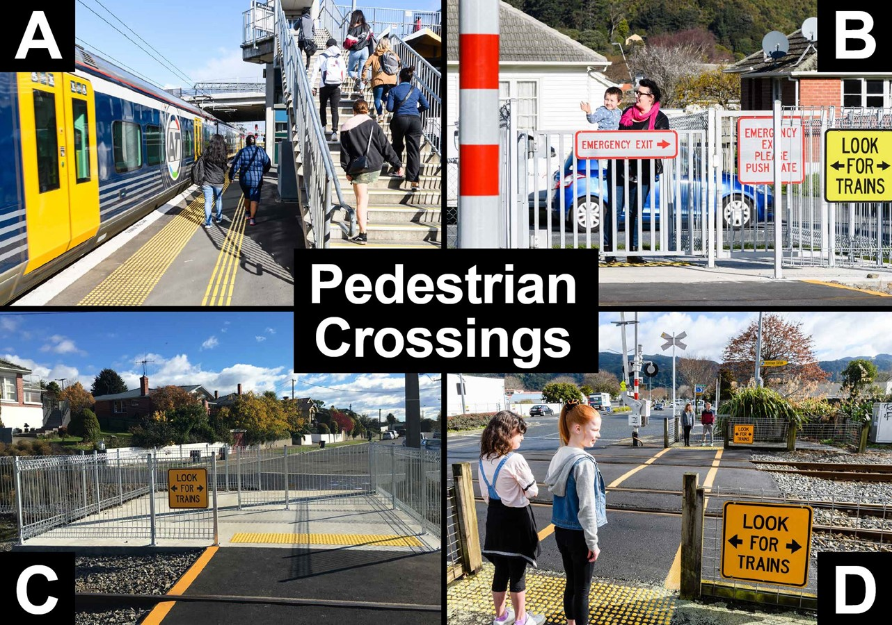
Notes:
Talking points:
“Here are some pedestrian-only level crossings. In picture A you can see a bridge that pedestrians can use to cross on top the tracks. The other pictures show crossings where you walk directly across the tracks. Some of them have automatic gates that shut when a train is coming. Others do not have gates, so you must always check for trains before crossing. It is unsafe and it is against the law to cross anywhere other than a level crossing.”
Note:
Picture A shows a pedestrian bridge. People use these to cross safely above railway tracks.
Picture B shows a pedestrian crossing with automatic gates. Flashing lights and bells activate, and gates close when a train is approaching. An emergency gate can be used if the gates start closing while someone has already started crossing.
Picture C shows a pedestrian crossing with a maze. A zigzag path with railings and warning signs before and after the railway tracks. The zigzag helps a pedestrian to look left and right before crossing.
Picture D shows a pedestrian crossing with flashing lights and bells and barrier arms on the road. The pedestrians wait behind the yellow line. Before crossing they need to wait for the alarms to stop and check that no trains are coming.

Slide 9
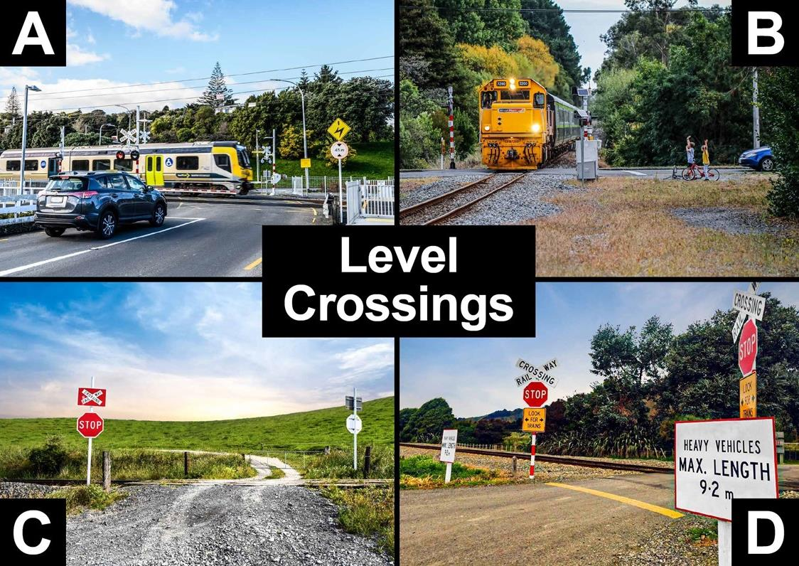
Notes:
Talking points:
“Here you can see different examples of level crossings. These are the only places where you are allowed to cross the train tracks. Some level crossings have lights and bells that tell you when a train is coming. Others do not have lights and bells, they only have STOP or Give Way signs. If you’re driving in the car with your parents/whanau they need to stop and look both ways. They must only drive across when there are no trains in sight.”
Note:
Picture A shows an urban level crossing with barrier arms, lights, and bells.
Picture B shows a rural level crossing with lights and bells only.
Picture C shows a crossing on private land which is required by law to have signage appropriate to the heaviness of the traffic flow.
Picture D shows a level crossing with a crossbuck, a Stop sign, and a ‘Look for trains’ sign. Another sign restricts heavy vehicles over a certain length.

Slide 10
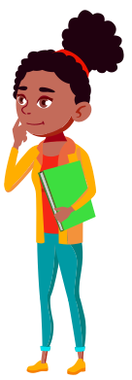
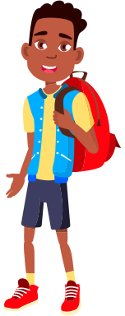
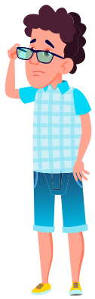
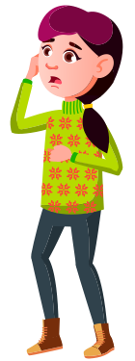
Flaticons by pikepicture
When crossing at a railway level crossing, always…
STOP behind
the line
LOOK
both ways for trains
LISTEN
for trains coming
THINK,
is it safe
to cross?
Notes:
Talking points:
“When crossing the train tracks at a railway level crossing, you must always STOP behind the line, LOOK both ways for trains, LISTEN for trains coming, and THINK, is it safe to cross?”
“Diesel and electric trains can both be very quiet and can sneak up on you without you hearing them.”

Slide 11
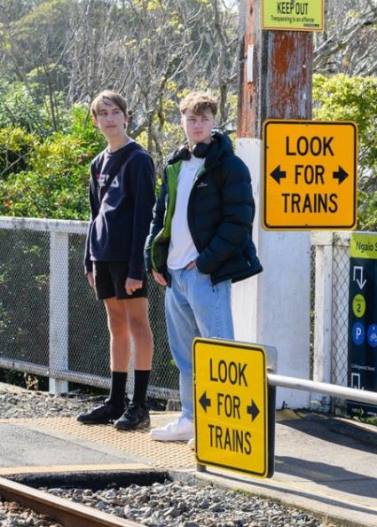
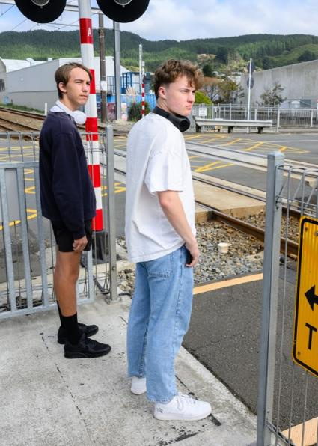
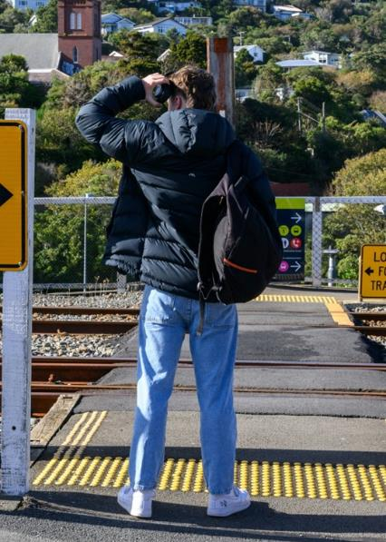
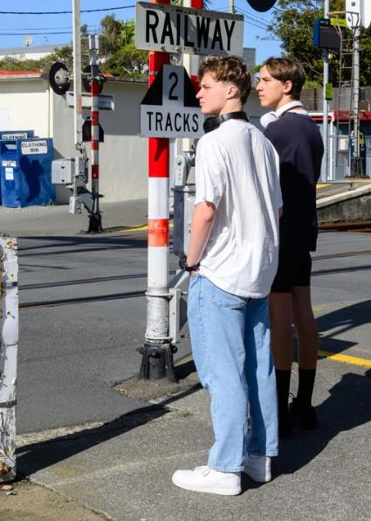
When crossing at a railway level crossing, always…
STOP behind
the line
LOOK
both ways for trains
LISTEN
for trains coming
THINK,
is it safe
to cross?
Only cross when there are no trains in sight
Notes:
IGNORE OVERLAP – SLIDE HAS ANIMATIONS
Talking points:
“You must only cross when there are no trains in sight!”

Slide 12
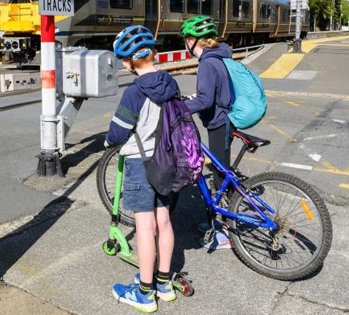
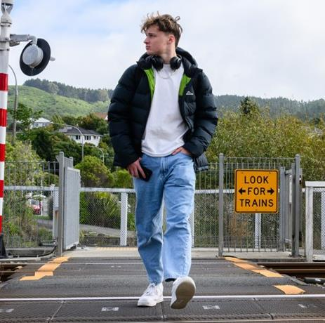
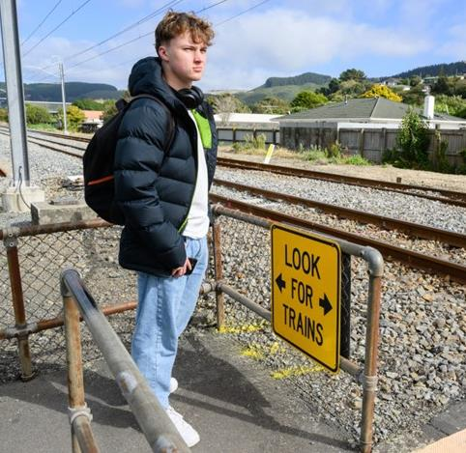
When crossing, you must always…
Get off and walk your bicycle/scooter
Remove your
headphones
Put your phone in your pocket
Notes:
Talking points:
“There are a few other things you to do to keep yourself safe when crossing the train tracks.
“You must always get off your bike, scooter, or skateboard and push it across the crossing.”
“You must remove your headphones so that you can hear the bells ringing or any trains coming.”
“You must put your phone in your pocket so that you are not distracted when you are crossing.”

Slide 13
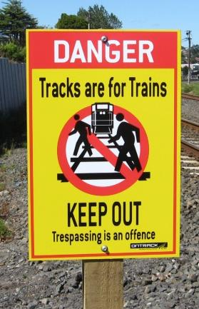
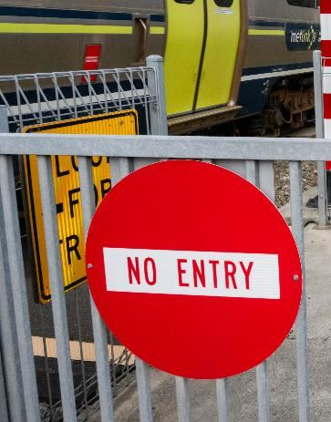
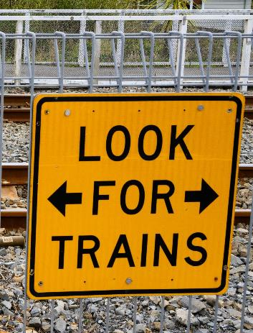
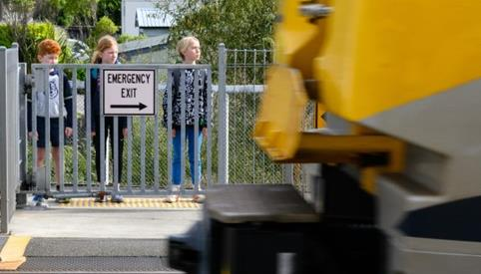
When crossing, you must always…
Obey all signs and signals.
Expect trains from either direction.
Cross with care.
Notes:
Talking points:
“When crossing, you must always obey the signs, expect trains from either direction at any time, and always be careful when you’re crossing.”

Slide 14
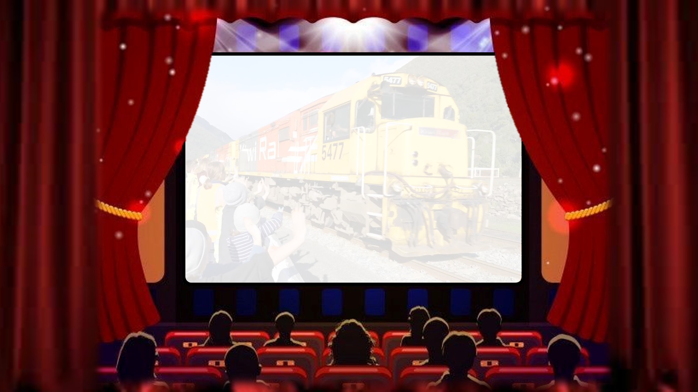



Notes:
Talking points:
“Now we’re going to watch a video of some school students asking train drivers questions.”

Slide 15

Notes:
SLIDE WILL TRANSITION AUTOMATICALLY.

Slide 16


Notes:
VIDEO WILL PLAY AUTOMATICALLY.
Link to video ‘What would you ask a train driver?’
https://www.youtube.com/watch?v=j3Aq5sZeP1M&list=PLmPgqniukFiOc5guO8AwxiHCw-81vZ2lN&index=3

Slide 17

?
?
Notes:
Talking points:
“Now it’s time for a quiz to see what you’ve learned today.”

Slide 18
The questions have two or three possible answers.
If you think the answer is…
A
Put your hands on your HIPS!
B
Put your hands
in the AIR!
C
Put your hands on your HEAD!
Notes:
Talking points:
“If you think the answer is A, put your hands on your hips!”
“If you think the answer is B, put your hands in the air!”
“If you think the answer is C, put your hands on your head!”

Slide 19
If you think the answer is…
A – Put your hands on your HIPS
B – Put your hands in the AIR
C – Put your hands on your HEAD
Question 1
Which of these is safe to do around train tracks?
A. Play with balls, scooters, and skateboards
B. Stay at least 5 metres away from the tracks at all times
C. Play music out loud or listen through your headphones
Notes:
Talking points:
“Question 1, Which of these is safe to do around train tracks?”
A. Play with balls, scooters, and skateboards
B. Stay at least 5 metres away from the tracks at all times
Play music out loud or listen through your headphones
“If you think the answer is A, put your hands on your hips.”
“If you think the answer is B, put your hands in the air.”
“If you think the answer is C, put your hands on your head.”

Slide 20

The answer is…
Notes:
Talking points:
“The answer is…”

Slide 21
Question 1
Which of these is safe to do around train tracks?
A. Play with balls, scooters, and skateboards
B. Stay at least 5 metres away from the tracks at all times ✓✓✓
C. Play music out loud or listen through your headphones
Notes:
Talking points:
“B, Stay at least 5 metres away from the tracks at all times.”

Slide 22
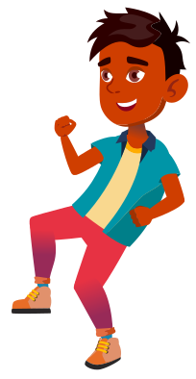
Flaticons by pikepicture
If you think the answer is…
A – Put your hands on your HIPS
B – Put your hands in the AIR
Question 2
It is safe to play on and walk along railway tracks:
A. True
B. False
Notes:
Talking points:
“Question 2, It is safe to play on and walk along railway tracks, true or false?”
“If you think the answer is True, put your hands on your hips.”
“If you think the answer is False, put your hands in the air.”

Slide 23
The answer is…
Notes:
Talking points:
“The answer is…”

Slide 24
Flaticons by pikepicture
Question 2
It is safe to play on and walk along railway tracks:
A. True
B. False ✓✓✓
Notes:
Talking points:
“FALSE! It is very unsafe to play on or walk along the railway tracks. It is also against the law.”

Slide 25
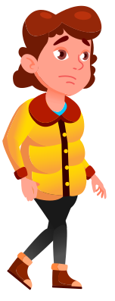
Flaticons by pikepicture
If you think the answer is…
A – Put your hands on your HIPS
B – Put your hands in the AIR
Question 3
What should you do if you see someone playing on the railway tracks?
A. Join in with them and start playing together
B. Tell an adult straight away
Notes:
Talking points:
“Question 3, What should you do if you see someone playing on the railway tracks?”
A. Join in with them and start playing together
Tell an adult straight away
“If you think the answer is A, put your hands on your hips.”
“If you think the answer is B, put your hands in the air.”

Slide 26
The answer is…
Notes:
Talking points:
“The answer is…”

Slide 27
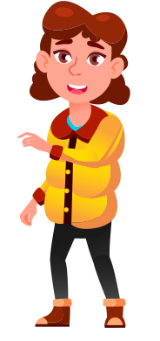
Flaticons by pikepicture
Question 3
What should you do if you see someone playing on the railway tracks?
A. Join in with them and start playing together
B. Tell an adult straight away ✓✓✓
Notes:
Talking points:
“B, tell an adult straight away. This could be a parent, teacher, or a member of the public. Never join in with anyone that is playing near the railway tracks.”

Slide 28
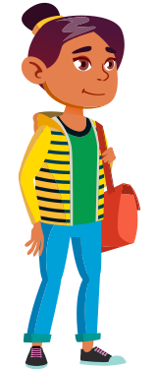
Flaticons by pikepicture
If you think the answer is…
A – Put your hands on your HIPS
B – Put your hands in the AIR
Question 4
Where are you allowed to cross a railway track?
At a formed crossing with a footpath, yellow lines, and railway signs
Anywhere that you want to cross as long as there are no trains coming
Notes:
Talking points:
“Question 4, Where are you allowed to cross a railway track?”
A. At a formed crossing with a footpath, yellow lines, and railway signs
B. Anywhere that you want to cross as long as there are no trains coming
“If you think the answer is A, put your hands on your hips.”
“If you think the answer is B, put your hands in the air.”

Slide 29
The answer is…
Notes:
Talking points:
“The answer is…”

Slide 30
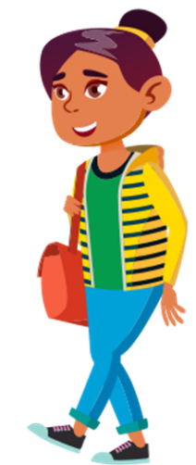
Flaticons by pikepicture
Question 4
Where are you allowed to cross a railway track?
At a formed crossing with a footpath, yellow lines, and railway signs ✓✓✓
Anywhere that you want to cross as long as there are no trains coming
Notes:
Talking points:
“A, At a formed crossing with a footpath, yellow lines, and railway signs. Crossing anywhere else is very dangerous. It is trespassing and it is against the law.”

Slide 31
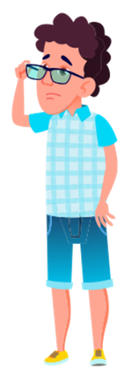
Flaticons by pikepicture
If you think the answer is…
A – Put your hands on your HIPS
B – Put your hands in the AIR
C – Put your hands on your HEAD
Question 5
Which of these should you do when crossing a railway track?
Run across as fast as you can to beat any trains coming
Cross when the lights are flashing or the bells are ringing
Stop, look both ways and listen to make sure there are no trains coming
Notes:
Talking points:
“Question 5, which of these should you do when crossing a railway track?”
A. Run across as fast as you can to beat any trains coming
B. Cross when the lights are flashing or the bells are ringing
C. Stop, look both ways and listen to make sure there are no trains coming
“If you think the answer is A, put your hands on your hips.”
“If you think the answer is B, put your hands in the air.”
“If you think the answer is C, put your hands on your head.”

Slide 32
The answer is…
Notes:
Talking points:
“The answer is…”

Slide 33
Flaticons by pikepicture
Question 5
Which of these should you do when crossing a railway track?
Run across as fast as you can to beat any trains coming
Cross when the lights are flashing or the bells are ringing
Stop, look both ways and listen to make sure there are no trains coming ✓✓✓
Notes:
Talking points:
“C, Stop, look both ways and listen to make sure there are no trains coming.”

Slide 34




If you think the answer is…
A – Put your hands on your HIPS
B – Put your hands in the AIR
Question 6
Trains can come from any direction at any time:
A. True
B. False
Notes:
Talking points:
“Question 6, Trains can come from any direction at any time: true or false?”
“If you think the answer is True, put your hands on your hips.”
“If you think the answer is False, put your hands in the air.”

Slide 35
The answer is…
Notes:
Talking points:
“The answer is…”

Slide 36
Question 6
Trains can come from any direction at any time:
A. True ✓✓✓
B. False
Notes:
Talking points:
“True! Trains do not always run to schedule, so you should expect them from either direction at any time. Other rail vehicles do not run on any schedules.”

Slide 37
If you think the answer is…
A – Put your hands on your HIPS
B – Put your hands in the AIR
Question 7
In an emergency, trains can stop quickly:
A. True
B. False
Notes:
Talking points:
“Question 7, In an emergency, trains can stop quickly, true or false?”
“If you think the answer is True, put your hands on your hips.”
“If you think the answer is False, put your hands in the air.”

Slide 38
The answer is…
Notes:
Talking points:
“The answer is…”

Slide 39
Question 7
In an emergency, trains can stop quickly:
A. True
B. False ✓✓✓
Notes:
Talking points:
“False! Trains can weigh up to 1 million kilograms, that’s how much 500 elephants weigh! When they brake, trains can take a whole minute to stop and can keep going for up to 1000 metres!”

Slide 40



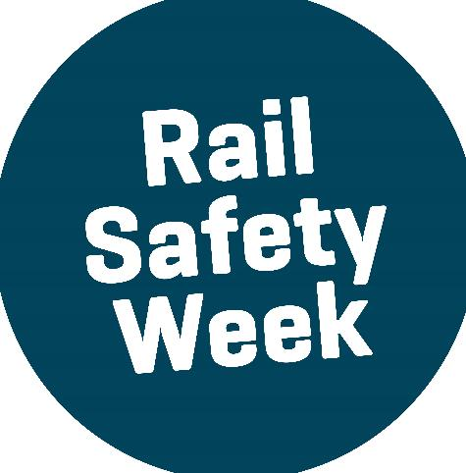

CONGRATULATIONS!
You are our
Rail Safety Week Champions!
Notes:
Talking points:
“Ka pai everyone!” (good job)
“You are all Rail Safety Week champions!”

Slide 41
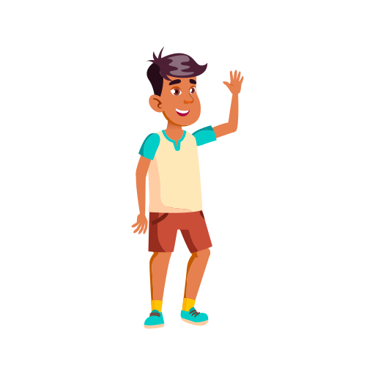

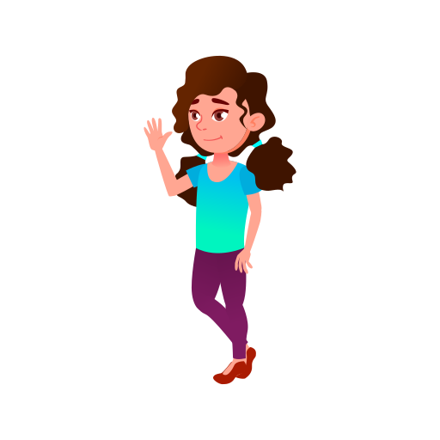
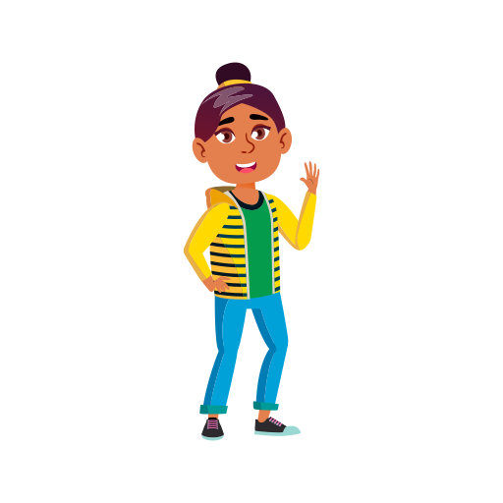
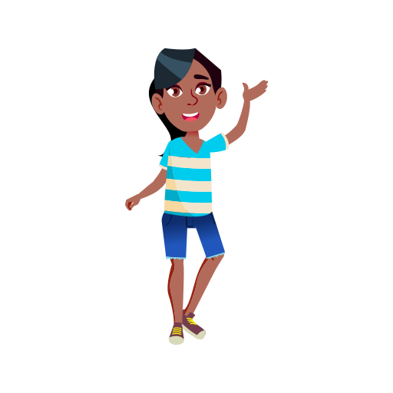
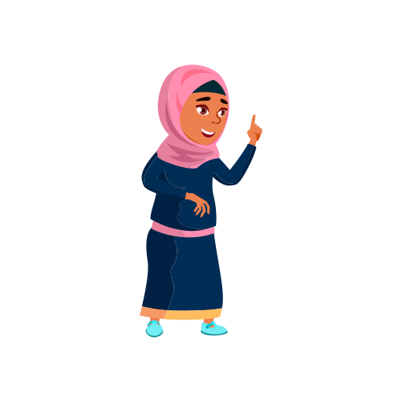


Any questions?
Notes:
Talking points:
“Any questions?”

