Slide 1
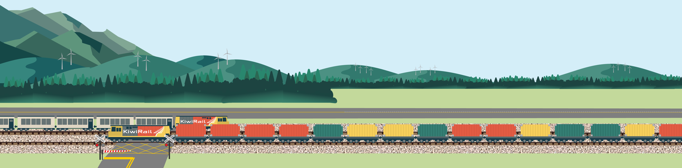


Let’s talk about rail safety

Slide 2

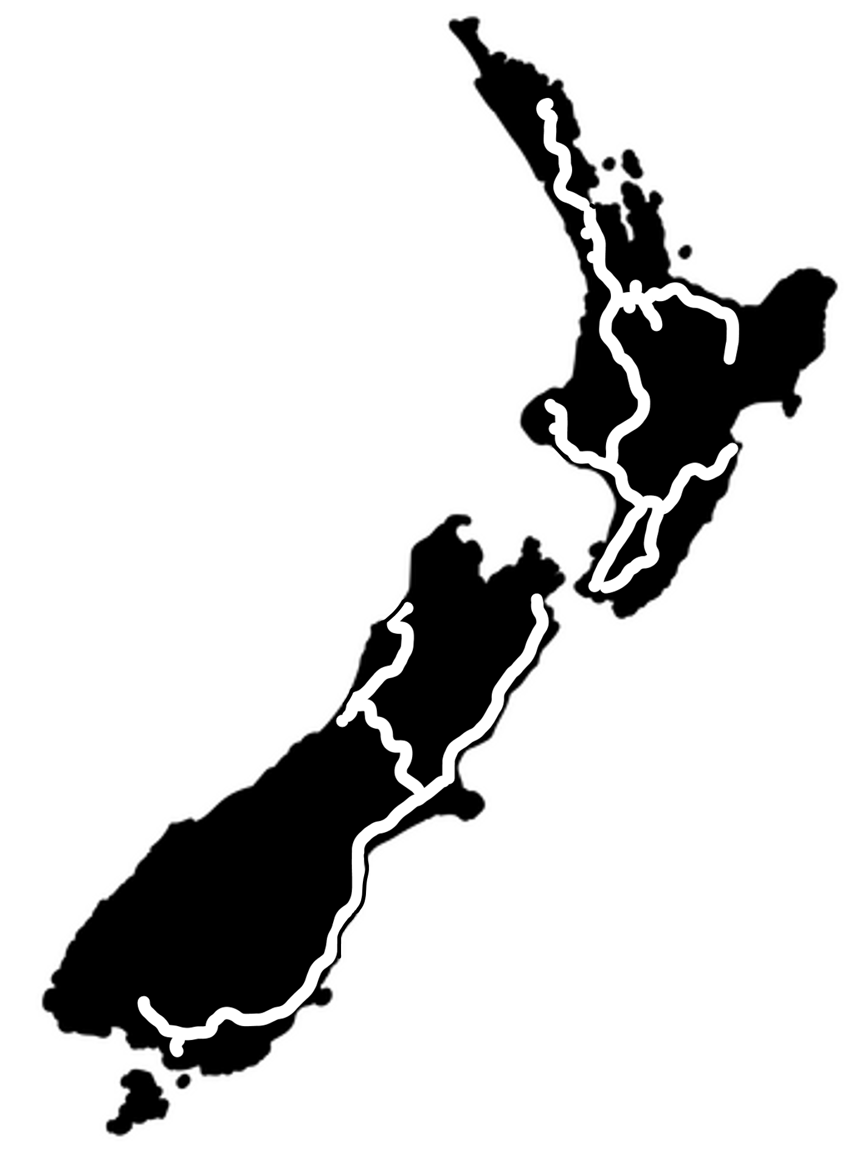
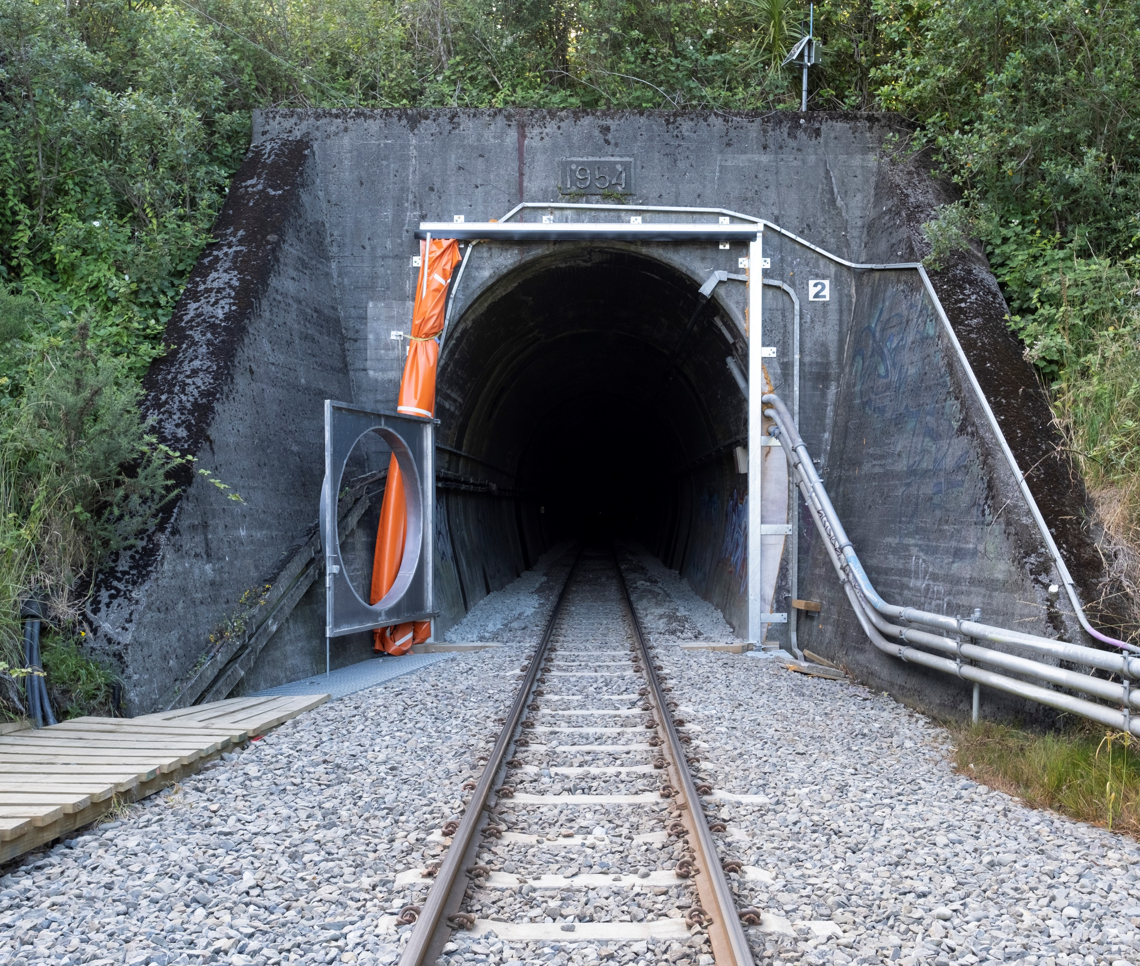
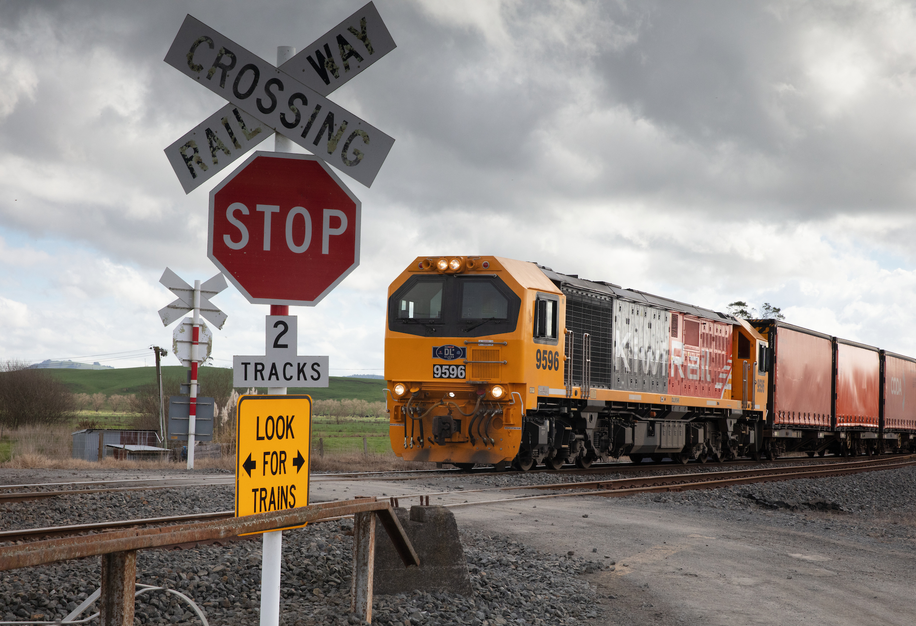
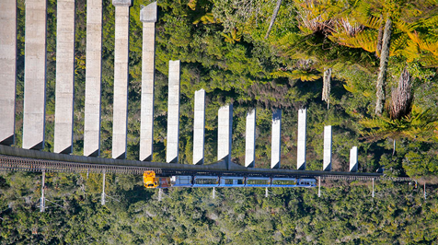

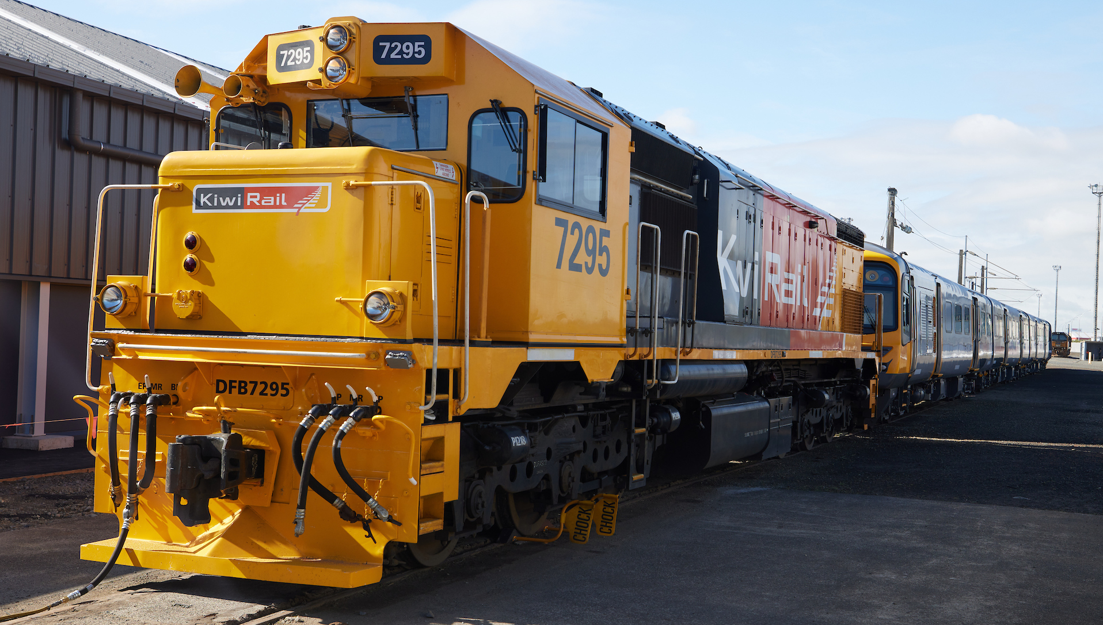
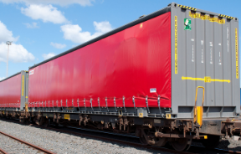
KiwiRail operates and maintain 3,700 kilometres of track.
106 tunnels 2,800 level crossings 1,367 bridges
240 locomotives 4,700 wagons
Notes:
Location pin is off-screen to right of NZ map. Optional: Move pin to location of school you are visiting.

Slide 3
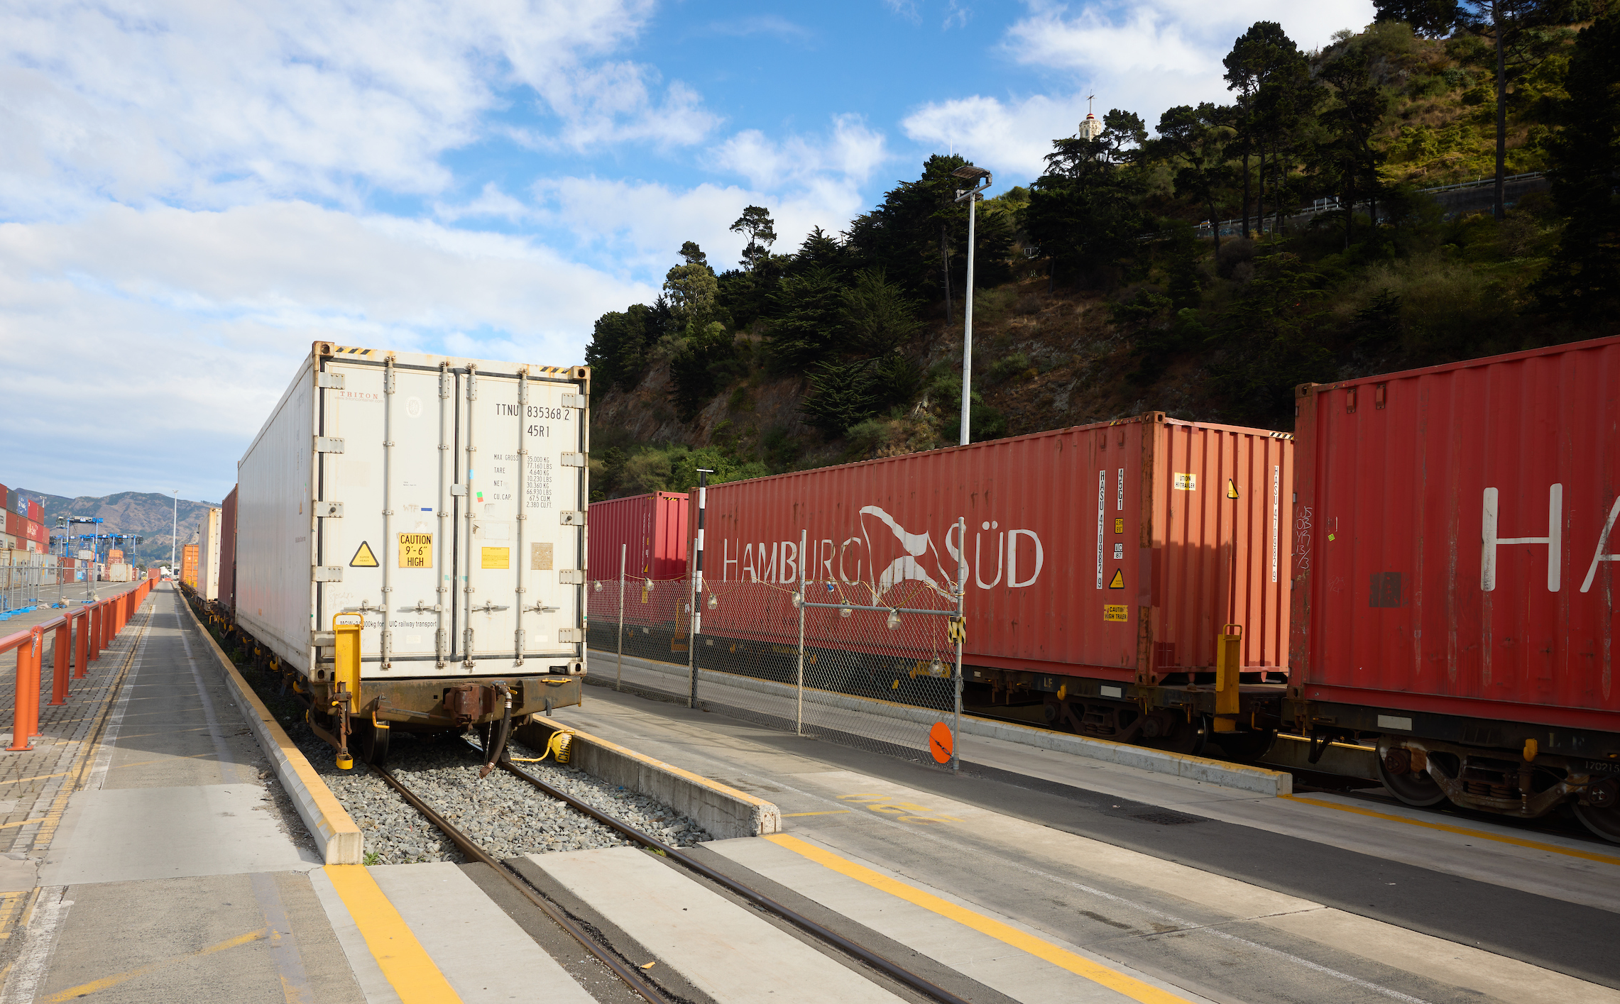
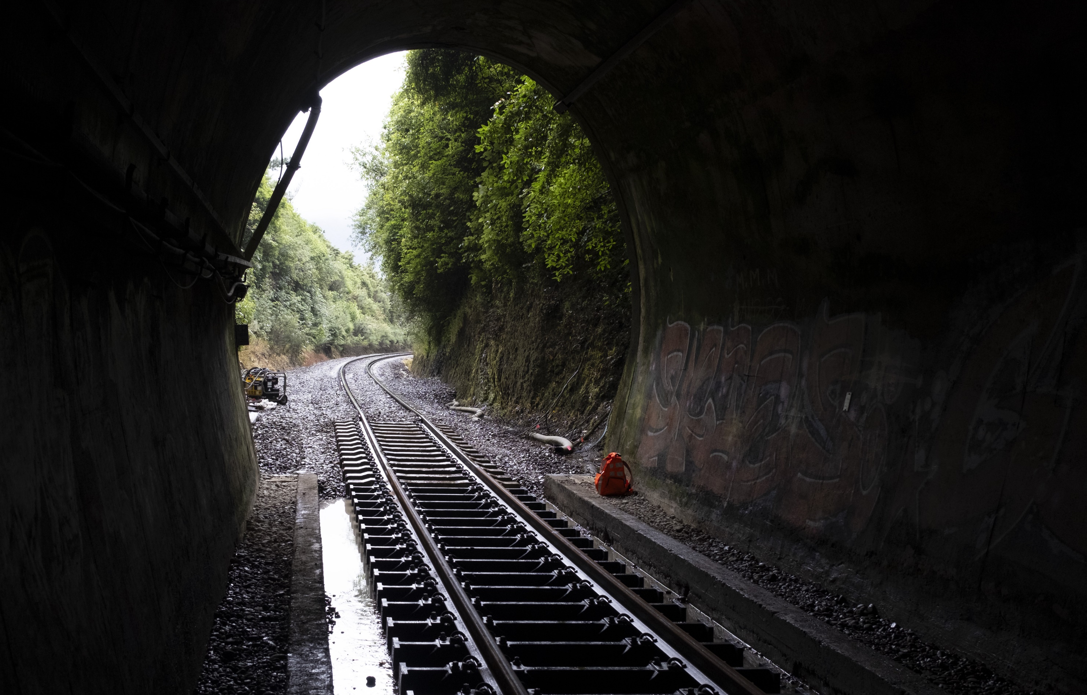
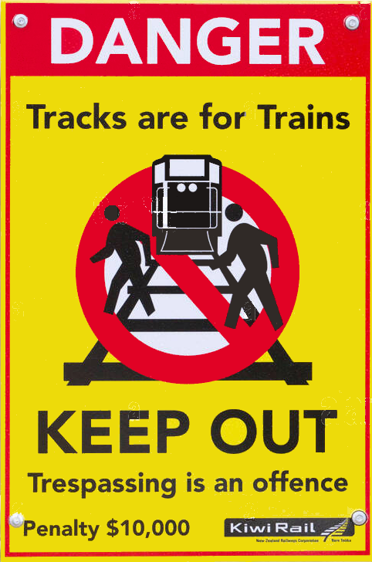
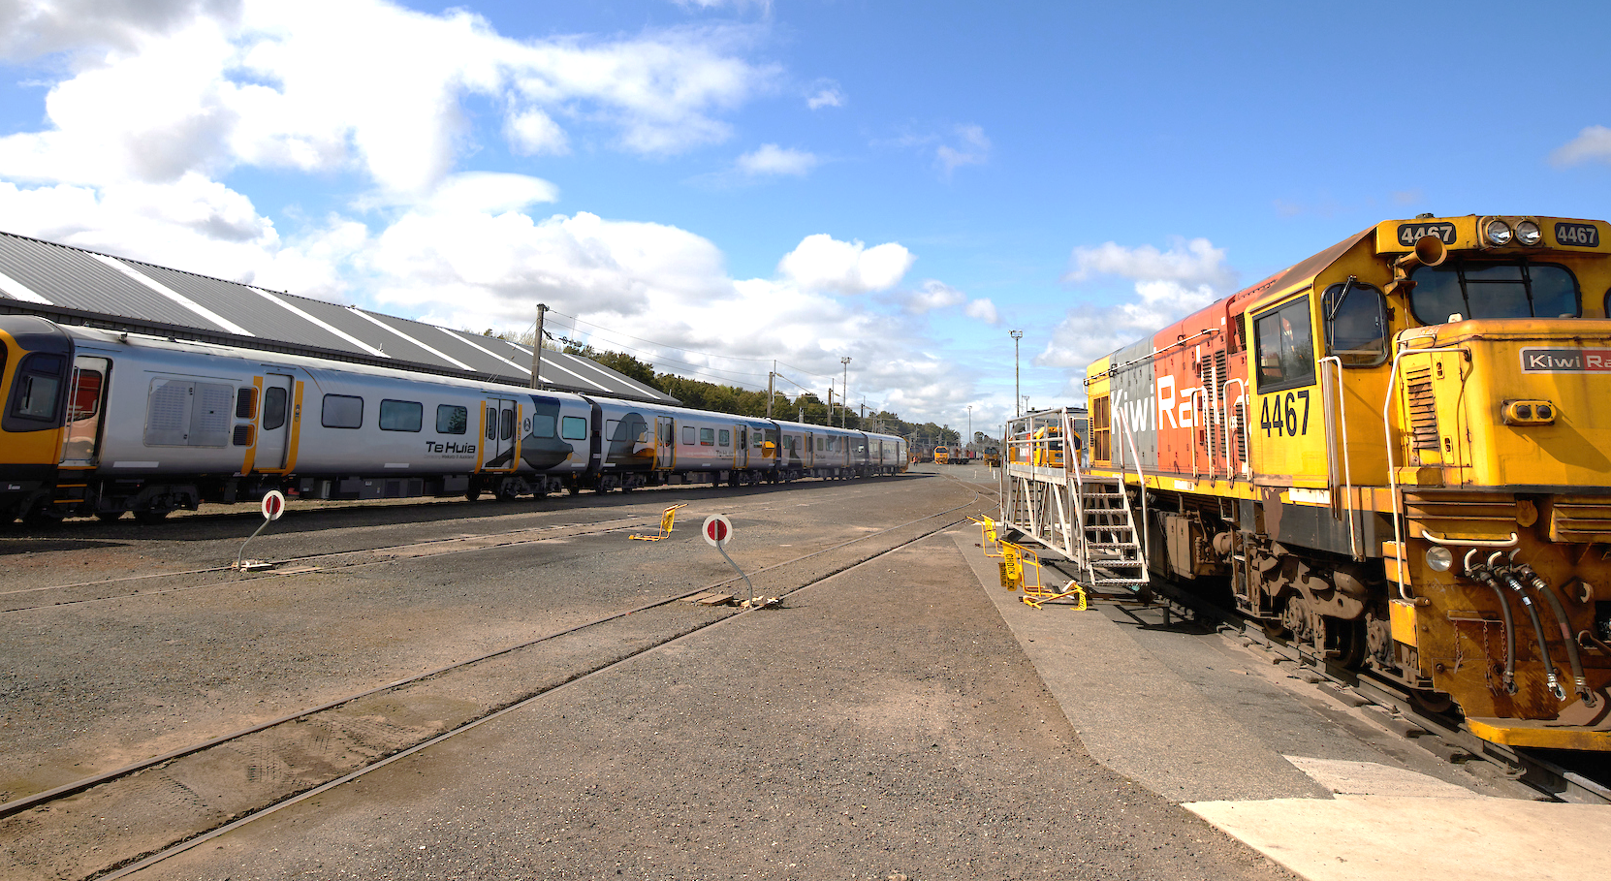
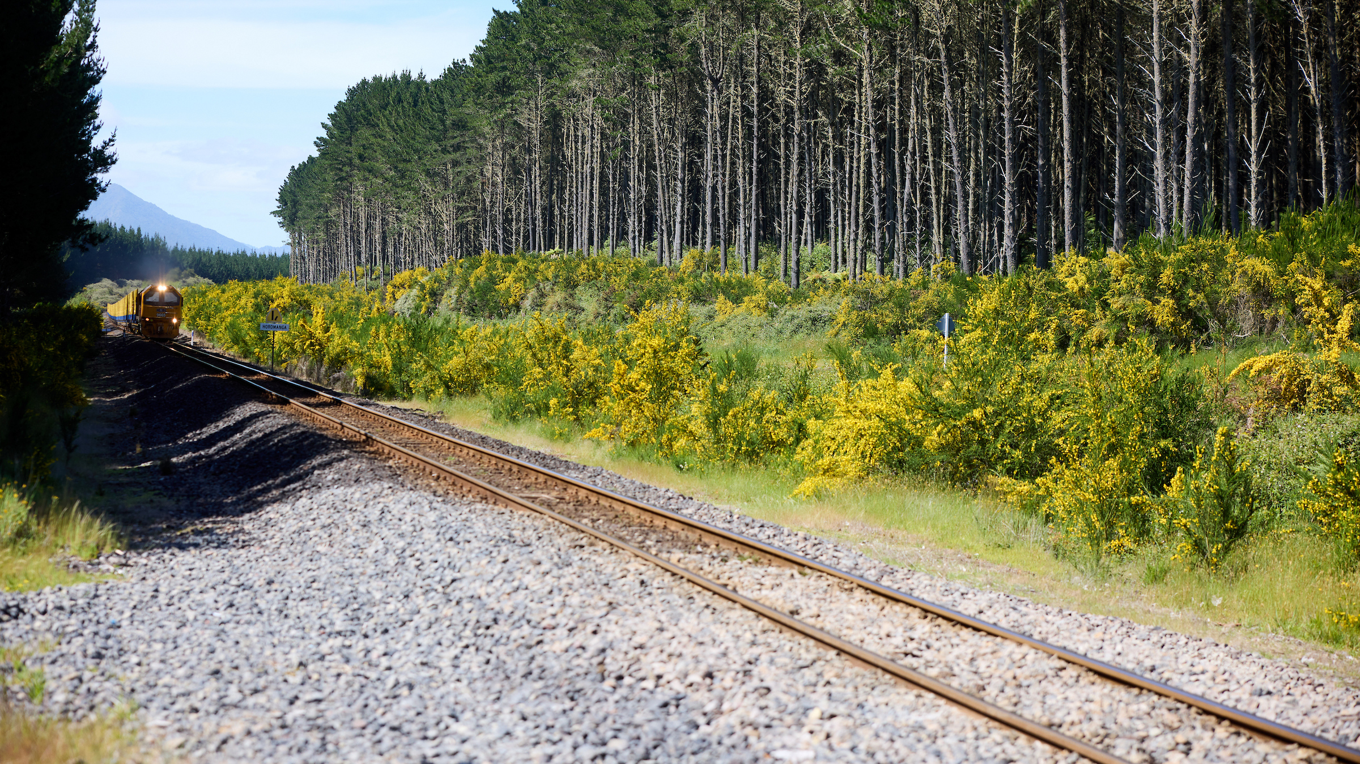
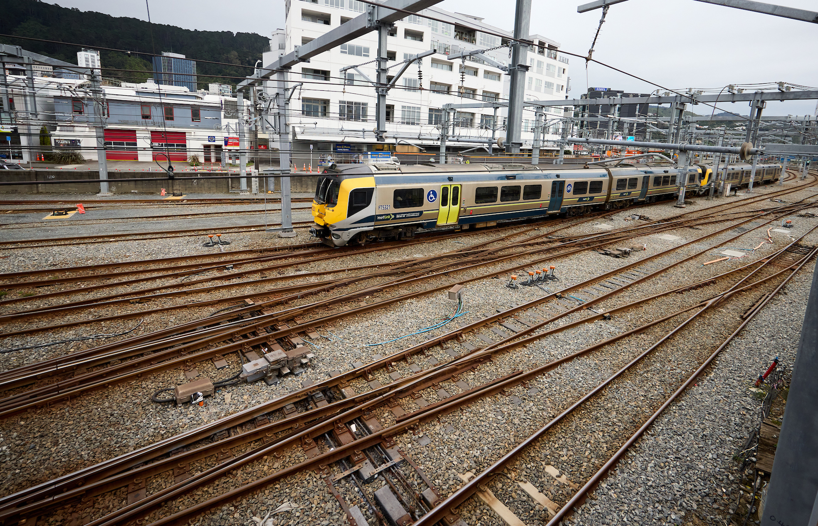
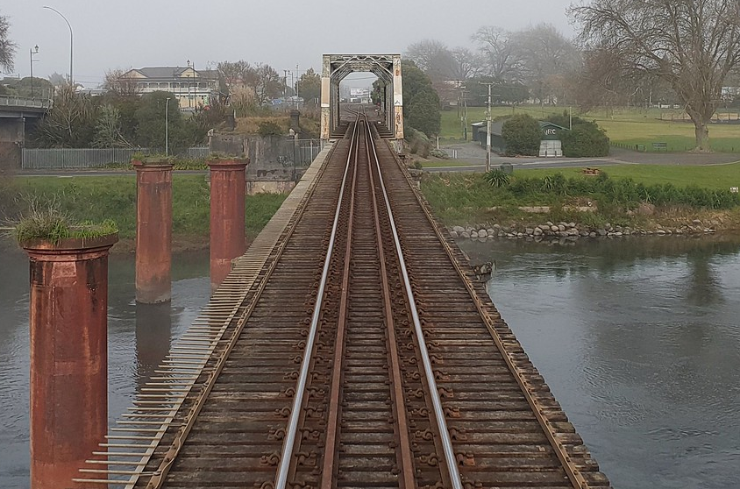
Walking through or loitering in any of these areas is unsafe and illegal (even if you are taking a short-cut)
Ports
Tunnels
Yards/Depots
Open track
You could be fined $10,000
Junctions
Bridges

Slide 4
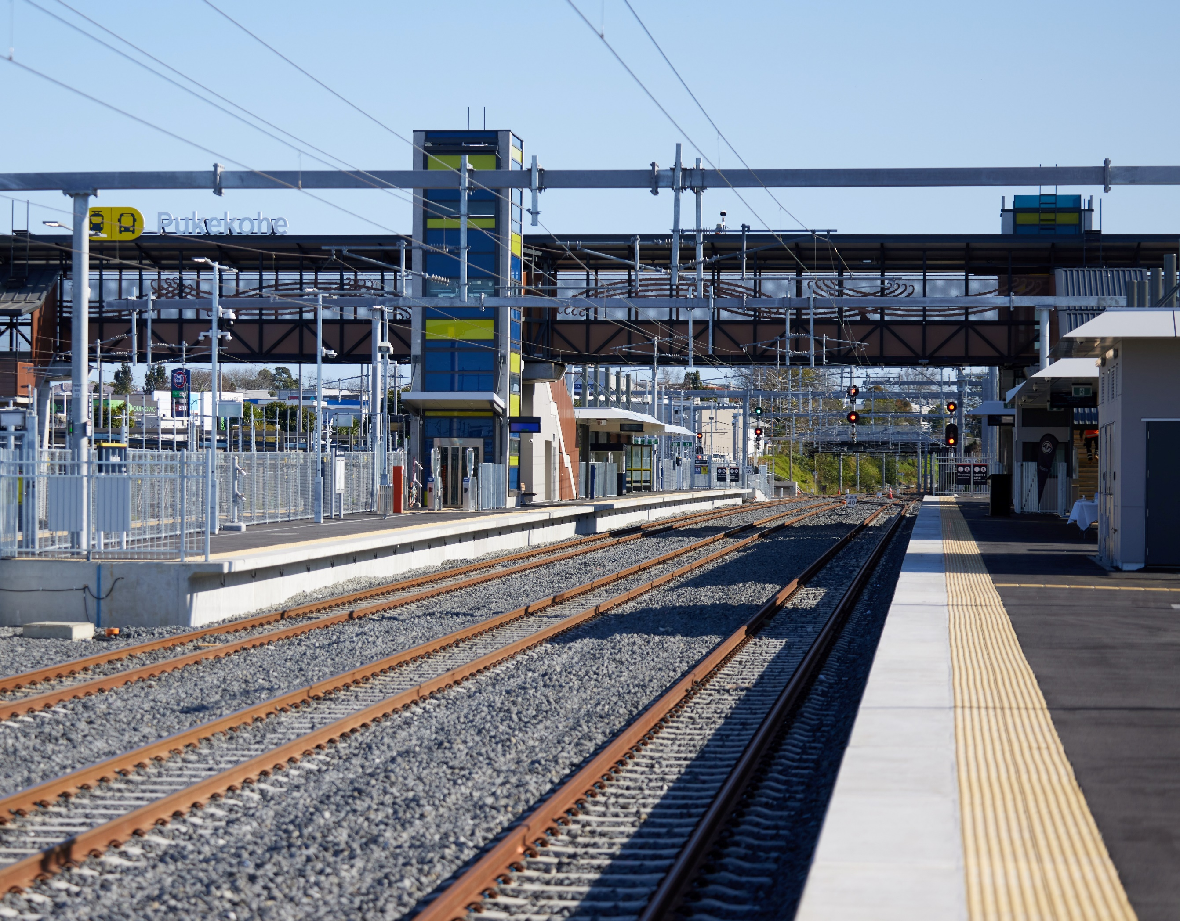
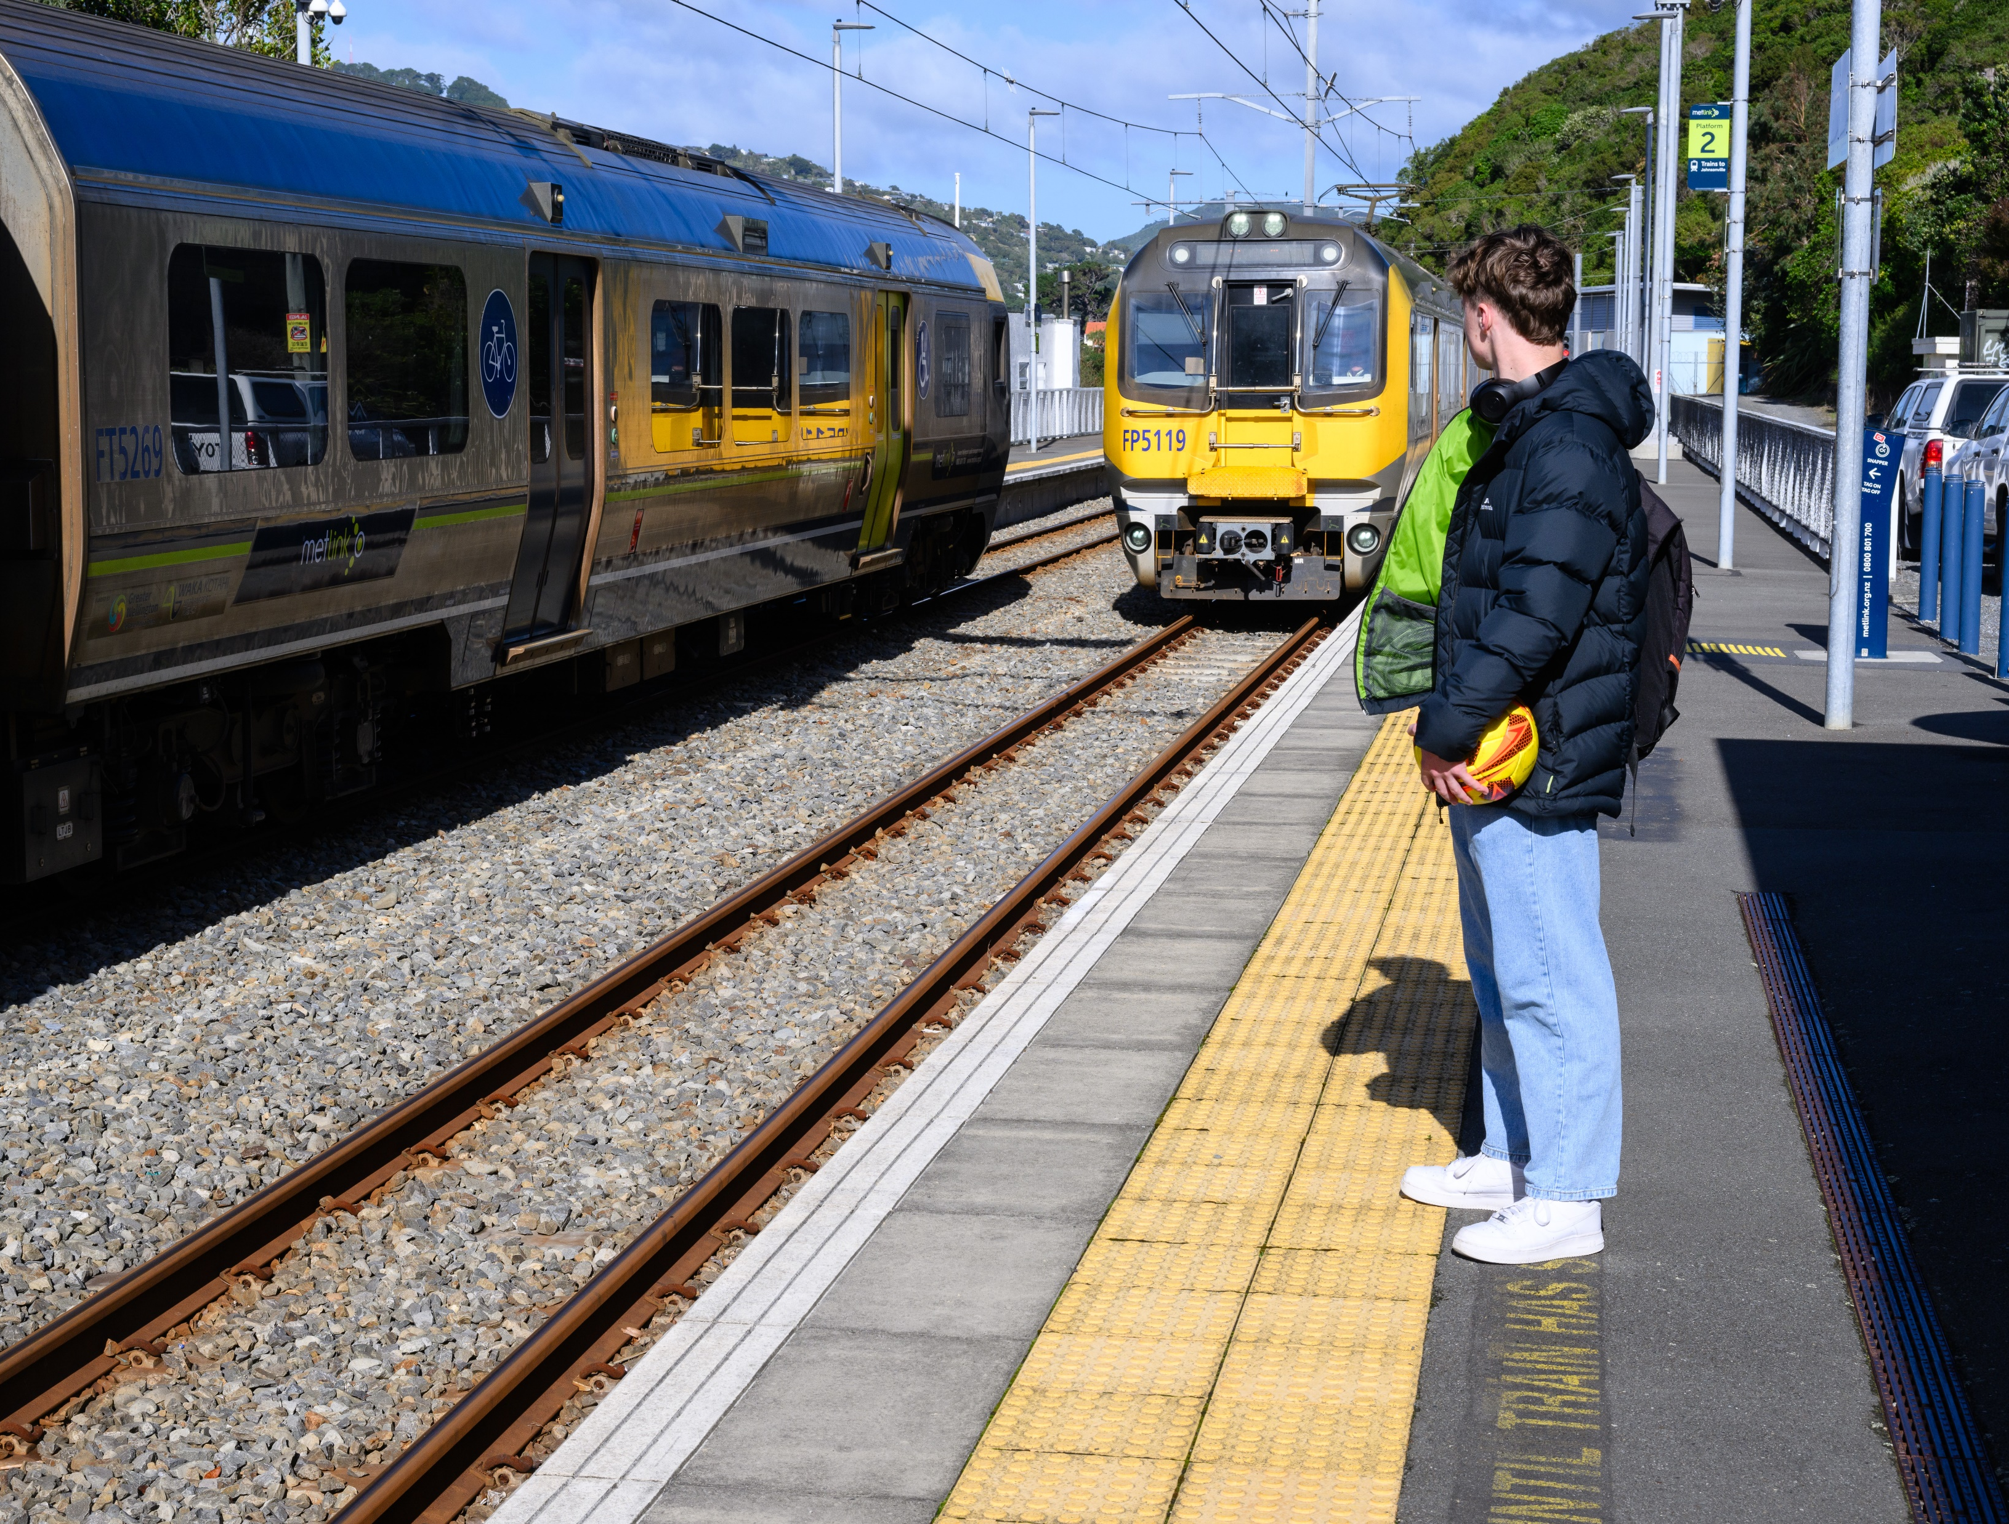
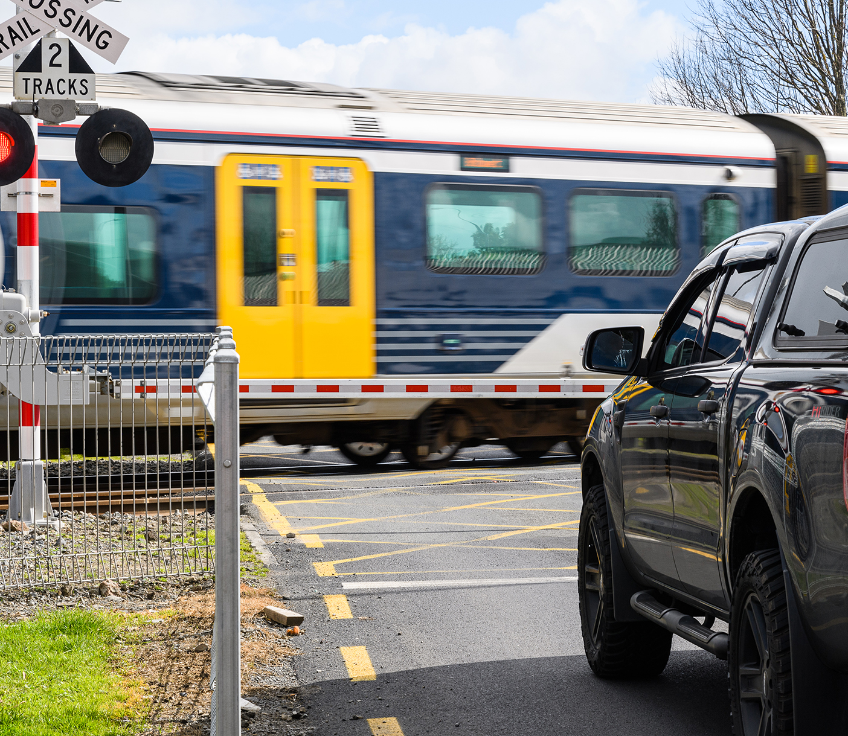
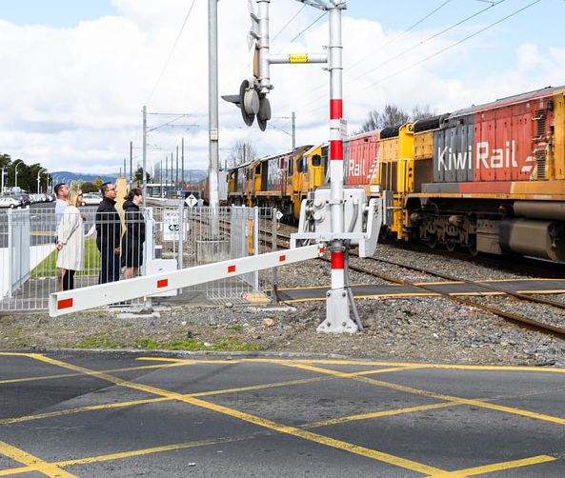
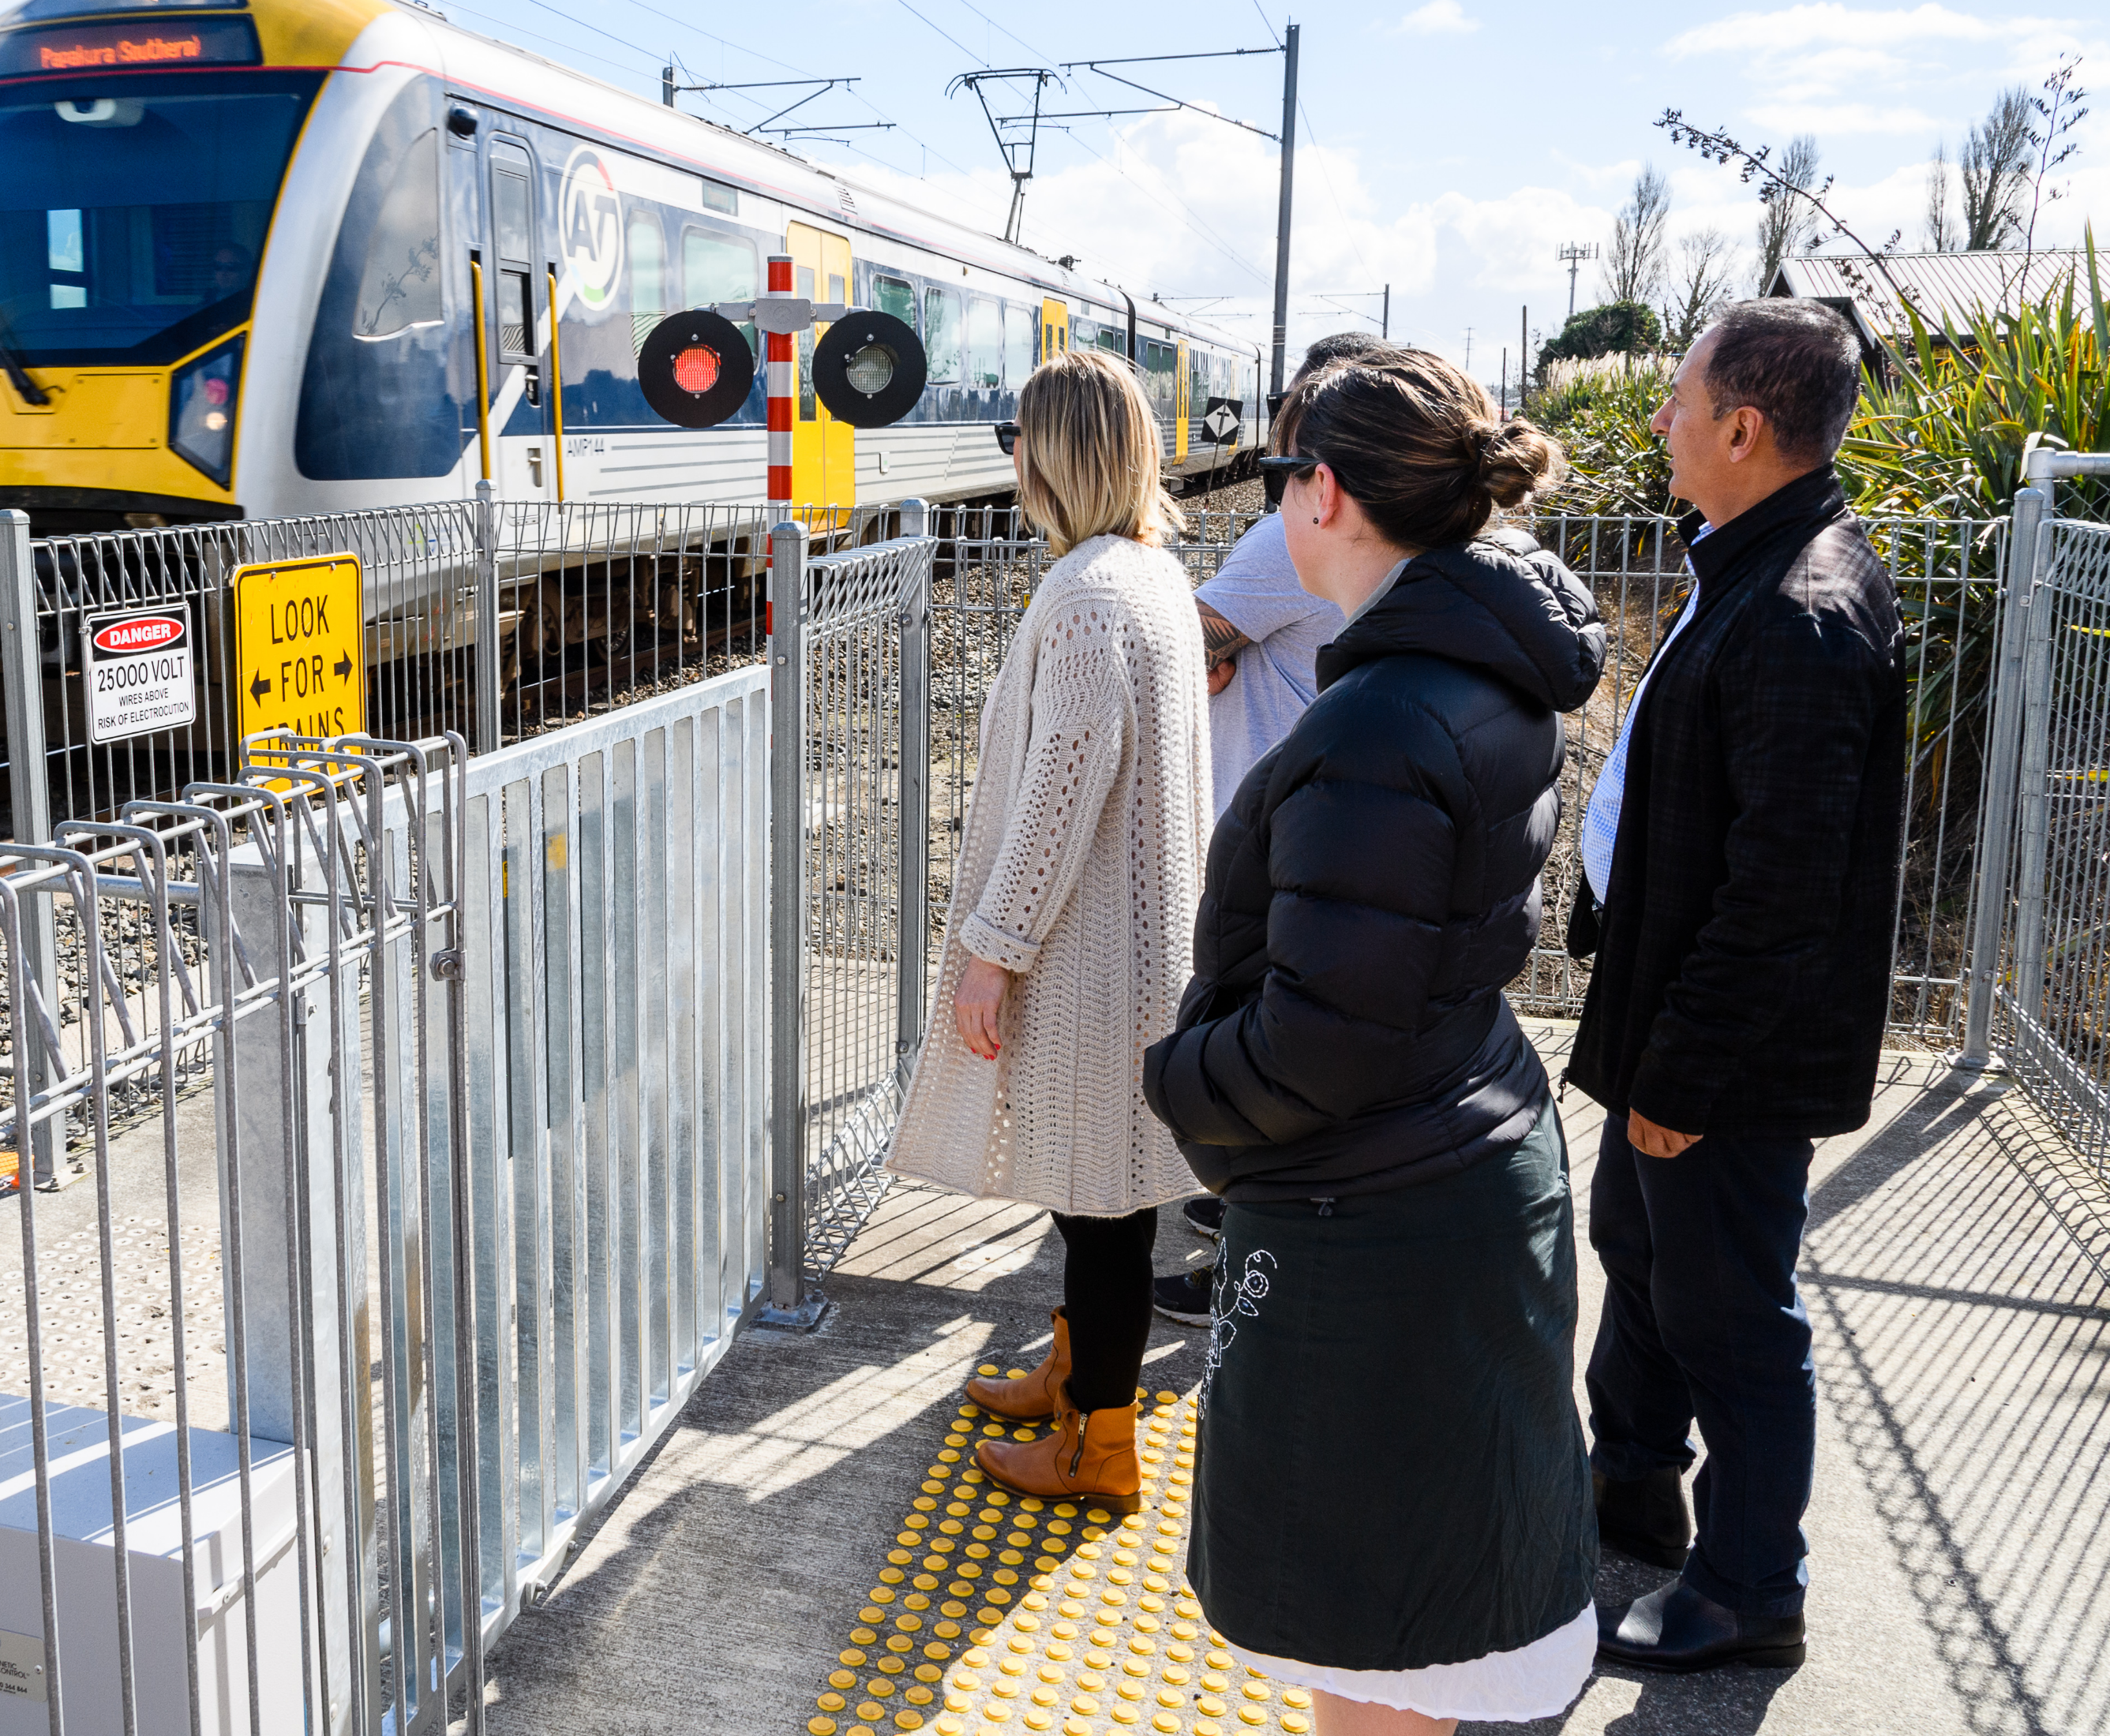
You must ONLY be in the rail corridor if you are at a train station platform or using an official level crossing.
You must ONLY be in the rail corridor if you are at a train station platform or using an official level crossing.

Slide 5
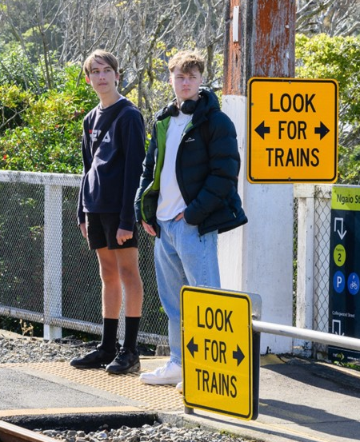
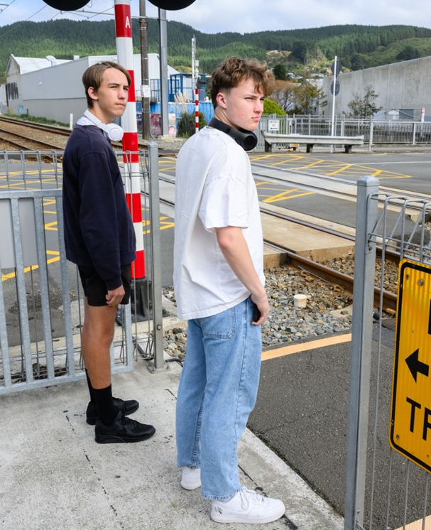
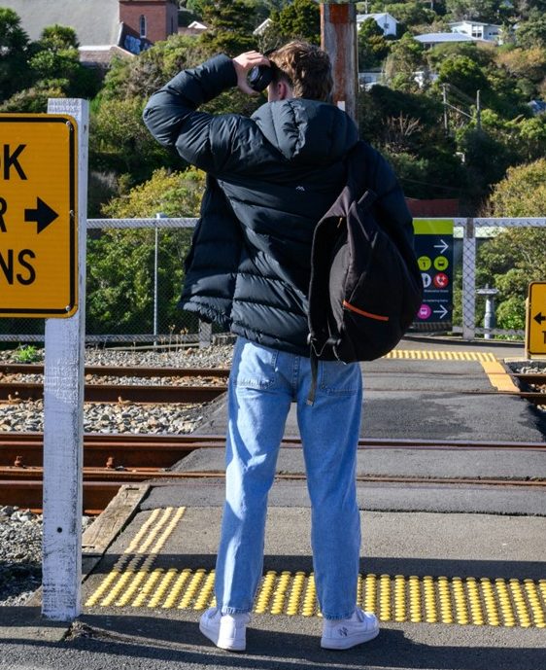
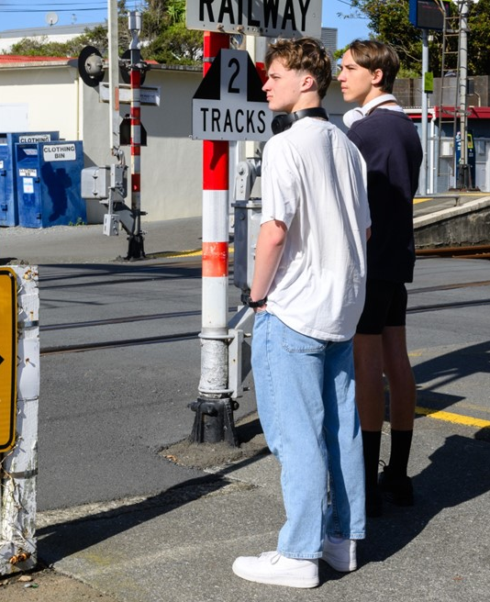
When crossing at a railway level crossing, always…
STOP
behind
the line
LOOK
both ways for trains
LISTEN
for trains coming
THINK,
is it safe
to cross?
Only cross when there are no trains in sight

Slide 6
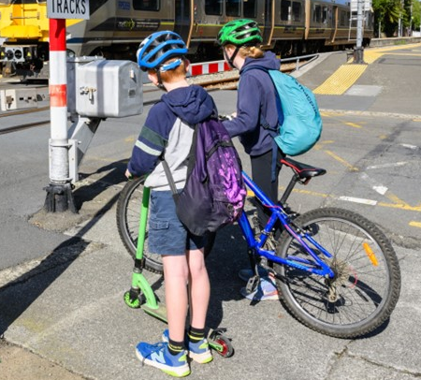
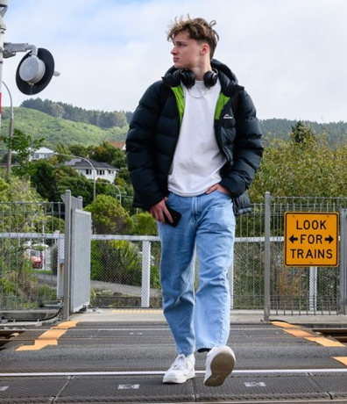
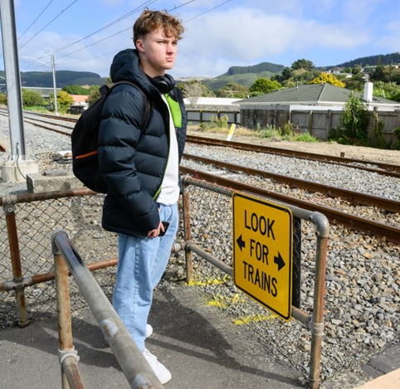
When crossing at a railway level crossing, always…
Get off and walk your bicycle/scooter
Remove your
headphones
Put your phone in your pocket

Slide 7
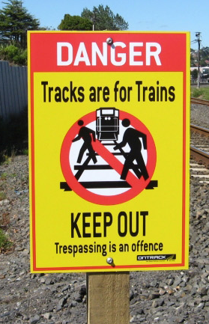
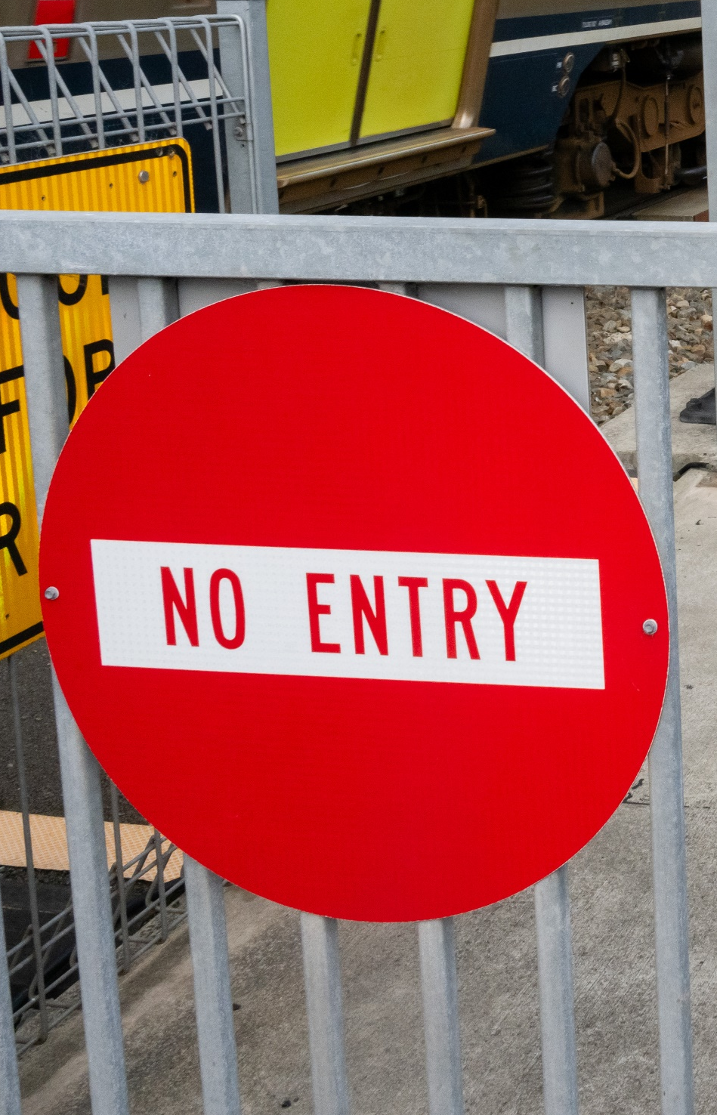
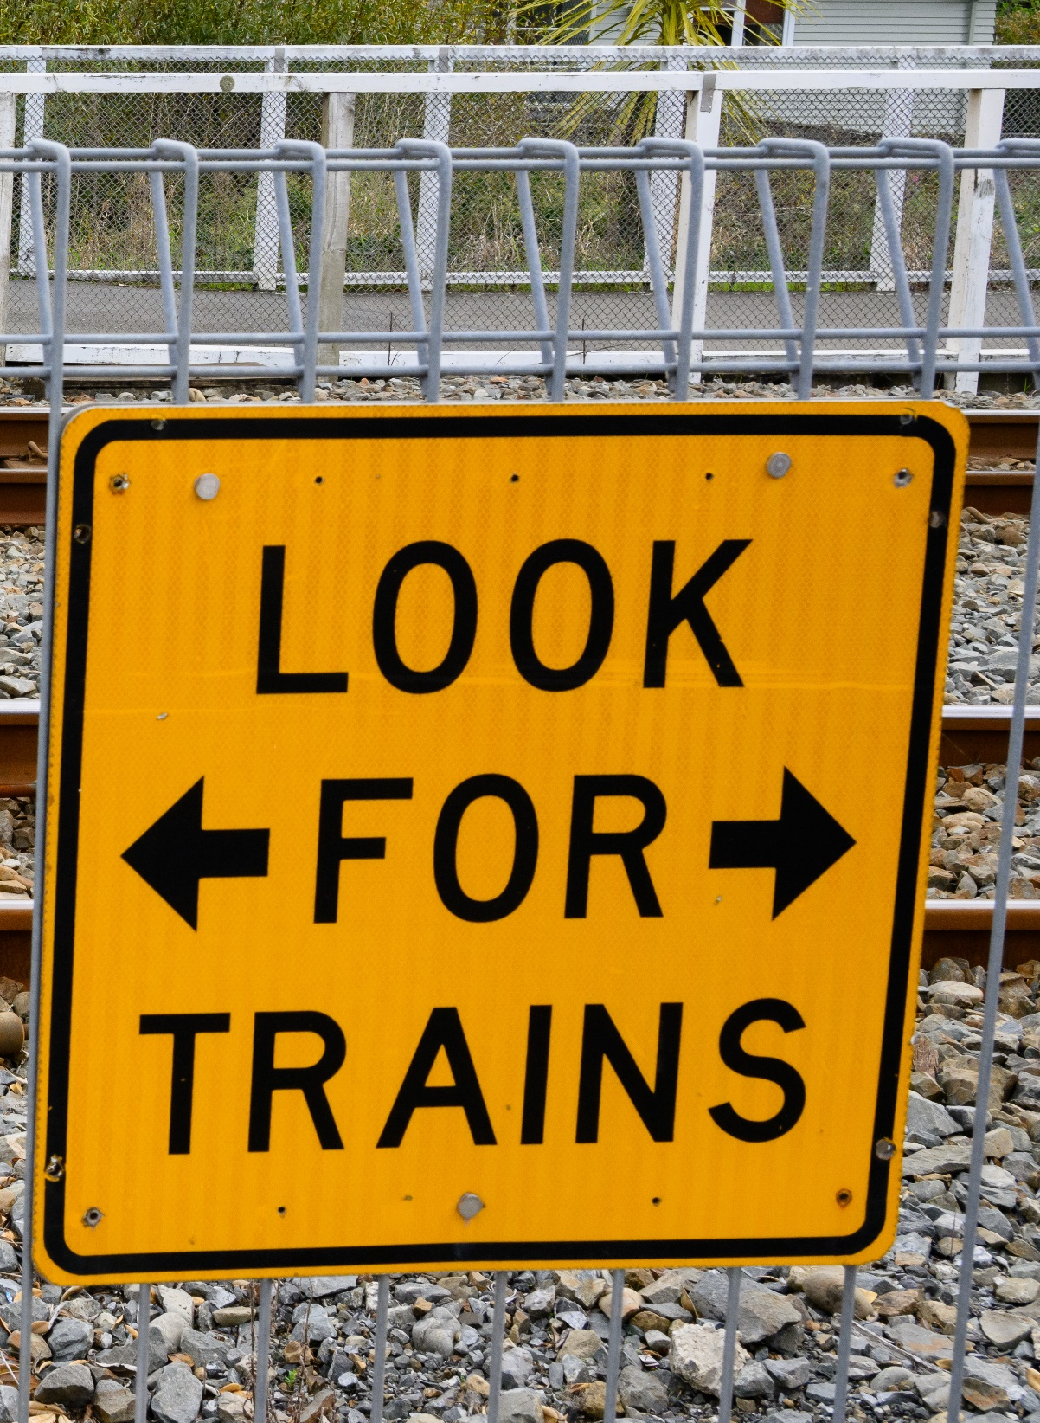
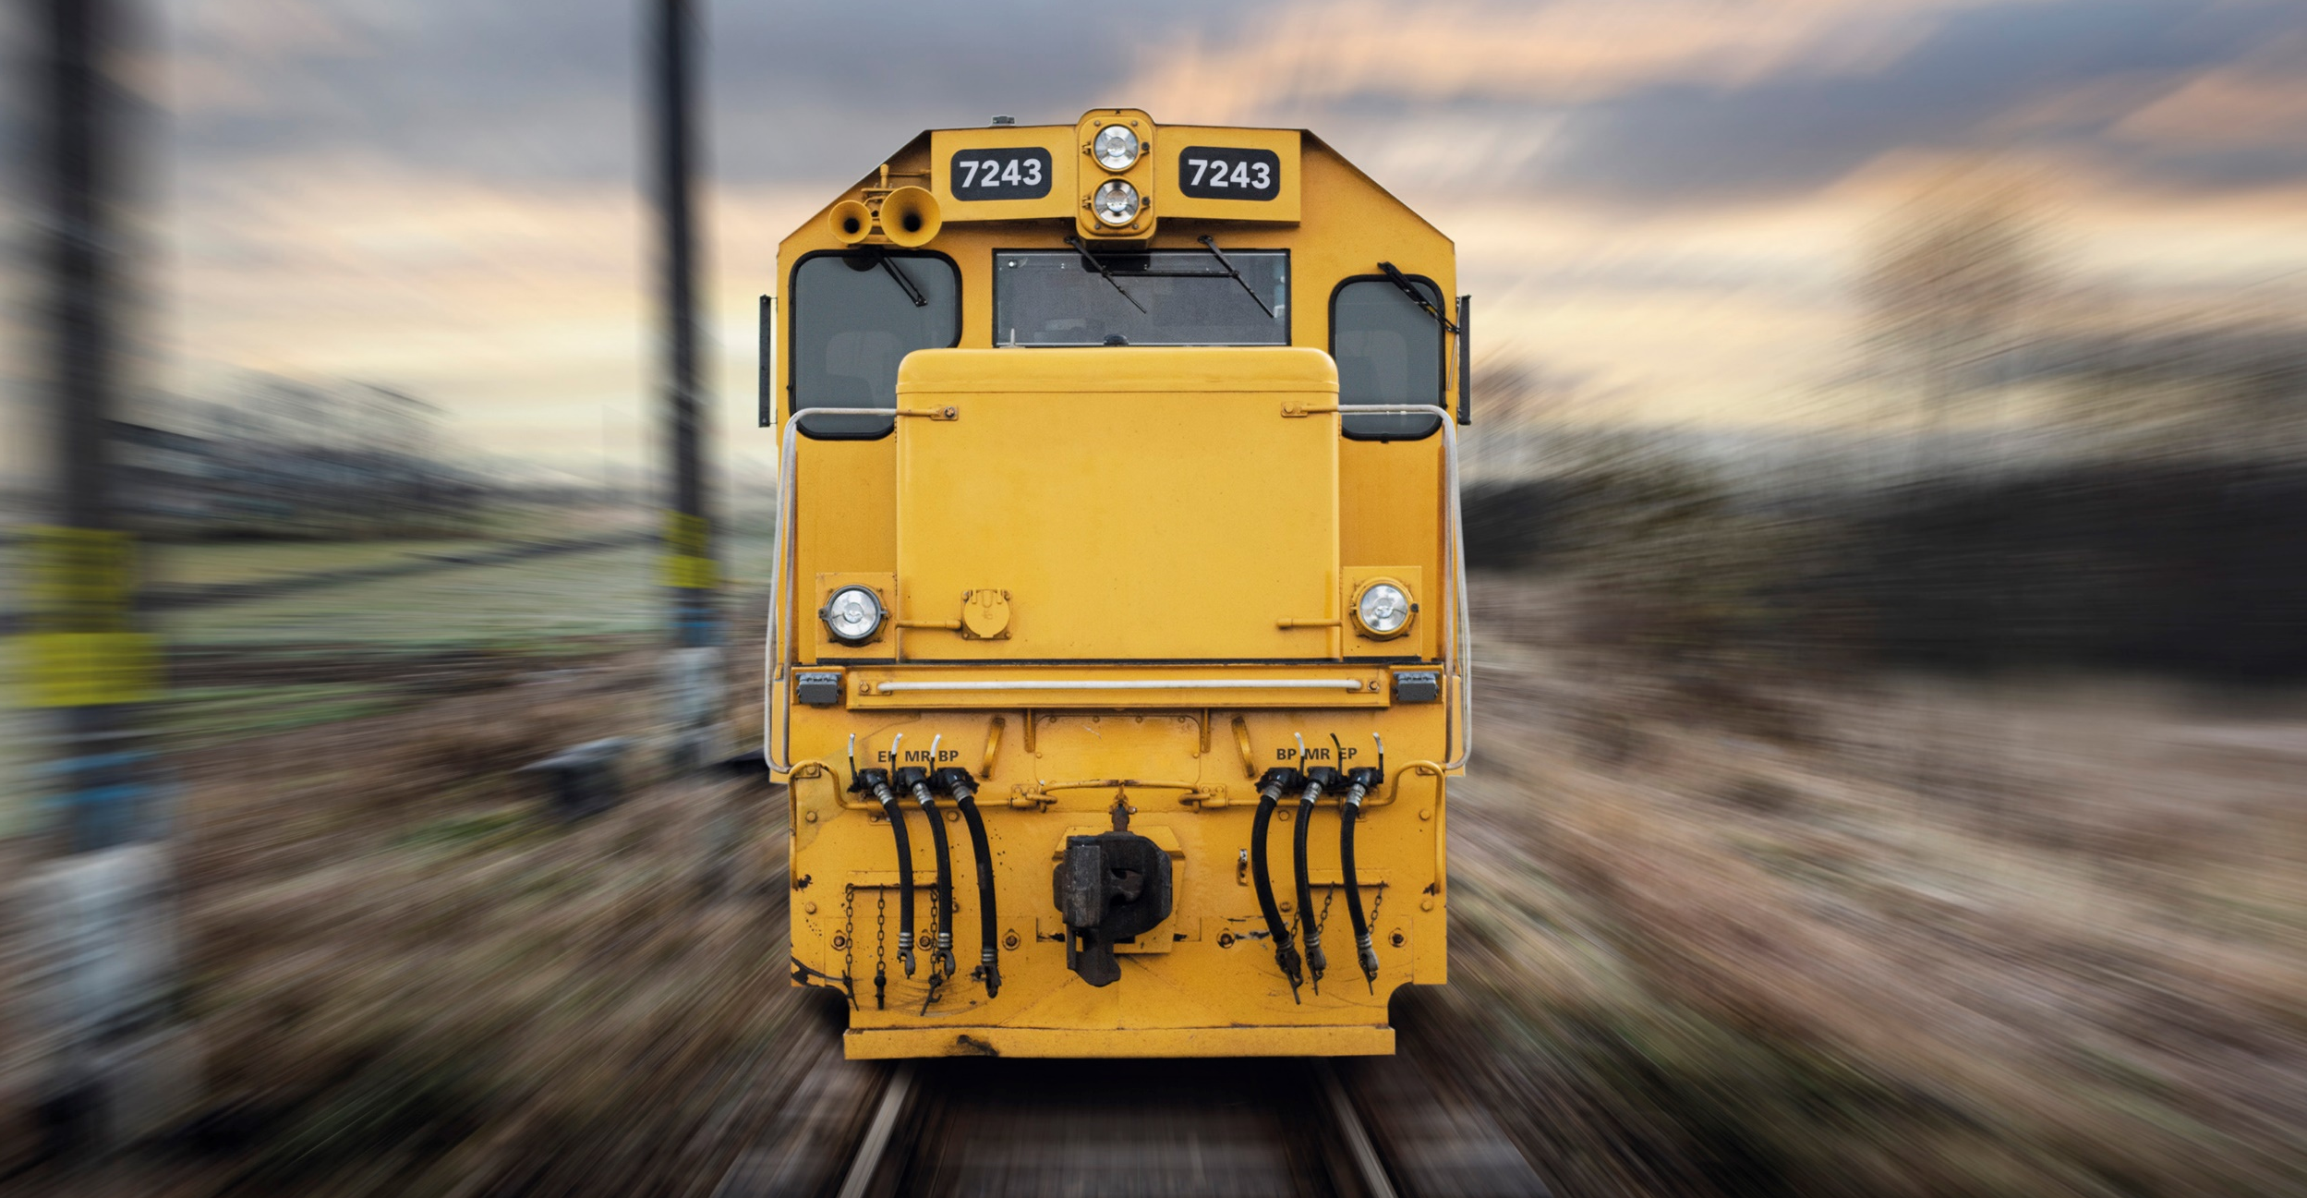
When crossing at a railway level crossing, always…
Obey all signs and signals.
Expect trains from either direction.
Cross with care.

Slide 8
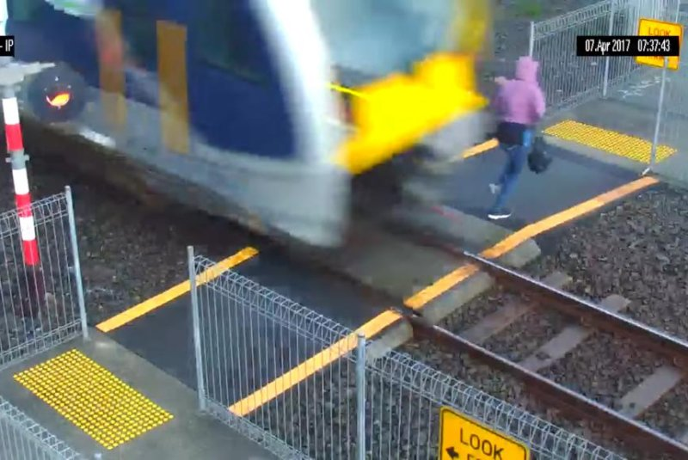
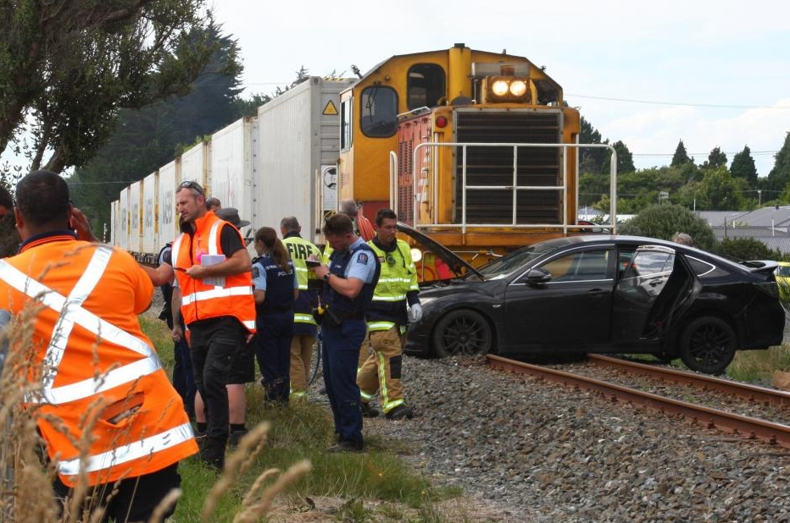
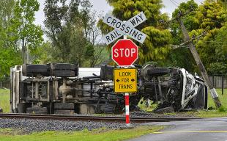
Between 2014 and 2024, there were more than 260 collisions at level crossings.
59
177
34
Collisions with persons
Collisions with cars
Collisions with trucks
(709 near misses)
(1,421 near misses)
(427 near misses)

Slide 9
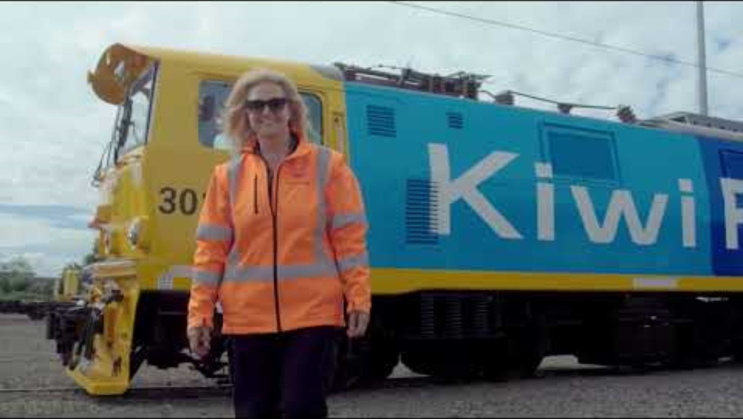

Notes:
VIDEO WILL PLAY AUTOMATICALLY.
Note: Please always ensure the video is shared with the school principal or other appropriate person for approval, prior to showing to students.
Link to video ‘Stay safe around level crossings: take a look from the train driver’s perspective’
https://www.youtube.com/watch?v=qIuziXTkAkA&list=PLmPgqniukFiOc5guO8AwxiHCw-81vZ2lN&index=3

Slide 10
You can be fined up to $1,000
if you...
You can be fined up to $10,000
if you…
You can be fined up to $20,000
if you...
Fail to comply with a stop or give-way sign at a level crossing.
Trespass on railway tracks, bridges or railway infrastructure.
Enter a level crossing when the red signal is displayed, or the barrier arm is lowered.
Fail to give way to a rail vehicle at a level crossing while driving.
Interfere with or damage a rail vehicle, container, property or infrastructure.
Enter a level crossing when the exit is blocked.
Walk along or cross tracks (not at a proper crossing).
Stop on a level crossing or near a level crossing to obscure other drivers’ view.
Walk across a level crossing and risk a collision with a rail vehicle.
Pass a vehicle stopped at a level crossing or within 60m of a crossing.
Railways Act 2005 (Section 73, 92); Land Transport (Offences and Penalties) Regulations 1999 (Schedule 1)

Slide 11
Questions?

Slide 12
KiwiRail’s emergency number is 0800 808 400
Use this number for level crossing emergencies and faults, blocked railway lines, damaged overhead wires, faulty alarms or barrier arms.
KiwiRail’s contact email is contactus@kiwirail.co.nz
Use this email to get in touch with our community engagement team.

